Slide 1
PARENTS TALK ST AILBES
NOV 20th 2018
Fin Chambers
fnchambers@Hotmail.com

Slide 2
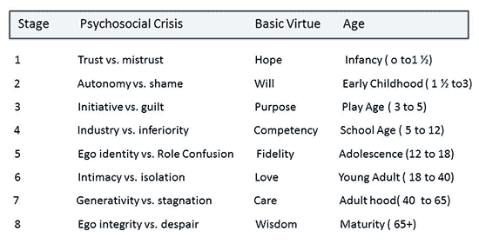

Slide 3
Gardner’s Multiple Intelligences
Visual/Spatial architects
Verbal/Linguistic writer
Logical/Mathematical scientist
Bodily/Kinesthetic sports
Musical/Rhythmic musician
Interpersonal verbal/non verbal communication
Intrapersonal self awareness
Natural biologist

Slide 4
EMOTIONAL INTELLIGENCE DEFINITION
Emotional intelligence is the ability to understand one’s emotional make-up and the emotional make-up of others and to use insight from this knowledge to effectively manage and regulate one’s own emotions to make good decisions and to act effectively

Slide 5
EMOTIONAL INTELLIGENCE
Educating the heart
Why do we get angry so fast
Can we manage emotional reactions
Why is it so hard sometimes to keep them under control
What happens to us when we get too emotional
Stress reactions
IQ v EQ

Slide 6
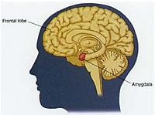
Amygdala Hijack
Like any skilled air traffic controller, the thalamus can quickly react to potential threat. In that case, it bypasses the neo cortex -- the thinking brain -- and the signal goes straight to the amygdala. The amygdala can only react based on previously stored patterns./Fight or flight/privileged position/anger or anxiety
--- Joshua Freedman
thalamus

Slide 7
WHY DO WE NEED TO UNDERSTAND ADOLESCENT DEVELOPMENT
Proper behavior management or discipline strategies
Avoid misinterpretation of the teen’s actions
Understand which behaviors are culturally-based
Recognize what is not typical

Slide 8
WHAT IS ADOLESCENCE?
The stage in life between childhood and adulthood.
A movement from dependency to independence.
Move from part of family to wider peer group.
Multi dimensional and gradual.
These typical ‘required’ changes differ from culture to culture.

Slide 9
WHAT IS ADOLESCENCE?
Development should be viewed in relation to challenges in the following areas
Biological
Cognitive
Psychological
Social
Moral

Slide 10
WHAT IS ADOLESCENCE?
Some teens develop quicker than others.
When the youth struggles with the developmental challenge they may suffer in the following areas.
Physiological
Emotional
Behavioural

Slide 11
THE TEENAGE YEARS
Trying to understand how they relate to the world
• A teenager's development can be divided into
three stages -- early, middle, and late adolescence.
• Growth during adolescence is greater than at any
other period of life after birth.
• Each is distinct and unique in his or her own way so
processes vary from teenager to teenager

Slide 12
Early Adolescence 12-14 yrs
Movement Toward Independence
• Struggle with sense of identity/peer groups vital
• Moodiness
• Improved abilities to use speech to express oneself
• More likely to express feelings by action than by words
• Close friendships gain importance
•Realization that parents are not perfect; identification of their faults

Slide 13
Middle Adolescence 15-16 yrs
Movement Toward Independence
• Self-involvement, alternating between unrealistically high expectations and poor self-concept.
• Complaints that parents interfere with independence/search for privacy
• Extremely concerned with appearance and with one's own body /confusion

Slide 14
Biological Changes
Puberty
Can be an issue if this is too early or late
May experience an uncomfortable level of stress as a result.
Consequences can effect self esteem and confidence in self.
NB The biological changes can trigger physiological, sexual and emotional changes.

Slide 15
SEXUAL CHANGES
Puberty triggers production of sexual hormones.
Increase in desire and sexual urges a move towards friendships away from family [part of dependent to independent movement]
Can cause difficulty and confusion.
In particular in early adolescence.
By late adolescence many young people are seen to be psychologically ready for an active sex life

Slide 16
COGNITIVE CHANGES
“egocentrism”/everyone’s watching me
Early childhood - limited ability to take perspectives of others
Adolescence - “unrefined” imagining the perspectives of others on “overdrive”

Slide 17
EGOCENTRIC THINKING
Feelings of uniqueness/u don’t understand me/ vulnerability, omnipotence/risk taking/nothing bad can happen/live forever [all part of the journey for individuality]

Slide 18
IDENTITY
Young people due to the many stresses at this time find it tough to tolerate change. [Shave and Shave 1989]
Therefore the adolescent can respond very emotionally to what might seem quite trivial to an adult. [mood swings/anger/depression]
Shame can be a big factor and young people can feel embarrassed, humiliated, ashamed, and is therefore understandable that they develop so many defense mechanisms. [denial/projection, regression etc]

Slide 19
PARENTAL EXPECTATIONS
Rutter [1995] saw parental expectations/lack of expectations as being a big problem for adolescents.
Steinberg [1990] saw the combination of adolescent phase of development and the high emotional changes caused great distress in many parents.

Slide 20
PARENTAL EXPECTATIONS
Typical parental reactions can be
decline in the marital relationship,
increased awareness of getting old,
inability to leave the teen differentiate,
distress at the disintegration of previous authority.
Causes many parents to withdraw and disengage at a time when support is needed most.

