Slide 1




Portfolio Module -
T.Y. End of Year Reflection/ Look Back.
18th May 2020 - 22nd of May.
TASKS
1) Read slides for instructions on work to complete.
2)Decide on genre of writing/ reporting.
3)Gather images, key points, stories, the good and bad.
4) Create T.Y. 19/20 blog/ diary/ Google slides etc...

Slide 2
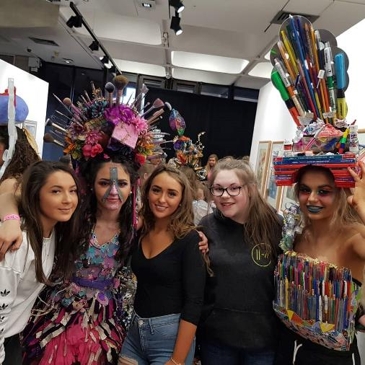
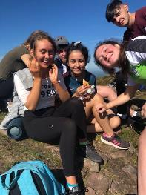
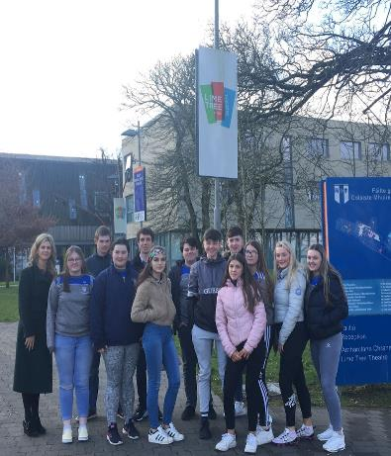

Slide 3
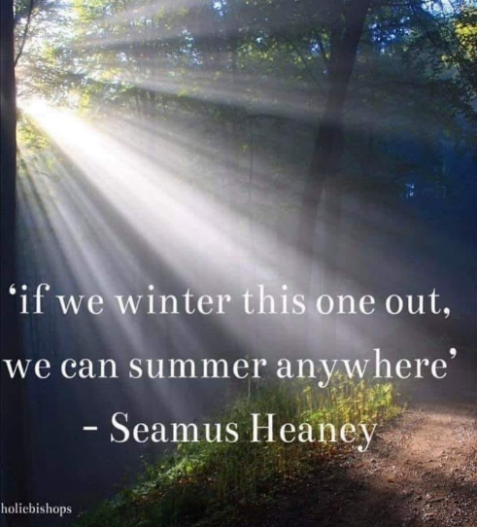
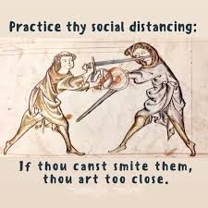
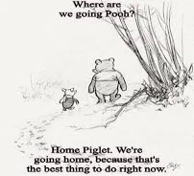
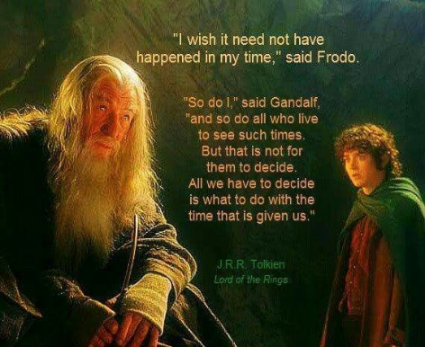

Slide 4
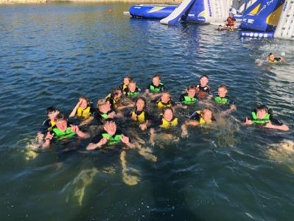
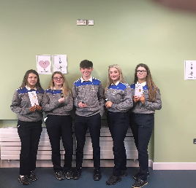
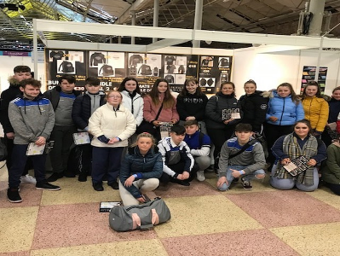
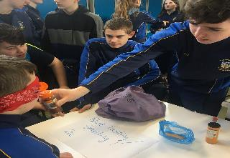

Slide 5
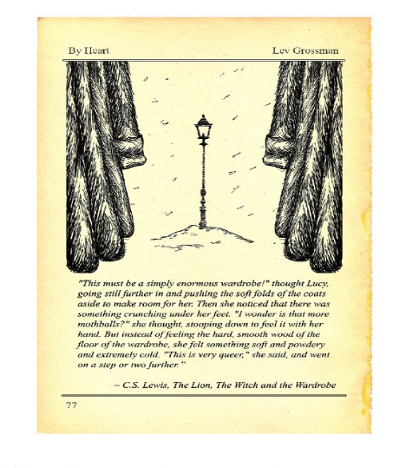


Slide 6
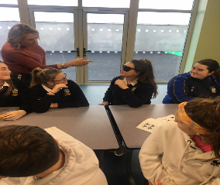
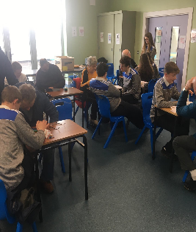
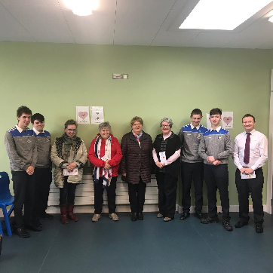
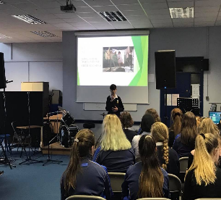

Slide 7
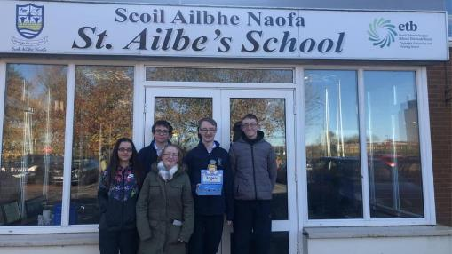
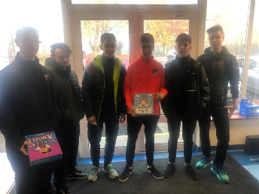
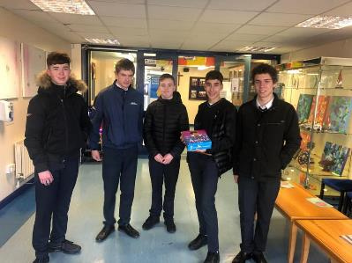
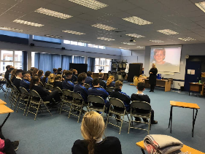

Slide 8
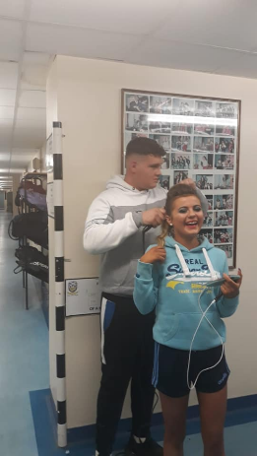
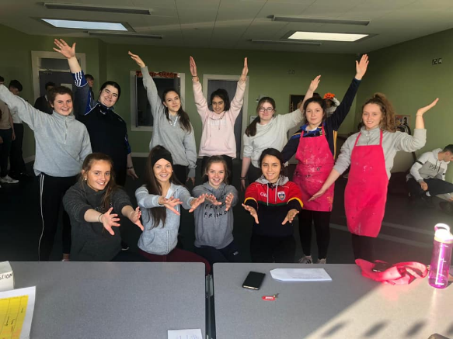

Slide 9
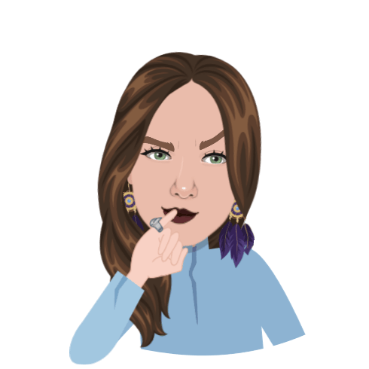
What were your top 5 moments from T.Y?
You can submit an Audio clip with some brief points on what you enjoyed and share on microsoft teams.

Slide 10
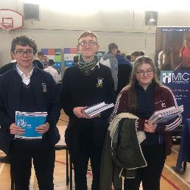
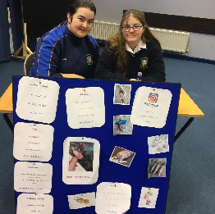
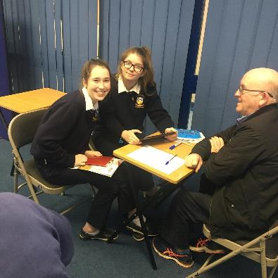
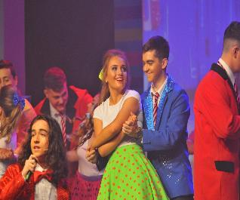

Slide 11



T.Y. End of Year Reflection/ Personal Lookback.
Purpose of the task is = to replace the assessment of your portfolio and interview that was meant to occur in school.
Date of submission = Friday 22nd of May.
Where to submit = an assignment tab will be created for you to turn this in on Microsoft teams.
Notes:
There might be other things that you would like to add into the success criteria

Slide 12

What is a reflection?
It is all you, your experience and your perspective.
I, me, my, myself, in my opinion, I feel, I think, I enjoyed, I loved,my favourite, my best, etc...

Slide 13

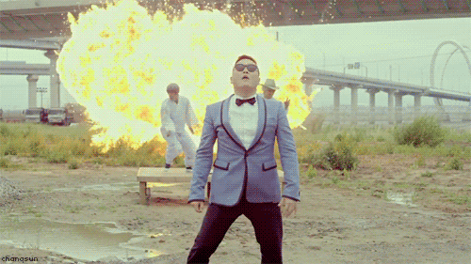
Writing/ reporting styles:
Powerpoint/ Google Slides.
Blog.
Google Docs/microsoft teams.
Vlog/ video.
Audio.
A3 poster (or bigger)/ collage.
Scrapbook.
Tik Tok.
Pick ONE.
If there is another style, one we have not mentioned please email us to check that your preferred style is suitable.

Slide 14
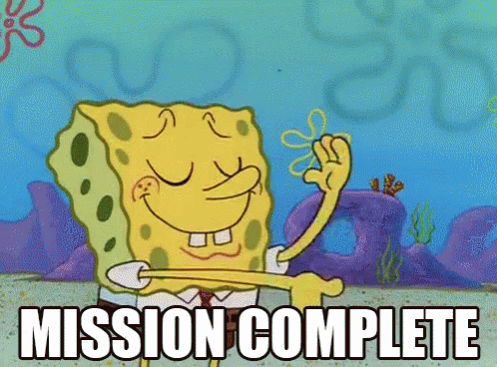
How is my work to be submitted?
Work must be submitted to your tutor via microsoft teams by May 22nd.
If it is a poster/ collage then you may take a picture of your assignment and submit pictures of it (please keep the original until September).

Slide 15


How long should my reflection/ piece be?
The most important thing is to make sure you have items 1 -10 from the success criteria checklist.
If using Google slides you might have size 14 font, and between 10 - 15 slides.
If using Google docs you might have size 12/ 14 font and 8 pages.
If using an audio style you might have a clip that is 5 - 10 minutes.

Slide 16

Success Criteria Checklist.
Decide how you are going to reflect and report.
Pick 1 style to write/ record your work in.
Show your own personality.
Be creative.
Select 5 activities and evaluate them.
Reflect on the development of your skills throughout the year.
Discuss and reflect on your work experiences.
Show how you engaged and participated in T.Y.
Reflect on at least 5 different subject areas/modules.
Give recommendations on T.Y. for next year
Detail, detail, detail
Notes:
There might be other things that you would like to add into the success criteria

Slide 17
What should I try to include? Prompts...
Introduction about you and a few thoughts on your T.Y. year.
Your favourite 5 activities from TY (include why you liked them and what you learned from them).
Evaluate 5 skills that you developed this year (explain how these skills will help you in future life/ Leaving Certificate).
Reflect on your work experiences (What did you like/ dislike about them? Did they impact your plans for the future?).
Reflect on the work that you did in different subject areas (Ideally you would include one thing from every subject/ module).
How do you feel you engaged with TY? (Did you give it your all? Did you get involved with everything? Any advice for somebody next year?).
What recommendations do you have to further improve TY next year?

Slide 18
Possible activities to consider...
-Foroige
-TY Sign Language choir experience
-Enterprise
-Gaisce experience
-Future Leaders
-Special Olympics guestspeaker
-School Musical
-TY First Aid and CPR/Defib training
-YSI experience
-IWA guesspeaker Paul and Josephine
-TY wellbeing talk
-Age Action experience
-TY Visit to Prison
-Work experience two blocks
-Junk Kouture
-Driving Lessons
-Ballyhass Lakes
-Fundraisers for charity

Slide 19
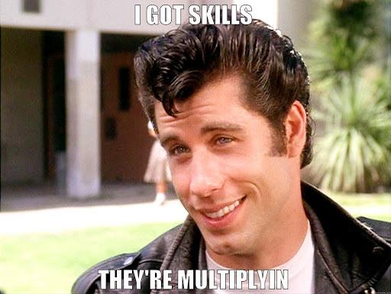



Slide 20
Examples of skills...
Critical thinking.
Creativity.
Independent thinking/ taking initiative.
Team work.
Communication.
Public speaking.
People skills.
Intrapersonal.
Interpersonal.
Research.
Analysis.
Life skills.
Leadership skills.
Improvisation.
Organization.
Literacy, and numeracy skills.

Slide 21
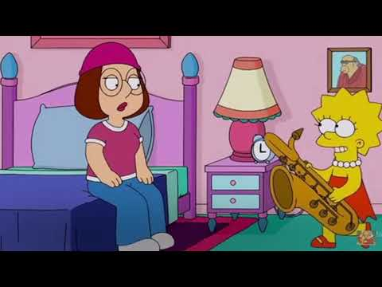
Worthwhile clip to consider - Howard Gardner’s Multiple Intelligence Theory.

Slide 22
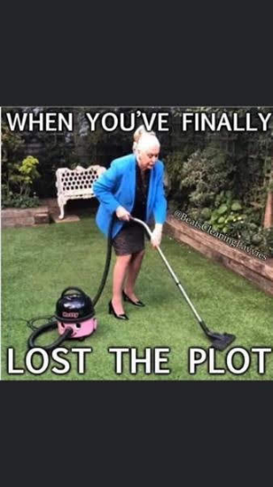
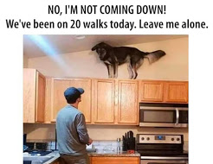
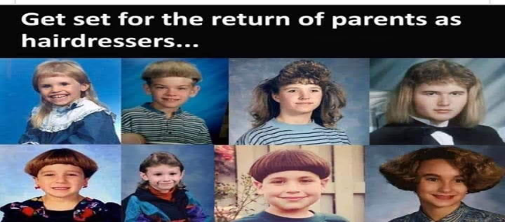

Slide 23
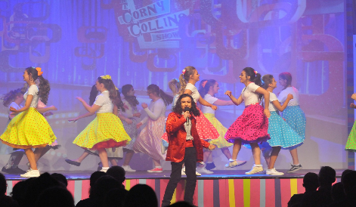
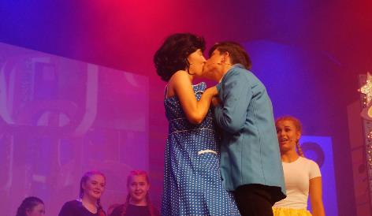
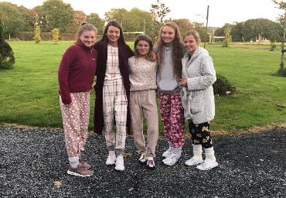
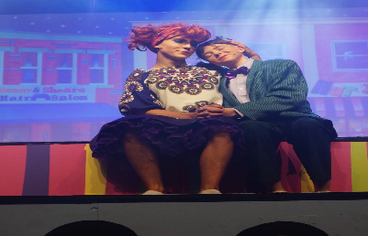

Slide 24

