Slide 1


Transition from Primary to Secondary School
School Completion Programme Manual

Slide 2


WHAT THIS PROGRAMME COVERS
All about You and Your Feelings
Difference between primary & secondary school
Organisational skills
Uniform
School Rules
Pastoral Care
Timetable
Study Skills
Getting to know each other
Homework & Exams
Subject choice

Slide 3
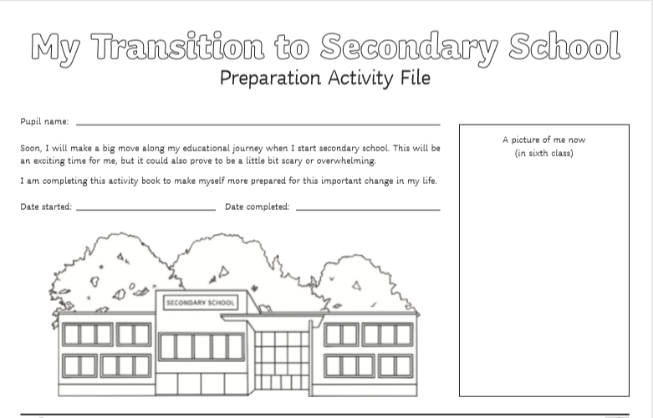

Slide 4
All about me and my Feelings

Slide 5
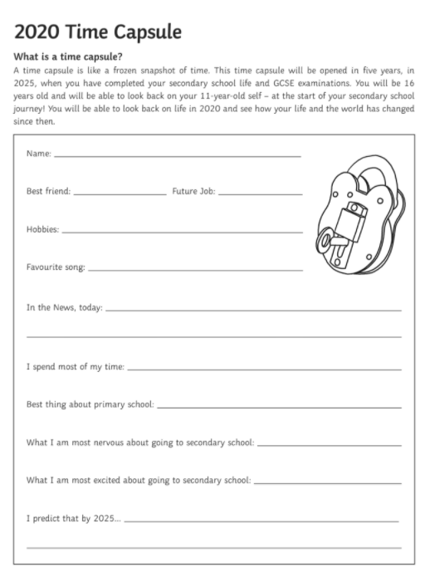

Slide 6

All About My Feelings
Things that I am nervous or worried about are ________________________________________________________________________________________________________________________________________
What am I feeling excited for ________________________________________________________________________________________________________________________________________
What I expect changing school will be like _____________________________________________________________________________________________________________________________________

Slide 7


Feelings-
Things that I am nervous or worried about are ________________________________________________________________________________________________________________________________________
What am I feeling excited for ________________________________________________________________________________________________________________________________________
What I expect changing school will be like _____________________________________________________________________________________________________________________________________

Slide 8


Slide 9
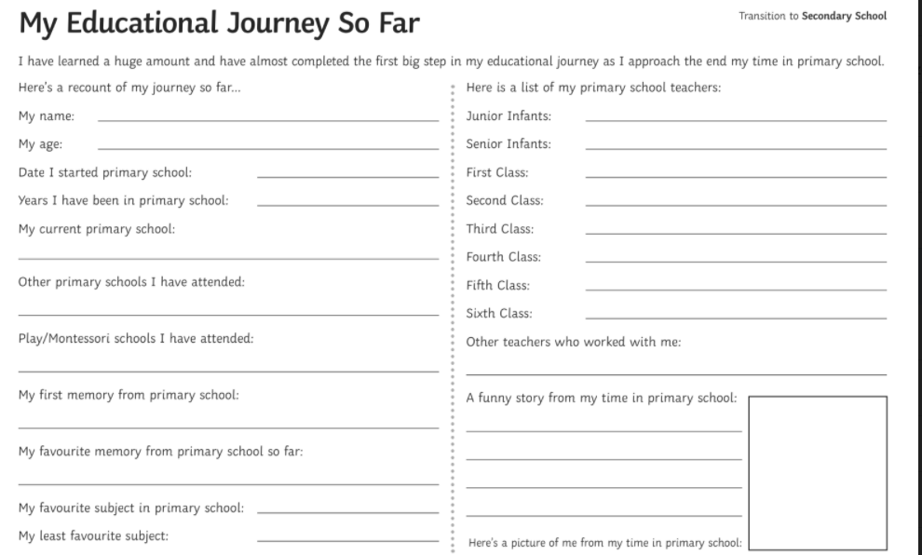

Slide 10
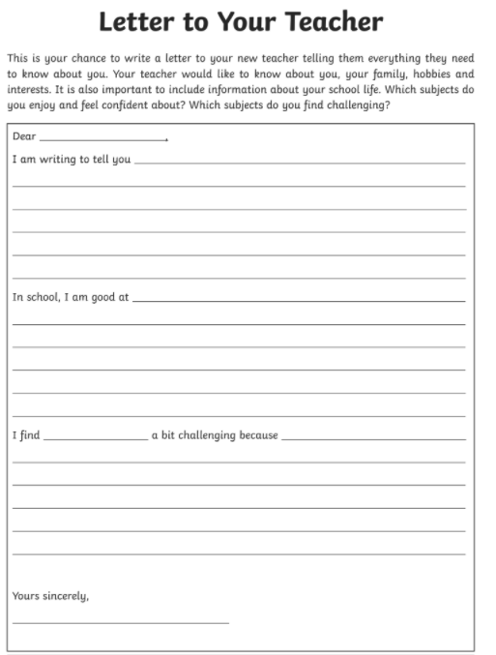

Slide 11


Slide 12
Difference between Primary & Secondary School

Slide 13

DIFFERENCES BETWEEN PRIMARY AND SECONDARY SCHOOL
THESE ARE JUST A GUIDELINE AS EACH SCHOOL WILL BE SLIGHTLY DIFFERENT
Start time
Individual class times
Changing class rooms
Class size
Increased amount of homework
Responsible for a locker
More subject choices
New & existing friends
Main uniform and tracksuit
Pastoral Care
Get back in the swing of talking to new people and trying new things
Subject choice
Homework & exams
Timetable
Extra curricular activities

Slide 14


Slide 15
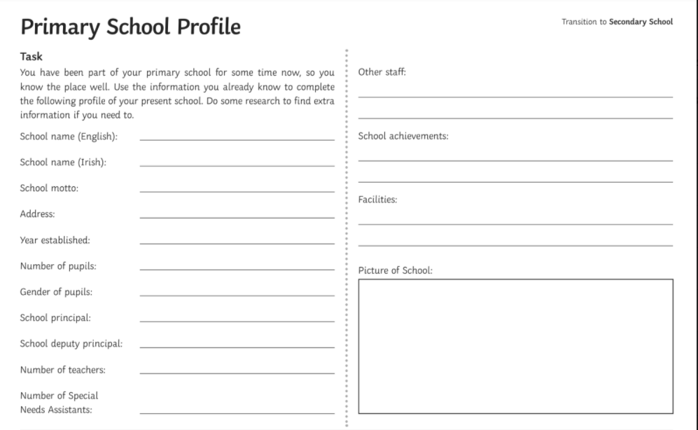

Slide 16
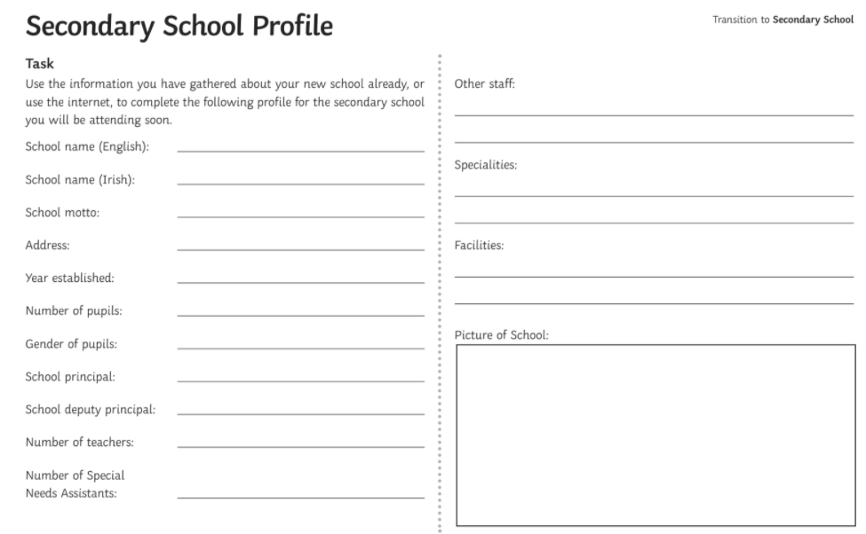

Slide 17

ABBREVIATIONS
P.E = PE
FR = French
Geo = Geography
M = Maths
MTW = Materials Technology Wood
H.EC = Home Economics
I = Irish
DIG = Computers
MUS = Music
MW = Metalwork
SC = Science
CSPE = Civic, Social and Political Education
ART = Art
Rel = Religion
TG = Technical Graphics
H = History
SPHE = Social, Personal, Health Educations
BS = Business Studies

Slide 18
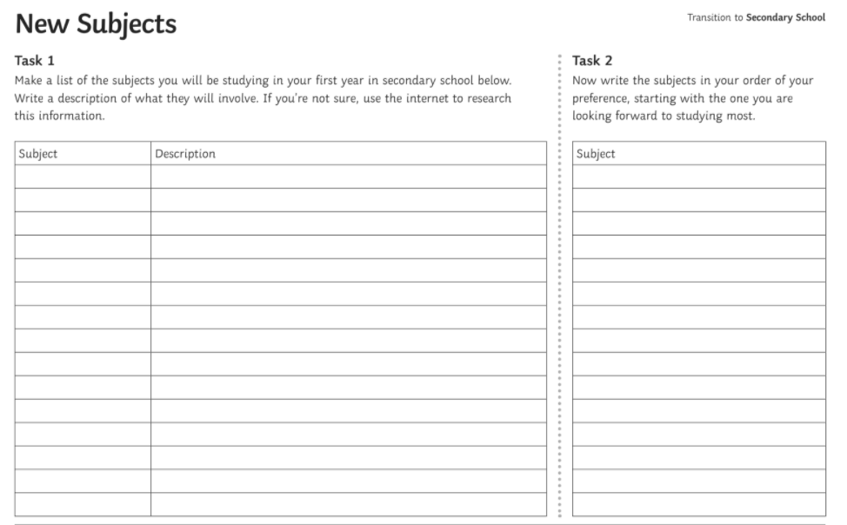

Slide 19

SCHOOL TIMES AND OPTIONS
School Times- Monday and Wednesday 8.50 – 3.40 lunch 35 mins
School Times – Tuesday and Thursday 8.50 - 3.40 lunch 55 mins
School subject option bands: Each school may have different options
1. Art, Music, Technical Graphics, Home Economics
2. Woodwork, Home Economics, History, Geography
3. Business, Metalwork, Woodwork, Geography

Slide 20
Organisational Skills

Slide 21

ORGANISATIONAL SKILLS –
BEFORE SCHOOL
Students must be in school by 8.40 am as classes begin at 8.50 am every day
Students are expected to have their school journal every day in each class
You are responsible for bringing and organizing all the books you need
It is important to be able to set and get up to your own alarm
you will need to get up in time to eat a breakfast before school or be in school early enough to avail of the breakfast club (If the school offers one)
When you come into school this is the time to organize your bag for your morning classes until break time. This means going to your locker with your timetable and making sure you have each book or folder you need for each of the classes.

Slide 22

ORGANISATIONAL SKILLS – DAY TIME
Break time is a short break usually 15 minutes. This break is for getting a small snack and also reorganizing your books for your next classes until lunch time
There are different facilities in each school, sweets are allowed but should be in moderation (If it meets healthy eating policy)
Bags and books should be kept at lockers on breaks and not left on corridors
Lunch Time – 1st, 2nd and 3rd year students are not allowed to leave school for lunch.

Slide 23

ORGANISATIONAL SKILLS – END OF DAY
Make sure you organize all books and copies that you need for homework.
Use your school journal where you have your homework written to make sure you have what you need
If you are attending homework club or evening study make sure all the books that you need are in your bag as you will not be allowed back to your locker once it has started
You will be allowed to stay on school premises after school if you are attending homework club, evening study or an after school activity e.g. sports. You will not be allowed to wait around for friends to finish an activity

Slide 24
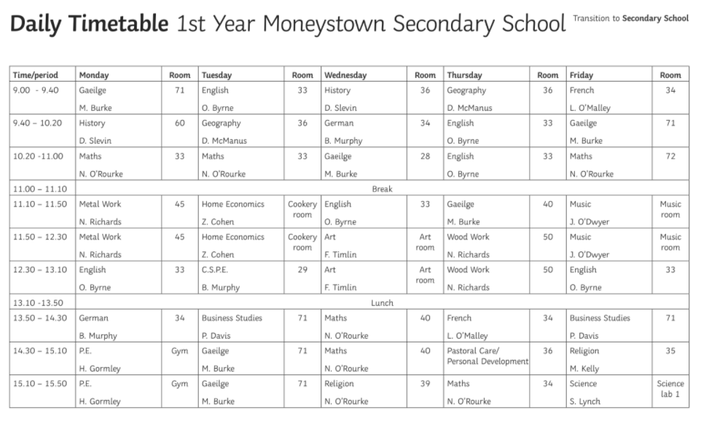

Slide 25
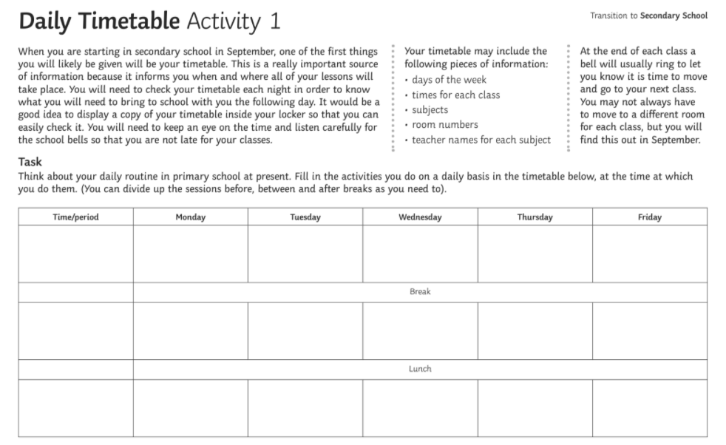

Slide 26
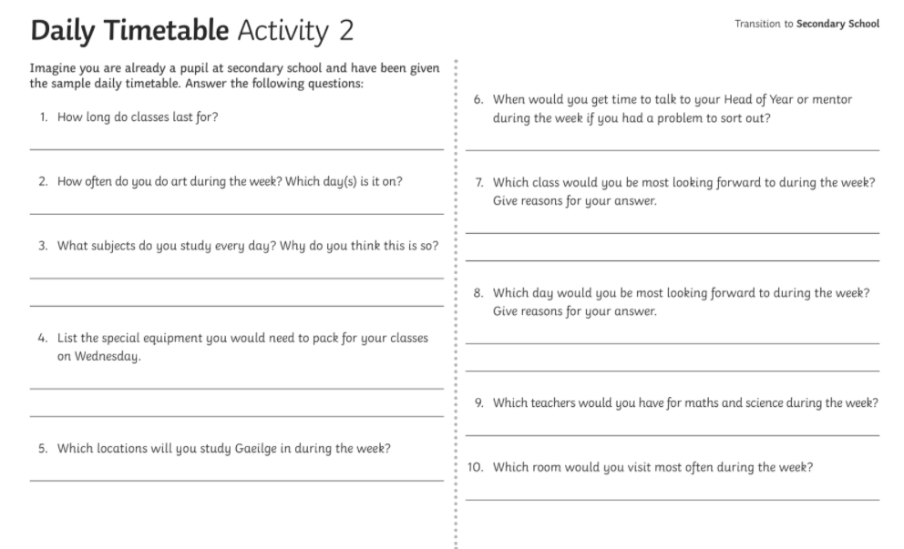

Slide 27
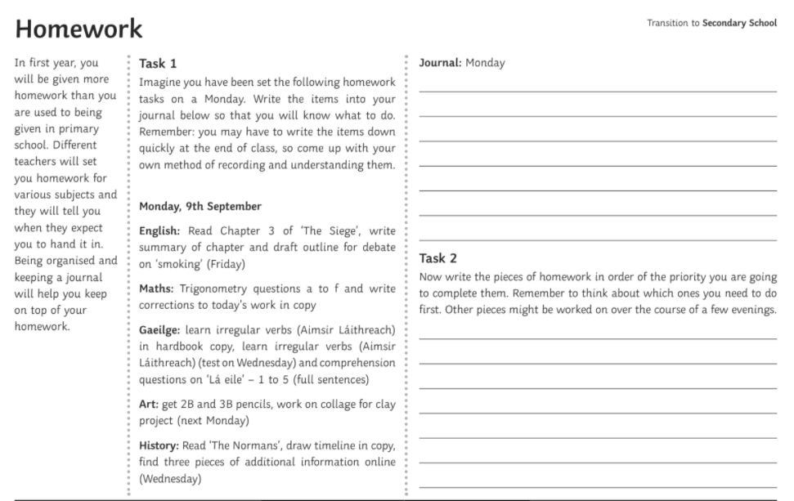

Slide 28
School Uniform

Slide 29
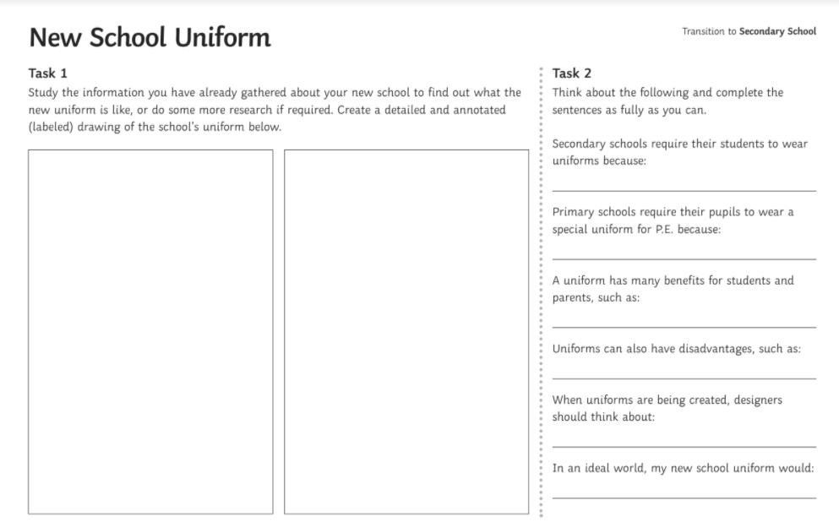

Slide 30
School Rules

Slide 31
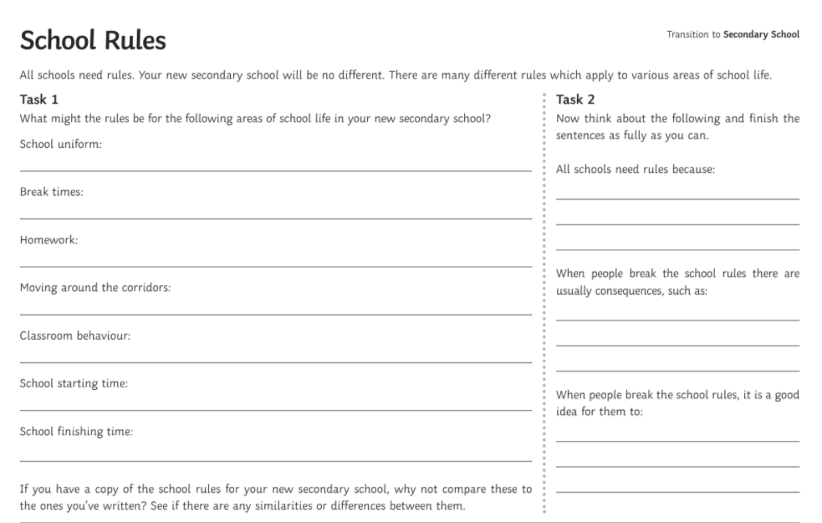

Slide 32

SCHOOL RULES
Students must arrive to classes on time
correct uniform should be worn at all times
mobile phones should be powered off and put in locker or school bag during the
school day
Chewing gum is not allowed
Hanging around the toilet area is not allowed
Inappropriate language/behavior is unacceptable
Bullying of any kind is not accepted
Respect is expected towards other students, members of staff and school premises
Make up – if worn must be natural and discreet only

Slide 33

HOMEWORK AND EXAMS
Homework is given in all subjects to be written into school journal
Homework is to reinforce what you have learned in the school day
Homework is not just written work but revising and reading also
Formal exams are given 4 times per year
Chapter tests will also be given at different times
3 years to Junior Certificate exams (Junior Cycle)
2-3 years to Leaving Certificate exam (Senior Cycle) TY, Fifth & 6th year and LCA

Slide 34

ACTIVITIES I CAN GET INVOLVED IN
Camogie
Football
Soccer
Hurling
Basketball
Rugby
Spikeball
Footsteps on Friday
Commit to be fit
Lunchtime games clubs
Music
Homework Club/Evening Study
Evening Study
Students Council
Library
School Play
Coding Club

Slide 35
Getting to know each other

Slide 36
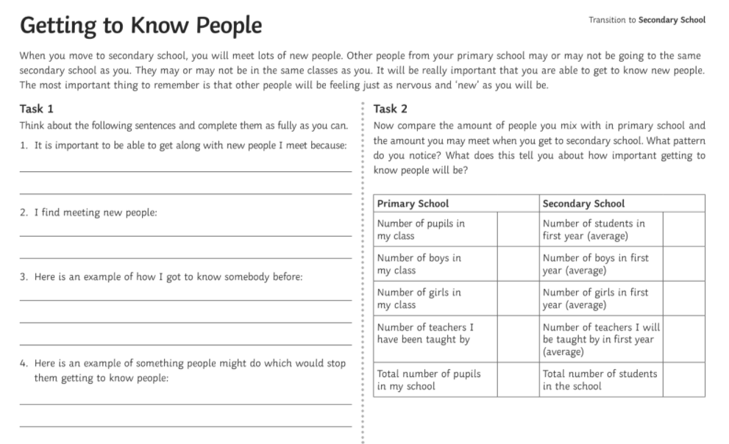

Slide 37
Top Tips

Slide 38

SIMPLE TIPS
Put your name on all of your books and copies to avoid confusion
Put your name or initials on your uniform
When you get your homework journal look through it fully to know how to fill it out
Pack your bag every night and make sure you look at your timetable to make sure that you have all the equipment that you need for the next day e.g. ingredients, books and PE gear
Purchase a keyring to put your locker key on and get a spare to give to the
caretaker/office
Use your locker appropriately, there is no need to carry all your books in your bag

Slide 39

SIMPLE TIPS
If you are have any problems with anything let someone know
Remember everyone will be in the same situation and many people will be nervous about the transition, it is normal
Remember to introduce yourself to new friends and if you think someone is struggling ask them if they are okay.
Students and teachers will help you if you let them know that you need it
The SCP staff are always on hand to help out and answer questions

Slide 40
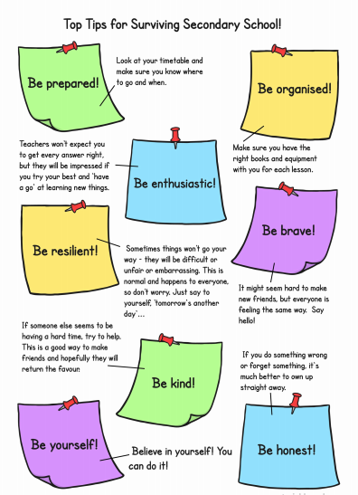

Slide 41
Mindfulness
Notes:
2A

Slide 42


Slide 43


Slide 44


Slide 45


Slide 46


Slide 47
ADDITIONAL INFORMATION

Slide 48
Tipperary Town & District School Completion Programme
CONTACT
Social Media
helen.kennedy@scp.ie
alanna.odonovan@scp.ie
stephanie.walsh@scp.ie
chanice.quinn@scp.ie
Instagram
Facebook
padlet

