Slide 1

St Ailbe’s 1st year Information for Parents
Welcome all parents/guardians of all 1st year students
Thank you for selecting St Ailbe’s for your son/daughter.

Slide 2
Subjects for Junior Cycle
Core subjects:
Irish
English
Maths
Science
History
CSPE
SPHE**
Intercultural and Religious Studies**
** Non – exam.
Plus three option subjects:
Art, Craft & Design (ACD)
Music
Home Economics
Woodwork
Technical Graphics
Metalwork
Geography
Business
French

Slide 3
Option Blocks
Students given a 6 week block of tasters for each subject and will pick one subject from the 3 option blocks which they will then carry forward to Junior Cycle with the Core Subjects.
That is 3 subjects from the options.

Slide 4
Junior Cycle Profile of Achievement (JCPA)
Assessment – What’s new?
At the end of the 3 year cycle students will receive a Junior Cycle Profile of Achievement which will comprise of two Classroom-based Assessments (CBA), generally, one in 2nd year and one in 3rd year, an Assessment Task(10%), based on the CBA’s and a final assessment (90%) in 3rd year

Slide 5
School Day
Monday & Wednesday Tuesday, Thursday & Friday
4 periods x 40 minutes
each 8.50 – 11.30
Break 11.30 – 11.45
2 periods x 40 minutes
each 11.45 – 1.05
Lunch 1.05 – 1.40
3 periods x 40 minutes
each 1.40 – 3.40
4 periods x 40 minutes
each 8.50 – 11.30
Break 11.30 – 11.45
2 periods x 40 minutes
each 11.45 – 1.05
Lunch 1.05 – 2.00
2 periods x 40 minutes
each 2.00 – 3.20

Slide 6
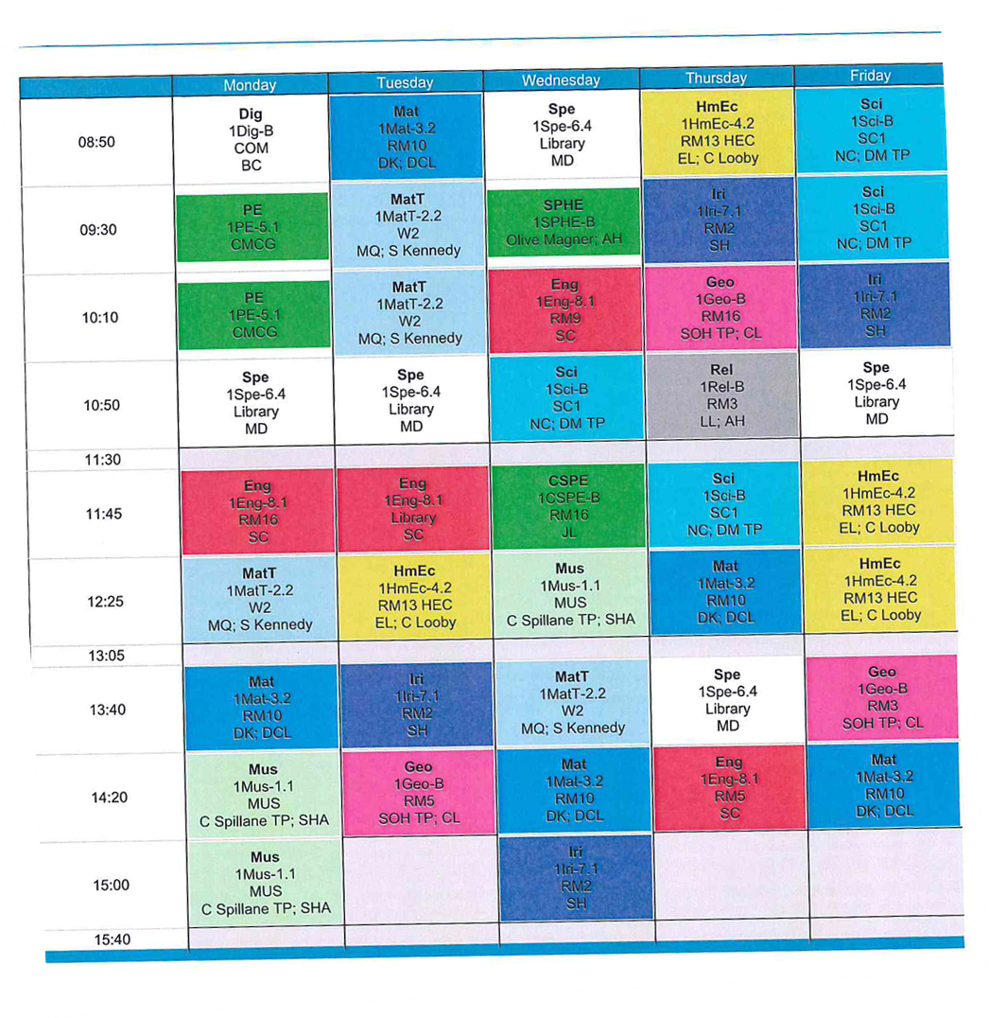
Timetable With Special Tuition (Spe White Blocks)

Slide 7
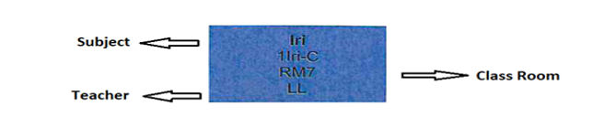
How to read the Timetable
Each block represents a, class period and is colour coded for each subject
Information in order of
Subject
Class group
Room number
Teacher
Advice: Have copies of the timetable at home, inside students locker and for the front of their journal

Slide 8
Material List
General Items for Every Subject
Pens at least 3 colours, Sharpener, Eraser,
2B & 6B Pencil, Ruler, Highlighters, Coloured Markers Colouring Pencils, Packet of poly-pockets
Materials
1A4 Refill Pad 3 60 page copy to be shared for the options 5 A4 hardback copy 4 120-page soft back copy 60-page Display Book Casio fx-83GTX Calculator – this model only Mathematical Set English Dictionary Irish Dictionary *Project Maths Copy available to buy in school (Room2)

Slide 9
Uniform
Navy Pants and/or Pleated Check Skirt
Navy V – Neck Jumper (School Crest)
White Shirt with Collar
Black / Dark shoes.
St Ailbe’s Tacksuit
Available from: Idsportshop.com
(Usually Fitting Day arranged for 2nd last week in August, will send text nearer to the time to clarify)

Slide 10
Homework Club | Evening Study
Monday & Wednesday 4:00 – 5:00 | Monday & Wednesday 4:00 – 5:00 / 5:50
Tuesday & Thursday 3:40 – 4:40 | Tuesday & Thursday 3:40 – 4:40 / 5:30
No Charge for 1st years Food available before commencement Register is maintained and absenteeism monitored. Fully Supervised

Slide 11
Supports & Extra Curricular Activities
Stay Safe
Friends For Life
Transition Program
Mentor/Buddy
Alert Program
Homework Club
Evening Study
Counselling Services
Numeracy Ninjas
Don’t be mean behind the screen
Working Things Out
Basketball
Rugby
Football
Hurling
Coding
Camogie
Soccer
Spike Ball
School Musical

Slide 12
Way2Pay
Online payment system for School Contribution, operated via a valid mobile number as on enrolment form, receipts issued by text
Contribution Arrangement: ????

Slide 13
VSware
VSware is used for recording Assessment, Attendance, Behaviour, Timetabling & Text Messages.
Parents/Guardians have access to VSware where they can see their son/daughters Personal Details, Attendance, Behaviour, Timetable and all Term Reports.
You will receive a Username and Password by Text to access VSware
Term Reports can only be seen on VSware, they no longer posted home.
Check VSware of a regular basis for to help keep you informed

Slide 14
Communication
Critical to the relationship between School and Parents
We strongly encourage Parents to engage with procedures and protocols that are currently in place.
Please do not contact your son/daughter directly on their mobile phone throughout the day.
Main office can deal with or communicate any issues/messages you may have.
Be familiar with the Student Journal and its contents.
Look at journal every day or at least once a week.
Sign the journal at the end of the week.
Use the journal for notes in relation to leaving school.
Check to ensure your son/daughter is doing homework.
Ensure they have the necessary equipment, books etc. for every class.
Ensure they are in proper uniform every day.
Ensure good attendance at school
Avoid, if possible, family holidays during the school year.
Encourage them to be on time for school, as it is a life lesson.
Emphasis on respect and punctually.
Encourage them to actively take part.
Attend Parent Teacher meetings

Slide 15
Thank you for reading this presentation , you can click on the below link to complete a ??? which might help to clarify to see if anything points??/
Mary Ryan

