Slide 1
St Ailbe’s 1st year Information Evening for Parents
Welcome all parents/guardians of all 1st year students
Thank you for selecting St Ailbe’s for your son/daughter.
Notes:
I would like to welcome everyone to our meeting and to thank you picking St Ailbe’s as your school of choice. We would prefer to meet in person but we will make the best of it.
I will start by asking my colleagues by introducing themselves and their role.
Edel & Alannah
I’m Mary Ryan the Home School Liaison Teacher, I act as a link between parents, home and school. My role is to support parents as much as possible while their child is in St Ailbe’s.

Slide 2
Outline
Curriculum
Timetables
Materials / Uniform
Pastoral Care/Guidance
VSware
Way2pay
Communication with school / Parents
Student Journal
Notes:
Here is a list of what we will be covering – hopefully we will have you out of here within an hour.

Slide 3
Junior Cycle Subjects
Core subjects:
Irish
English
Maths
Science
History
CSPE**
SPHE**
Intercultural & Religious Studies**
**Non Exam Subjects
Option subjects: (Pick 3)
French
Applied Technology
Geography Block 1
Wood Technology
Art
Visual Art
Music
Home Economics
Woodwork Block
Graphics 2 & 3
Engineering
Business
Geography
Notes:
Lets look at the subjects your child will studying for the next 3 years. Students are examined in 5 core subjects and 3 option subjects at Junior Cycle.
Subjects are divided into 2 categories, Core subjects – on the left and Option on the right.
Every student will study all the core subjects for their 3 years at Junior cycle

Slide 4
Option Blocks (Open to change)
Block 1: French, Geography, Technology, Wood Tech, Art
Students will pick a subject from Block 1 before starting 1st year, either through an on-line survey or based on discussions at the one-to-one meetings with Mr Devitt or Mr O’Dwyer. The reason for this is that we don’t want to wait 15 weeks before starting French.
Block 2 and 3: Business, Engineering, Home Economics, Visual Art, Woodwork, Graphics, Music, Geography
Notes:
Option Subjects are divided into 3 blocks.

Slide 5
Contd.....
Every 3 weeks, for a total of 15 weeks, students will experience 2 new subjects from option Blocks 2 & 3
Throughout the 15 weeks students will take part in a Wellbeing Module
Timetabled subjects will change 5 times from September to Christmas
Each student will carry 8 subjects through to 3rd year.
(5 core and 3 options)
Notes:
Don’t worry every student will experience all the options subjects during the 3 week taster blocks. At the end of the 15 weeks students will have to pick 1 subject from each of block 2 and 3.
Block 1 is different – in that the students in conjunction with yourselves will have to pick 1 subject from the block 1 before starting in September. You can do this on the survey Mr Devitt has sent out or you can wait to discuss your choice during the one-to-one meeting you will be having with Mr Devitt or Mr O’Dwyer at the end of the month, or you might like to discuss it with Edel.

Slide 6
Junior Cycle Profile of Achievement (JCPA)
At the end of the 3-year cycle students will receive a Junior Cycle Profile of Achievement which will comprise of
2 Classroom-based Assessments (CBA), generally, one in 2nd year and one in 3rd year
Assessment Task (10%), based on the CBA’s
A final assessment (90%) in 3rd year
Notes:
So what happens at the end of the 3 years. Students will receive a Junior Cycle Profile of Achievement based on 2 CBA’s, an Assessment Task and a final examination in 3rd year.

Slide 7
School Day
*Monday & Wednesday Tuesday, Thursday & Friday
4 periods x 40 minutes
starting at 8.50
Break 11.30 – 11.45 (15 mins)
2 periods x 40 minutes
starting at 11:45
Lunch 1.05 – 1.45 (40 mins)
3 periods x 40 minutes
until 3.45
4 periods x 40 minutes
starting at 8.50
Break 11.30 – 11.55 (25 mins)
2 periods x 40 minutes
starting at 11:55
Lunch 1.15 – 1.55 (40 mins)
2 periods x 40 minutes until 3.15
*Long day – short break – early lunch
Notes:
The School Day
Monday & Wednesday are our long days, we finish at 3:45, with a 15 minute break in the morning and 40 minutes for lunch.
Tuesday, Thursday and Friday short days finishing at 3:15, with a 20 minute break and 40 minute lunch.

Slide 8
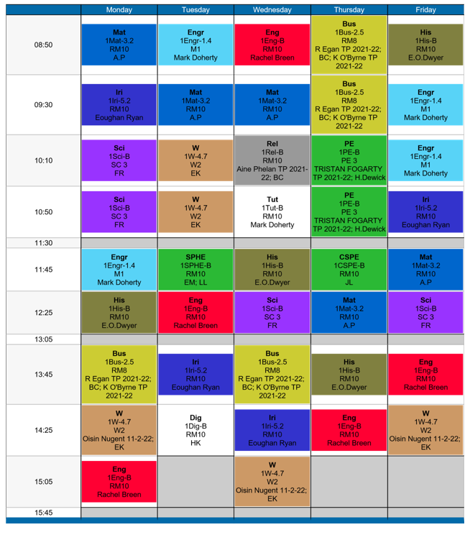
Timetable 1
Notes:
Handout 3 page 6 and 7
Reading the timetable can be confusing so I think it is important to explain it.
It is coloured coded for each subject.
Each block has the Subject on 1st line, French, the next line you can ignore.
3rd line is the name of the class room where it is being taught and the last line is the name of the teacher delivering the subject.
A good idea is to print out 3 copies of the timetable, 1 for at home on the fridge, one for their journal and the last for the inside of their locker. When you log onto Vsware you will be able to see the students timetable as well.

Slide 9
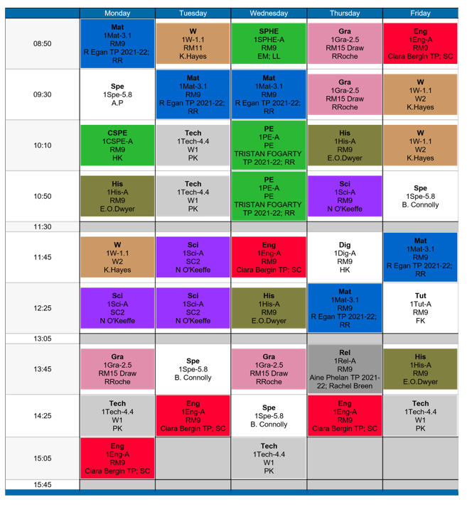
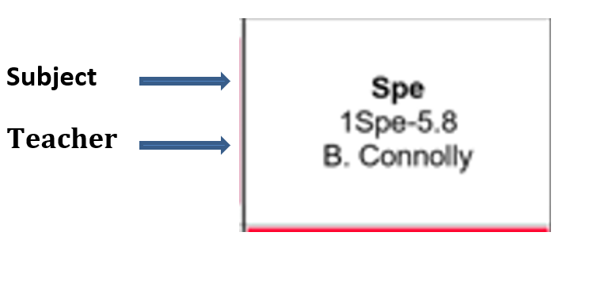
Timetable 2 – SEN Classes
Notes:
The only difference between this timetable and the previous one is this timetable contain an SEN class, they will always be coloured white

Slide 10
Class Materials
General Items for Every Subject
Pens at least 3 colours, Sharpener, Eraser,
2B & 6B Pencil, Ruler, Highlighters, Coloured Markers Colouring Pencils, Packet of poly-pockets
Notes:
The list of class material is also available on the website, please try to ensure that your child has all the necessary materials before school starts as it will make life easier for them.
Handout 1 page 4 of Parent Information Booklet

Slide 11
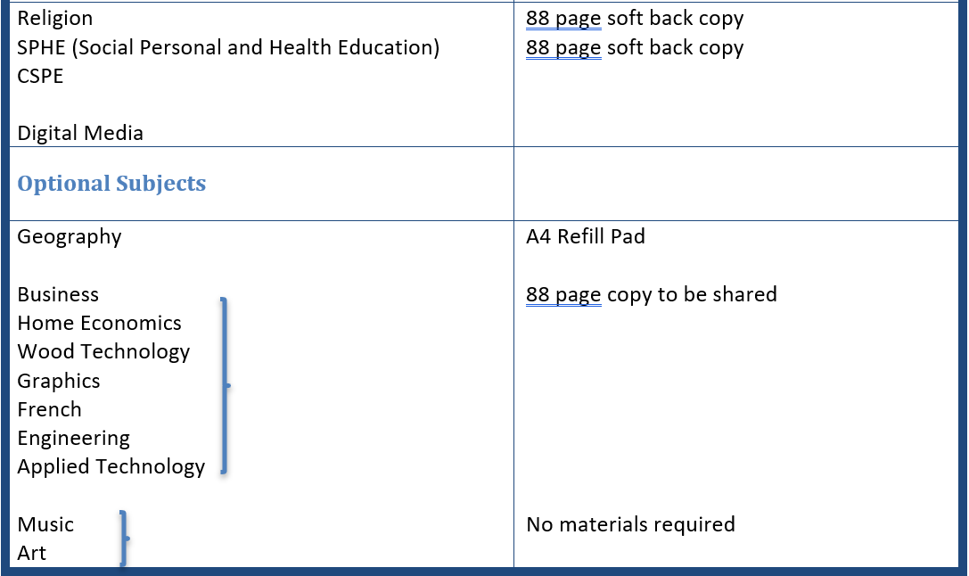
Notes:
Handout 1 page 4 of Parent Information Booklet

Slide 12
Uniform / Boys & Girls
Navy Pants – Pleated Check Skirt is also an option for girls.
Navy V – Neck Jumper (School Crest).
White Shirt with Collar
Black / Dark shoes.
St Ailbe’s Tracksuit (Idsportshop.com) - Fitting date in June, will be notified.
Notes:
Uniform is a navy pants with v neck jumper with school crest.
There is a school track suite which is only available on line from Idsportshop.com
There will be a fitting arranged in school for 28 & 29 June with a second one in late August, try to attend the June fitting as it takes 6-8 weeks to receive your order. We will let you know the exact dates nearer to the time.

Slide 13
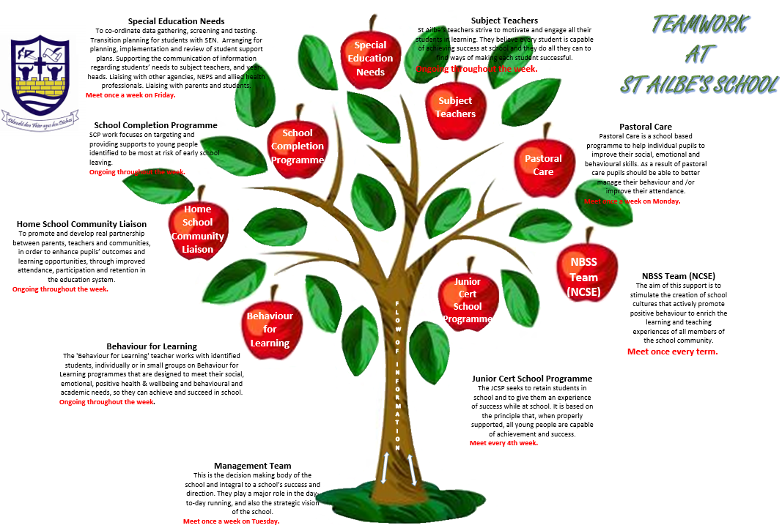
Pastoral Care & Guidance Teams
Notes:
I will now pass over to Edel and Alannah who will talk about pastoral care and guidance.

Slide 14
Supports to Assist 1st Years
Stay Safe
Friends For Life
Transition Program
Mentor/Buddy
Alert Program
Homework Club
Evening Study
Counselling Services
Numeracy Ninjas
Don’t be mean behind the screen
Working Things Out

Slide 15
Homework Club
No Charge
1hour after school
Monday & Wednesday
4:00 – 5:00
Tuesday & Thursday
3:40 – 4:40
Fully Supervised

Slide 16
Evening Study
No Charge for 1st years
1 hour after school
Monday & Wednesday
4:00 – 5:00 / 5:50
Tuesday & Thursday
3:40 – 4:40 / 5:30
Food available before starting
Fully Supervised
Register is maintained and absenteeism monitored.

Slide 17
Extra Curricular Activities
Basketball
Rugby
Football
Hurling
Coding
Camogie
Soccer
Spike Ball
School Musical
Gaming Club
Music Generation
Debating

Slide 18
SCHOOL AND EDUCATION
RELATIONSHIPS AND FRIENDSHIPS
CHILDHOOD TO ADOLESCENCE

Slide 19
SCHOOL AND EDUCATION
School building - moving and base room
Lockers
9 different teachers in one day
Teaching styles and personalities
Subjects/timetable
New timetable
Canteen:
Homework management. Some homework may not be due in for a few days.
School Diary

Slide 20
The School
Canteen – Fob Costs etc.
Lockers – Timetable with blue-tack or in poly pocket Zip Lock – colour coded
Uniform – names on everything
First Day: Nerves Bus, Bag, Pencil case, in uniform, supply of copies
School Office – Clodagh and Mary

Slide 21
SOCIAL MEDIA:
FACEBOOK SNAPCHAT
TWITTER
COMPUTER GAMES
RELATIONSHIPS
SELF
PARENTS/GUARDIANS
FRIENDS
SCHOOL BAG
TIMETABLE
EQUIPMENT
PHONE
TEXT MESSAGES
HISTORY
SCIENCE
FRENCH
ORGANISATION
PRIORITISATION
HOW AND WHEN TO HELP
NO-ONE UNDERSTANDS ME,
INCLUDING ME!
WHY?
WHY?
WHY?
PHASE 2!
BODY CHANGES
VOICE
BODY
IDENTITY
FAMILY SECOND PLACE

Slide 22
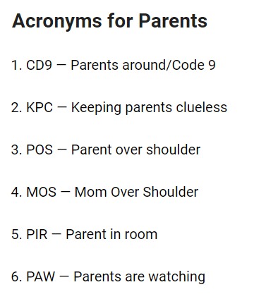
TIME TO UP-SKILL

Slide 23
RELATIONSHIPS & FRIENDSHIPS
From Senior Students to Junior Students
Be kind to everyone
Friendship groups change
Get to know students from other schools, new and old friends.
HERE TO LEARN, TO HAVE FUN

Slide 24
ROLE MODEL
ADMIT MISTAKES
RELATIONSHIPS
SELF
PARENTS/GUARDIANS
FRIENDS
Collaboration Vs Control
MEAN WHAT YOU SAY
HOMEWORK
ORGANISATION PLACE
PLAN
PRIORITISATION
PARENTING TEENS
CALM
EMOTIONS ARE CONTAGIOUS
ACTIVE LISTENING
Two Way Steet
Calm
Without Judgement
KINDNESS
PEOPLE
SITUATIONS
SUPPORTIVE BOUNDARIES MOBILE PHONE
TIMES ETC

Slide 25
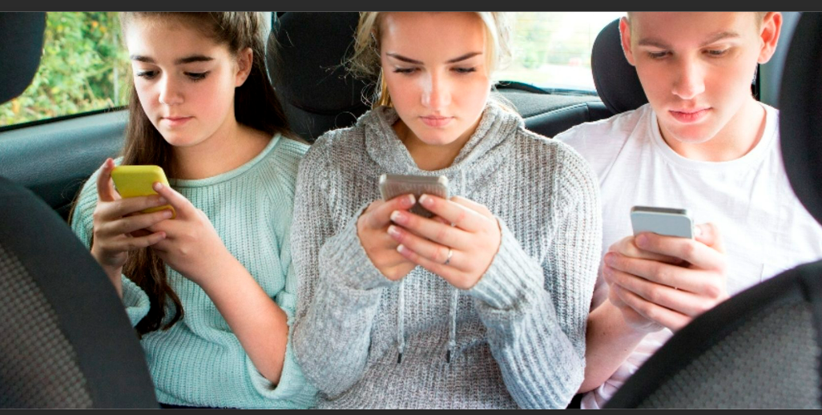
Parenting Adolescents

Slide 26
5 Main Areas of Change
Physical
Your child is growing and developing into a young adult. This can be a difficult time for them. Be Prepared.
Social
The family may be no longer their social centre. Friends and
peers become important
Sexual
Adolescence can be a difficult time as your child becomes aware of
their sexuality.

Slide 27
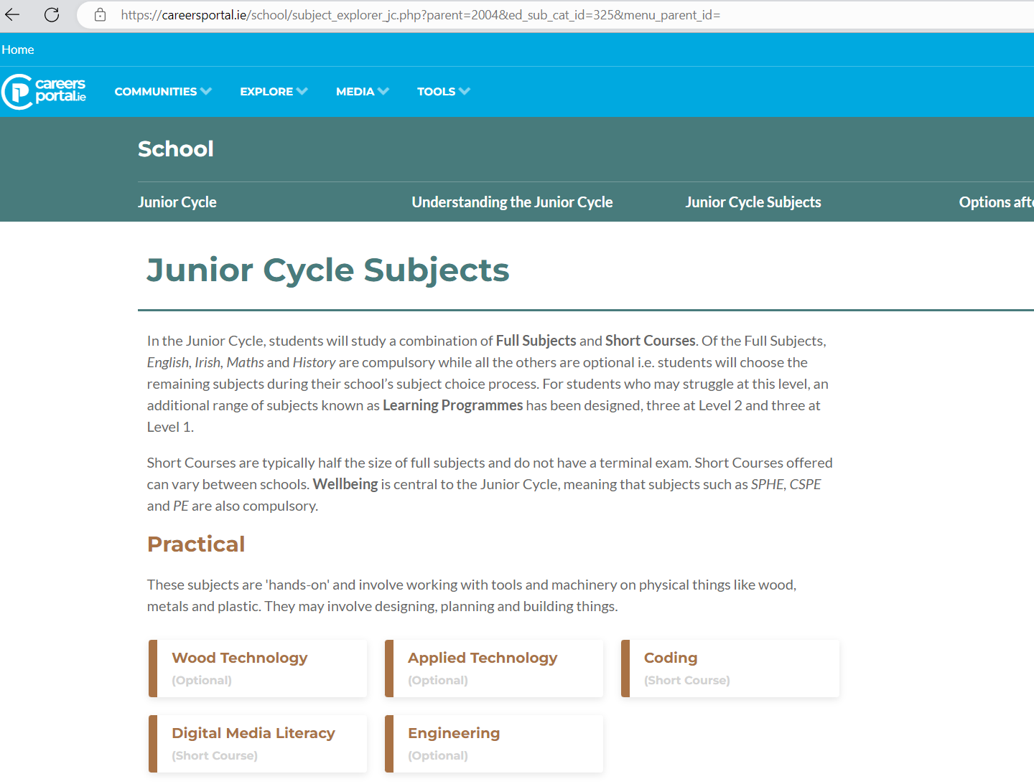
Contd....
Vocational
Adolescence is a time for searching for and identifying
possible careers www.careersportal.ie

Slide 28
My Way!
Judgements and peer pressure
Teenagers question the things they are taught.
They are not always doing this just to be a rebel. This questioning helps them find their own identity and independence.
Their questions are often genuine questions they have for themselves

Slide 29
THINGS TO CONSIDER
We all have our own unique set of strengths
With adolescence comes ownership and responsibility
Self esteem is often fragile at this time. Relationships/friendships play a major role.
Helpful Boundaries, Be the reason to say no
Active participation in growing up – school, friendships, sport, extra-curricular activities
Do encourage a good night’s sleep. sleep and rest are important

Slide 30
SOMETHING TO THINK ABOUT!
“What I need most is to feel loved and valued, no matter how foolish I may seem. I need someone who believes in me because I do not always believe in myself.......”
By Virginia Satir

Slide 31
VSware
VSware is a management tool used for recording Assessment, Attendance, Behaviour, Timetabling and sending Text Messages. You can download the app from the App store or go through the St Ailbe’s website. Instructions available on the website under Downloads.
Parents/Guardians have access to VSware where they can see their son/daughters Personal Details, Attendance, Behaviour, Timetable and all Term Reports. It can also be used for parents to enter reasons for absence, appointments, signing out etc.
You will receive a Username and Password by Text to access VSware
Notes:
To help you follow your child's progress during the year all parents/guardian have access to VsWare, here you will see information on attendance, behaviour, time tabling. We also use it to send text messages.
You can download the app from the App Store or log in through the St Ailbe’s website.
Details of your log on will be send by text.

Slide 32
Term Reports can only be seen on VSware, they are no longer posted home.
Check VSware on a daily/weekly basis for to help keep you informed on attendance, behaviour, etc.
Notes:
Just be aware we are no longer posting out term reports of examination results, they will only be available on VsWare, you will be informed by text when the window for viewing the reports opens.

Slide 33
Way2Pay
Online payment system for Book Rental and School Fee, Extra Curricular Activities, which can be accessed on St Ailbe’s website
Debit card is required for payment
Valid mobile number as on enrolment form
Text message with link/password late June/July
Receipts issued by text
Cash only payment at office
Cheques payable to Tipperary ETB only
Notes:
We would encourage you to use the Way2Pay system for paying the school contribution or any other payment that is required during the year.
You do need a Debit card to use the system and a valid mobile number.
Like VsWare you will be sent a text message with the link and password.
Way2Pay can be accessed on the website.

Slide 34
Communication
Critical to the relationship between School and Parents
We strongly encourage Parents to engage with procedures and protocols that are currently in place.
Please do not contact your son/daughter directly on their mobile phone throughout the day.
Main office can deal with or communicate any issues/messages you may have.
Be familiar with the Student Journal and its contents.
Look at VSware every day or at least once a week.
Sign the journal at the end of the week and ensure students are using journal to take down homework.

Slide 35
Use Vsware to submit absence request for notes in relation to leaving school.
Check to ensure your son/daughter is doing homework.
Ensure they have the necessary equipment, books etc. for every class.
Ensure they are in proper uniform every day.
Ensure good attendance at school
Avoid, if possible, family holidays during the school year.
Encourage them to be on time for school, as it is a life lesson.
Emphasis on respect and punctually.
Encourage them to actively take part.
Attend Parent Teacher meetings

Slide 36
Student Journal
Code of Behaviour
Code of Discipline/ Ladder of Referral
Permission to Leave School
Message to Parents
Report cards
Positive Behaviour Tracker
White Report
Yellow & Red Report
Notes:
The student journal is a very important book, it contains a great deal of useful information. All teachers use it to communicate with home so keep an eye on any entries that are made. Make sure to sign it every week as the assigned class teacher will be checking them weekly.

Slide 38
Contact Details
Noreen Ryan – Guidance and Counselling
Noreen@ailbes.com Ext. 104
Edel Merrign - Guidance & Counselling
edel@ailbes.com Ext: 104
Alannah O’Donovan - School Completion alanna@ailbes.com Ext: 111
Denis Keating – HSCL
denis@ailbes.com Ext: 103
Notes:
Here are our contact details.
We will email the presentation in case you missed anything.

Slide 39
Thank you for attending our Transition Evening – please feel free to ask any questions. Alanna, Noreen, & Denis

