Slide 1
LCVP
Leaving Certificate
Senior Cycle Options
Transiton Year
LCA

Slide 2
Format
Introduction/Overview – Mr Ruaidhri Devitt
Exam Revision App
Transition Year – Ms Claire Long
Leaving Certificate Applied – Ms Helen Kennedy
Leaving Certificate Established – Ms Noreen Ryan
Leaving Certificate Vocational Program
Subject Outline
Eirquest Aptitude Test
Q & A

Slide 3
Leaving Certificate Established

Slide 4
Students normally take 7 Subjects
English
Irish (Unless Exempt)
Maths
+ 4 option subjects + LCVP Link Modules

Slide 5
Brian Comerford Subject Choice Advice

Slide 6
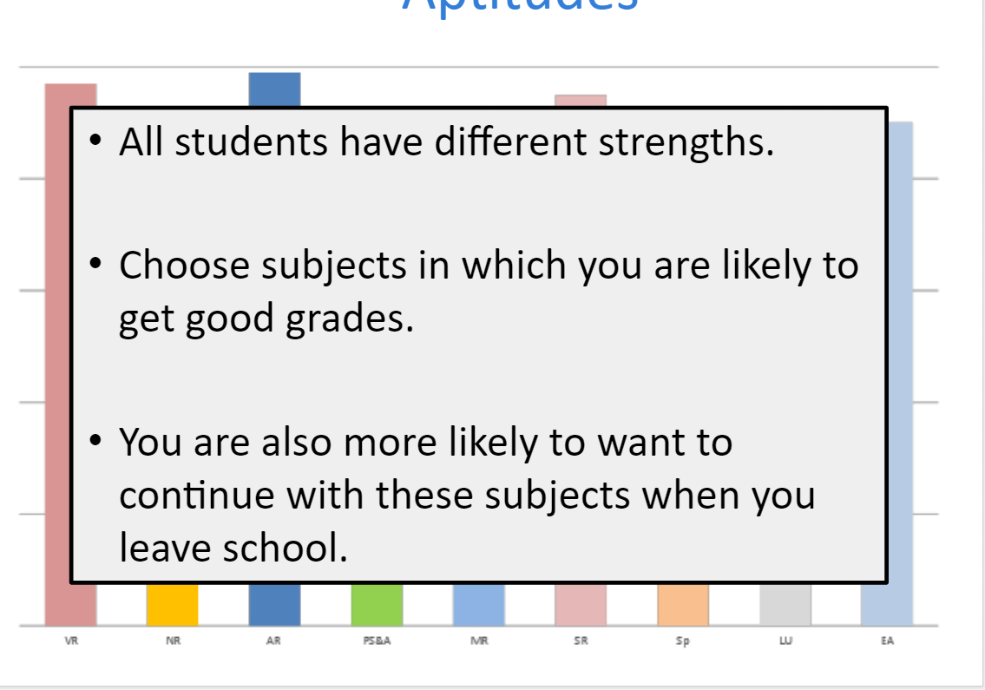

Slide 7
Subject Guides – CareersPortal.ie

Slide 8
Practical Subjects
Project work - substantial percentage of the overall grade.
Ease the burden of studying on students.
Having a practical focus can also add variety to your Leaving Cert subject combination.
Timing of Assessment/Oral can also ease the burden

Slide 11
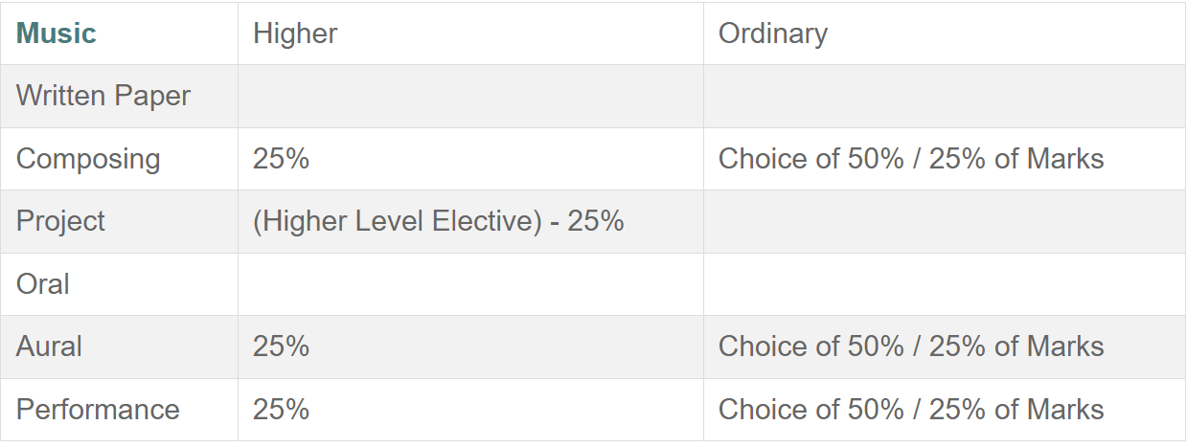

Slide 14
Leaving Certificate Vocational Program (LCVP)
Leaving Certificate Established with an additional subject option.
This subject comprises of 2 additional link modules covered over 2 years.
Enterprise Education
Preparation for Work
Students also do work experience as part of this program.

Slide 15
LCVP
Approximately 80% of students nationally use LCVP for CAO Points
Unless you are doing all Higher level subjects and expect to get 500+ points, LCVP is a very worthwhile subject. Those that use it generally increase their points.

Slide 16
LCVP Assessment
60% | Students prepare a portfolio of work including a CV, Career Investigation, An enterprise/action plan, a summary report. Pre-corrected
40% Exam | Case Study Question worth approx. 10% students get the case study to prepare before the exam.

Slide 17
LCVP

Slide 18
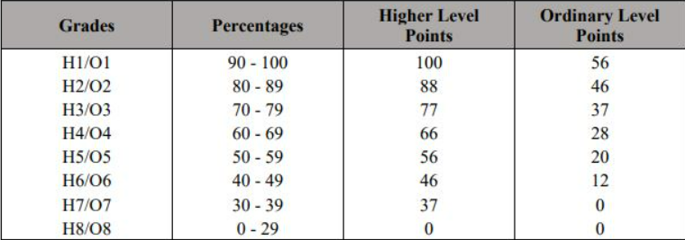
Leaving certificate points

Slide 19
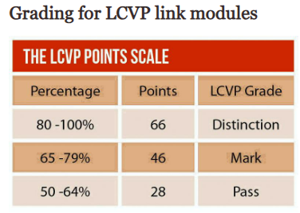
Higher Level Maths
+ 25 Bonus Points for
H6 – H1 in Maths ( 40-100)

Slide 20
Percentage of H1 grades vary between subjects

Slide 21
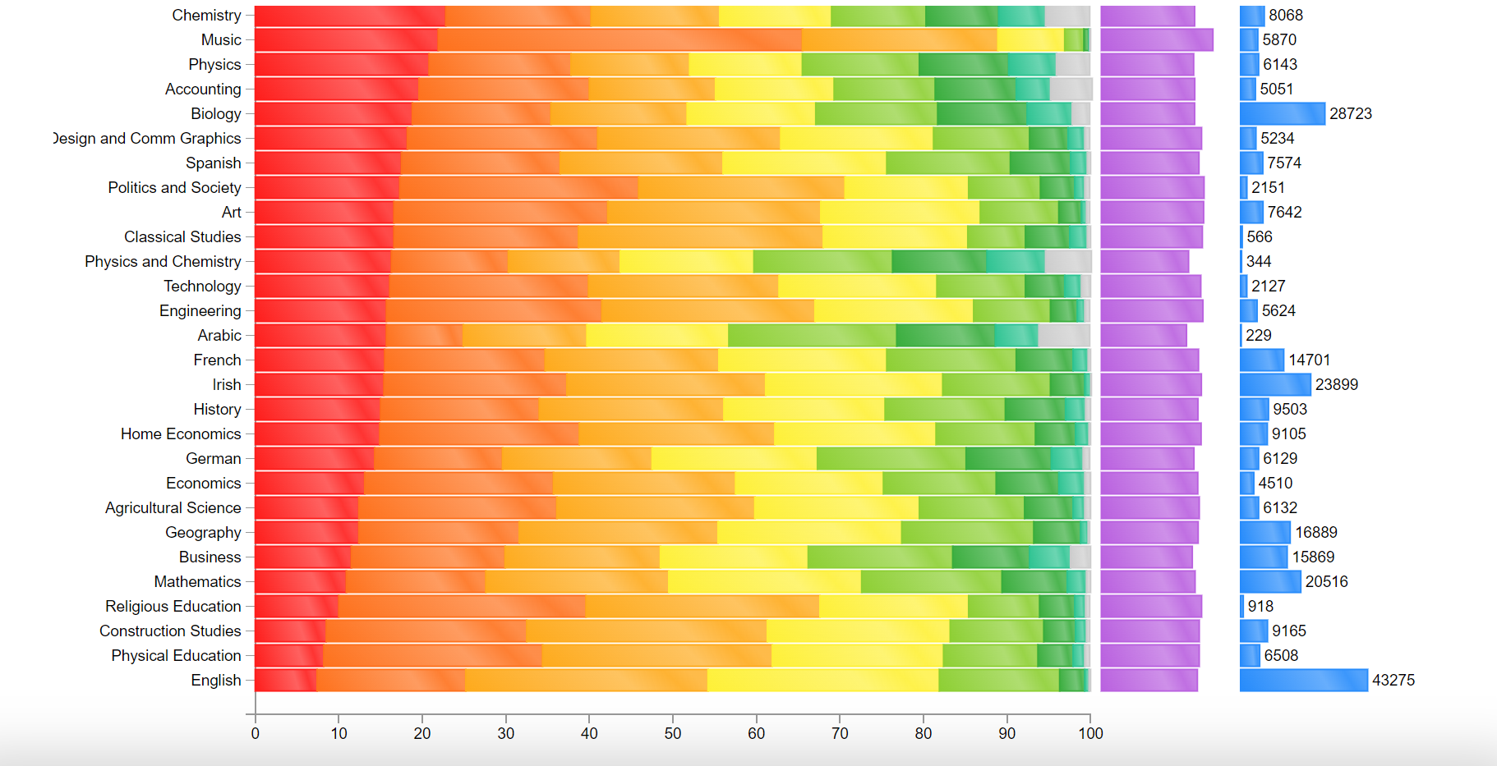
Leaving Certificate Results 2023

Slide 24
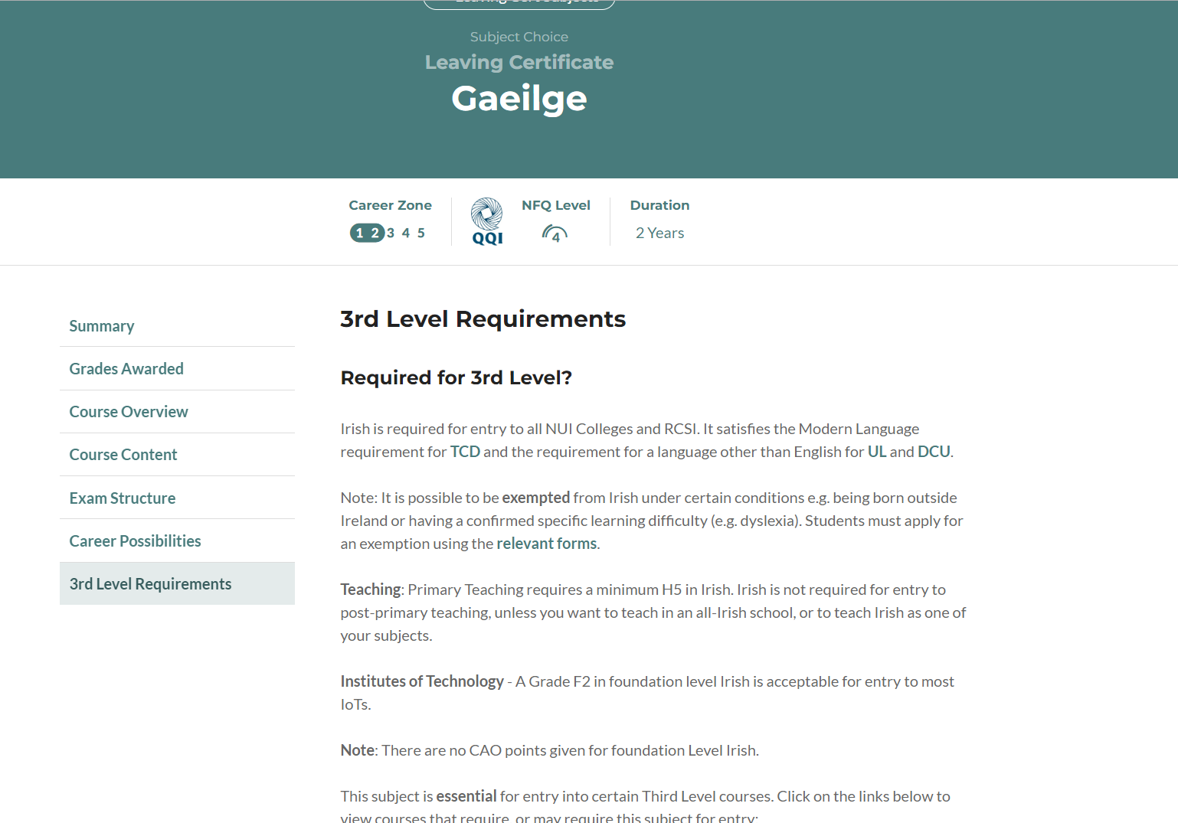

Slide 25
Aptitude testing

Slide 28
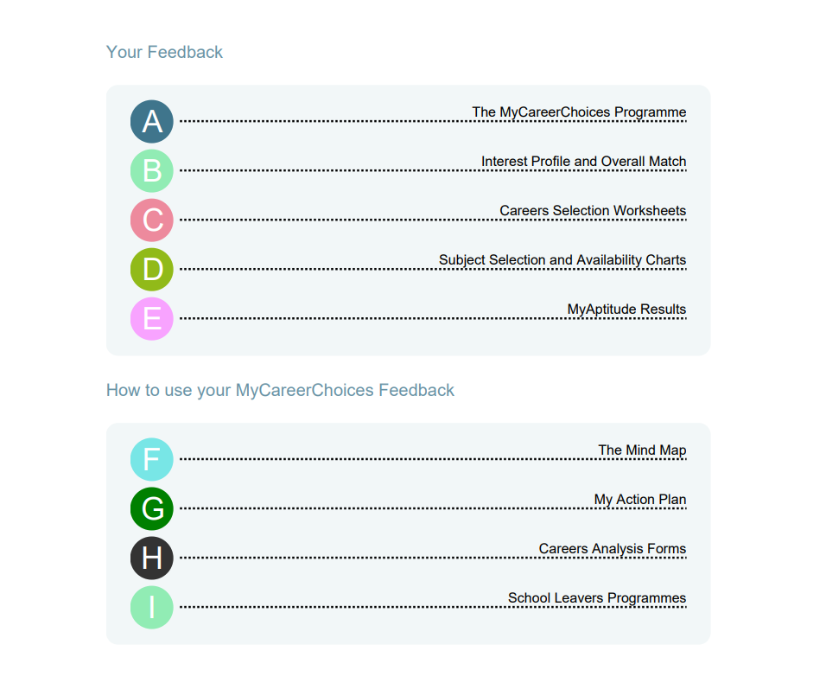

Slide 31
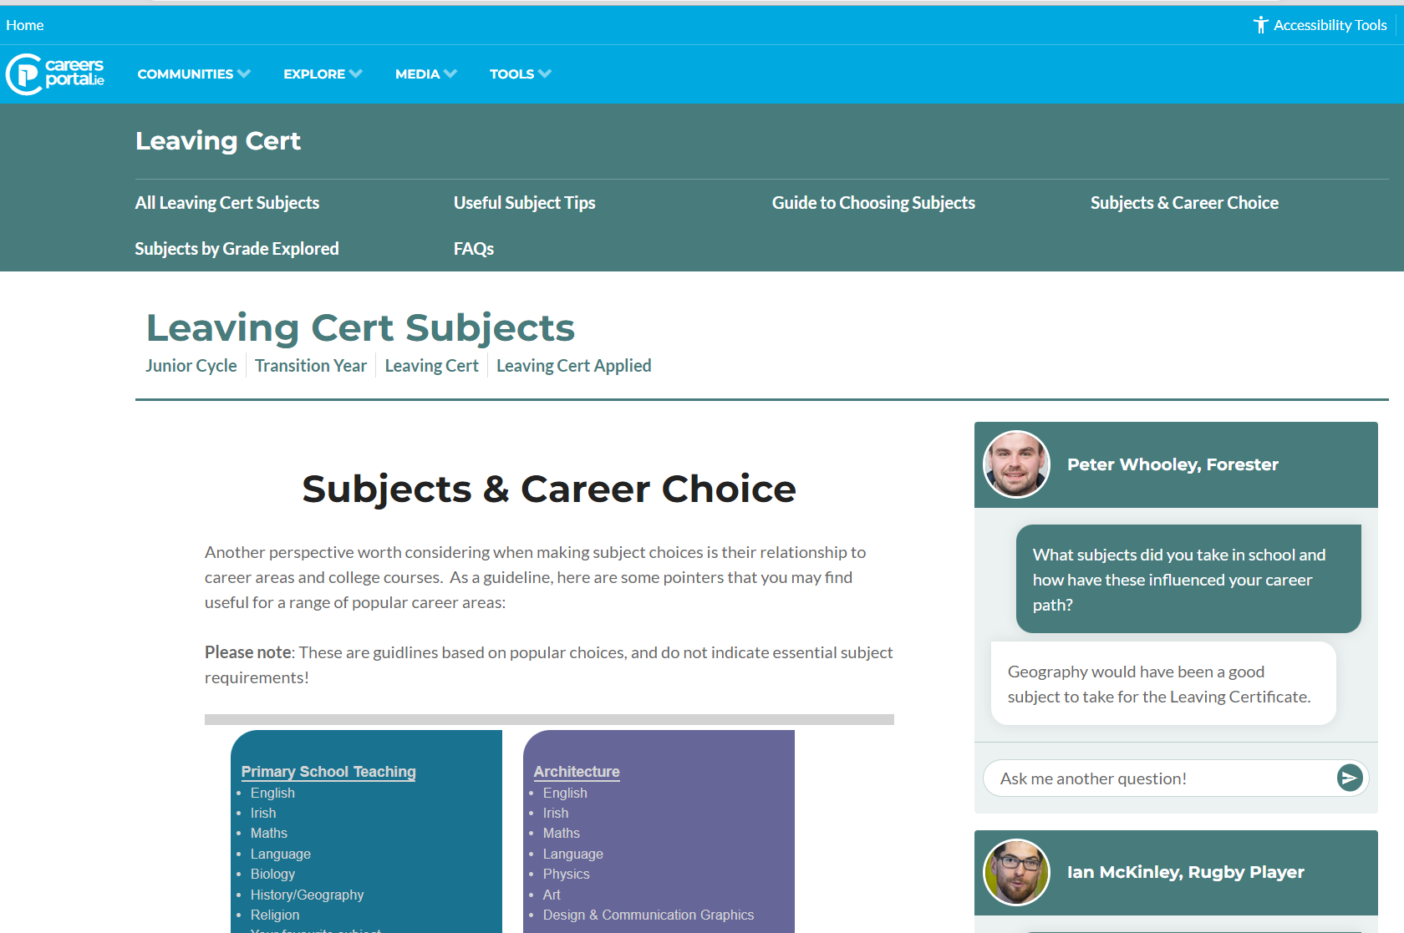
Useful Resources
Careers Portal
All LC Subjects
Subject Tips
Useful subjects for careers
Grades
A guide to choosing the subjects
Leaving Cert Subjects | CareersPortal.ie Community/School/Leaving Cert

