Slide 1
St. Ailbe’s School

Slide 2
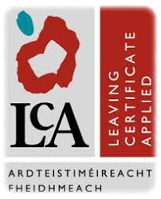
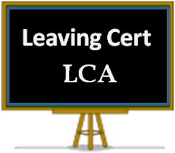
A brief guide
to the
Leaving Certificate Applied Programme

Slide 3
What is the leaving Certificate applied programme
It is a distinct, self-contained two-year Leaving Certificate programme aimed at preparing students for adulthood and working life
It highlights forms of achievement and excellence which are different to the Leaving Certificate Established.

Slide 4
Who would benefit from Leaving Certificate applied
Students who are not adequately catered for by the traditional Leaving Certificate programme
It offers the opportunity to prepare for and progress to further education and training, PLCs & Solas (FÁS)
Students wishing to progress to Universities or Institutes of Technology must first of all do a 1-year PLC course after the LCA programme

Slide 5
What is the rationale of the leaving Certificate applied programme
Prepares students for adulthood and working life
Key component of LCA is work experience
Work experience takes place one day a week
Applies knowledge and skills to the solution of real problems
Promotes communication and decision-making skills
Recognises talents of all pupils

Slide 6
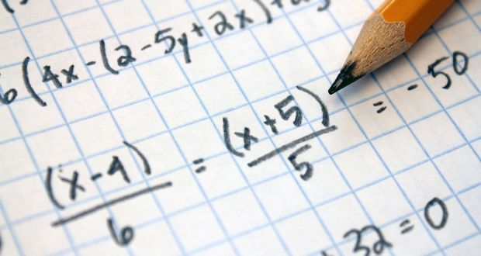
the leaving Certificate applied curriculum
English & Communications
Mathematical Applications
Social Education
Languages: French & Irish
Graphics & Construction

Slide 7
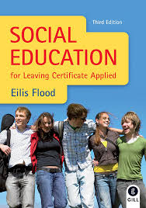
the leaving Certificate applied curriculum
Vocational Preparation & Guidance
Arts Education: Music
Information Technology
Leisure & Recreation

Slide 8
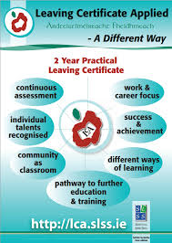

Slide 9
the leaving Certificate applied assessment
3 Forms of Assessment
Satisfactory completion of Modules 62 credits (31%)
7 Student tasks 70 credits (35%)
Total 200 credits (100%)
Final examinations 68 credits (34%)

Slide 10
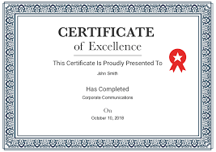
the leaving Certificate applied
Certification:
Pass 60-69 % (120 - 139 credits)
Merit (70-84 %) (140 - 169 credits)
Distinction (85-100 %) (170 - 200 credits)

Slide 11
the LEAVING CERTIFICATE APPLIED ROUTE MAP

Slide 12
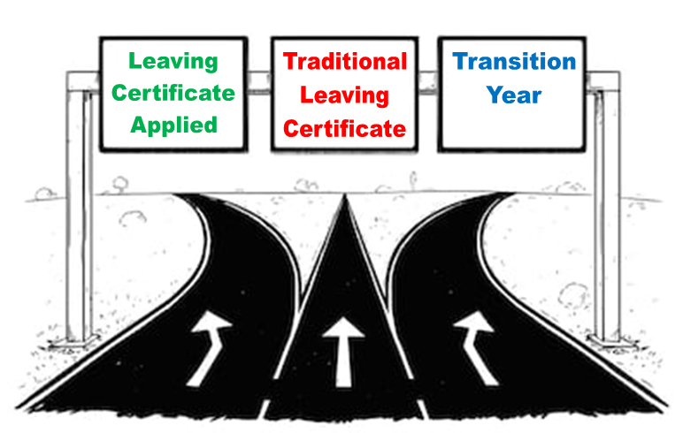
If you have any questions in relation to the
LCA programme, please get in touch!

