Slide 1
Transition Year at St. Ailbe’s

Slide 2
Admission to the programme
We have currently 75 students enrolled in the TY programme.
Students are invited to attend for a brief interview in April ( after the Easter holidays)
Students will be given an assigned interview time.
Following the interview, the students will be asked to sign a contract, committing to full participation in TY.
The purpose of the interview is also to establish what the students would like to achieve in the course of the year
Prospective students must have a good record of attendance, punctuality and behaviour
Students must have shown the ability to meet deadlines and complete assignments and project work
It would also be an advantage if the student has made a positive contribution to school life in their involvement with extra- curricular activities.

Slide 3
The TY Programme
We build upon our list of activities each year. We also invite students’ input and suggestions too.
Here are some but by no means all of the activities and courses we complete….
Trip to outdoor activity centre
School Musical
First Aid
Defib and CPR
Visit to Mitcelstown Caves
Law Ed workshop
Forensic Workshop
Ice skating and shopping trip in December
DELL Digital Futures Workshop
Jiving

Slide 4
TY Activities
Driving Lessons
GAA Coaching
Carol singing at Christmas
Volunteering at local nursing home
Irish Heart Foundation Fundraiser
St. Mary’s Community Food Bank
Tony O’Reilly Gambling Addiction Workshop as part of Tipperary Mental Health Week
Work Experience (3 weeks – December, February and April)
Visits to college open days/ RDS Higher Options
Fitness and well-being module
Foreign Trip at Easter

Slide 5
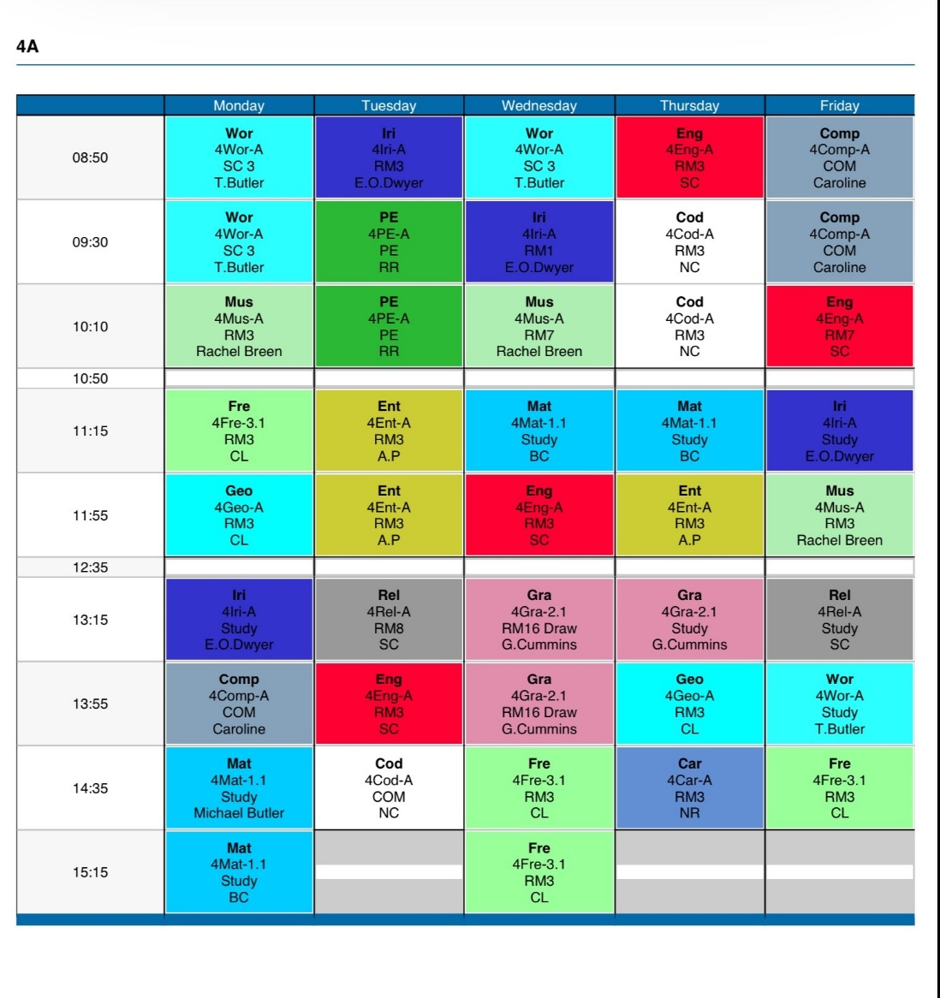
A look at an example of a TY timetable

Slide 6
Cost
The fee for TY is the same as other academic years, €150.
Although students will not have textbooks in all subjects, this cost covers photocopying, class materials and heavily subsidised activities and workshops
Other costs include activities and optional extras like the school tour at Easter, driving lessons, ice skating trip to Limerick and Ballyhass Outdoor Activity Centre
Some activities that have incurred a fee so far are attending school musicals, TY Comedy Show (subsidised), RDS Higher Options day,
Other examples include - First Aid will be subsidised, Law Education Workshop will be free

Slide 7
The Benefits of doing TY
It may sound like a cliché but you get out of TY what you put in. That is to say that the more activities you get involved in and the greater the effort you make, it will be an enriching year and highly beneficial.
Students learn to work independently and also as part of a group
They become more confident and generally their communication skills will improve through work experience, involvement in the school musical and engaging with the various guest speakers.
It is an extra year to mature
A lot of the courses and workshops we do are certified or at least student participation is recognised
Students gain an insight into the world of work. This may also influence their subject choices going forward into Fifth Year
Students who approach the year with an open mind and positive attitude will benefit most

Slide 8
I have included a number of photos of some of the activities that we have done so far this year.
We are very proud of their achievements and level of commitment and we are just half way through the year
We still have lots more to pack in
Thank you for your time and I wish you every success in your future studies here at St. Ailbe’s
If you have any further questions, please do not hesitate to contact me claire@ailbes.com

Slide 9
Collaboration with the Gaelscoil and Tipperary Dance

Slide 10
Higher Options The RDS

Slide 11
Higher Options The RDS

Slide 12
The Addams Family

Slide 13
The Addams Family

Slide 14
TY’s helping with the Hope

Slide 15
Joe and Karen from DELL
DELL Digital Futures Workshop

Slide 16
DELL Digital Futures Workshop

Slide 17
Enterprise – Market Day

Slide 18
Reflections For Christmas Ceremony

Slide 19
Reflections For Christmas Ceremony In St. Mary’s Church

Slide 20
TY Christmas Trip
Limerick On Ice

Slide 21
Limerick On Ice

Slide 22
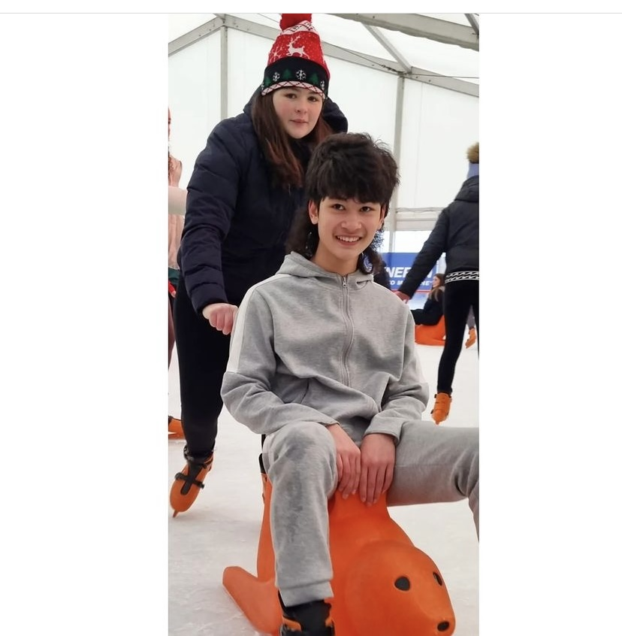
Limerick On Ice

