Slide 1
HEAR & DARE APPLICATION
2024/25
www.accesscollege.ie for full details

Slide 2
HEAR
Higher Education Access Route
It is a third level admissions scheme for school leavers who for social, financial or cultural reasons are under-represented in third level education. Eligible students may be offered places on reduced points and receive extra supports in colleges that run the scheme.
DARE
Disability Access Route to Education
It is a third level admissions scheme for school leavers whose disabilities have had a negative impact on their second level education. Eligible students may be offered places on reduced points in the colleges that run the scheme

Slide 3
What does ‘reduced points’ mean?
If you apply to HEAR/DARE and meet the application criteria you may be offered a place even if you do not have enough Leaving Certificate points for your preferred course. CAO points 350, HEAR/DARE 340
You still need to meet the minimum entry requirements and any specific programme requirements before being considered for a HEAR/DARE
Each of the colleges set aside a quota of places for HEAR/DARE students each year.

Slide 4

Map showing higher education institutions participating in HEAR and DARE

Slide 5
HEAR Application

Slide 6
How do I know if I’m eligible to apply to HEAR
*Indicator 1 - Low Income (Must have Indicator 1 plus correct combination of 2 other indicators)
Is the household income below the HEAR Income threshold in 2023? €46790 fewer than 4 dependant children
Indicator 2 - Medical Card
Your family has a Medical Card/GP Visit Card in date on 31st December 2024.
Indicator 3 - Social Welfare
Is the applicant’s parent(s) or guardian in receipt of a means-tested social welfare payment for a minimum of 26 weeks in 2023.
Notes:
6 indicators. Page 3 of handout

Slide 7
Indicator 4 - Socio-Economic Grouping (based on occupation and employment status)
Is the applicant a member of a group underrepresented in higher education i.e. non-manual workers, semi and unskilled workers.
*Indicator 5 - DEIS School (Every St Ailbe’s Student)
“DEIS” scheme (Delivering Equality of Opportunity in Schools) for the duration of their second level education.
Indicator 6 - Geographical Area
Does the applicant live in an area of concentrated disadvantage – high unemployment and poverty, or a small proportion of adults attend third level education.
Search for Pobal maps deprivation

Slide 8
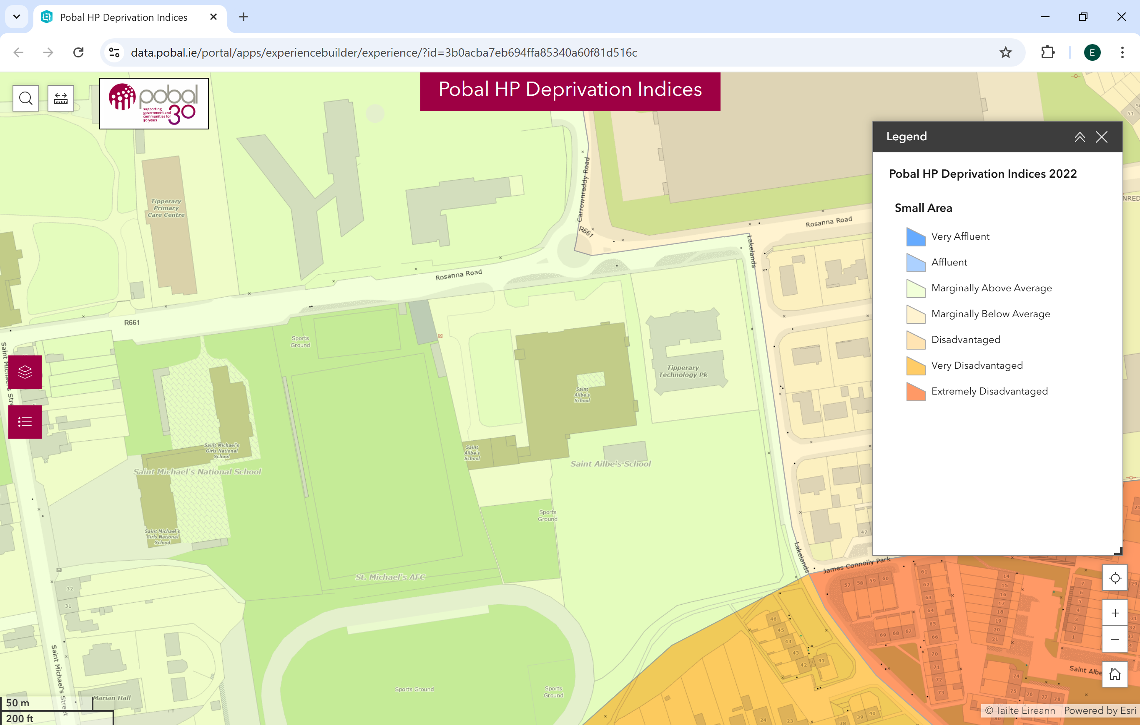

Slide 9
The combinations of Indicators for eligibility are:
1+ 2 +
4 or 5 or 6
1+ 3 +
4 or 5 or 6
1+ 4 +
5 or 6
1+
5 + 6
INDICATORS
1 Income €46790
2 Medical/GP Visit Card
3 Social Welfare Payment (26 wks 2023)
4 Socio-economic Group (non-manual, semi & unskilled manual workers)
5 DEIS School
6 Concentrated Disadvantage

Slide 10


How do I apply?
Apply to CAO at www.cao.ie by 1 February 2025.
Review your HEAR Handbook https://accesscollege.ie/wp-content/uploads/2023/09/HEAR-2024-Handbook-WEB-NEW.pdf
3. Complete all elements of the online HEAR application form by 17:00 on 1 March 2025.
4. Submit clear copies of supporting documents requested on your checklist to CAO by 15 March 2025.

Slide 11
How do I know what documents I need?
When you fill in your online HEAR application you will receive a checklist at the end. This is based on the information you provided.
The checklist tells you what documents you need to submit to fully complete your HEAR application.
You should start gathering your documentation in a timely fashion, i.e. before 15 February.
Send in all documents requested on the checklist to make a complete application before 15 March 2025.

Slide 12
DARE Application
Must have a disability which has/had a negative impact on their second level education.
Notes:
Disability Access Route to Education

Slide 13


DARE Eligibility Criteria
To be eligible for DARE you must meet both the DARE educational impact criteria and DARE evidence of disability criteria.
Applicants must provide the required evidence of their disability and provide an Educational Impact Statement from their school to be considered for DARE.

Slide 14
What disabilities are eligible for consideration for DARE?
Attention Deficit Disorder (ADD) *
Attention Deficit Hyperactivity Disorder (ADHD)
Autistic Spectrum Disorder (including Asperger's Syndrome)
Blind/ Vision Impaired
Deaf/ Hearing Impaired
Developmental Coordination Disorder (DCD) – Dyspraxia
Mental Health Condition *
Neurological Condition (including Brain Injury and Epilepsy)
Physical Disability
Significant Ongoing Illness *
Speech and Language Communication Disorder
Specific Learning Difficulty (including Dyslexia and Dyscalculia)*
* Dated after 1 Feb 2022
* Additional school based testing
Notes:
Page 4 &5 handout. Type, documentation, professional

Slide 15
Providing Evidence of your Disability
Your evidence of disability documentation is a crucial part of your application to DARE. It is used by DARE to establish whether or not you meet DARE’s evidence of disability criteria and therefore overall DARE eligibility. In addition, it is used by DARE colleges and universities to determine the kinds of supports you might need when you get to college. Your application will not be complete until you provide evidence of your disability by 15 March 2025. Evidence could be a report from an Appropriate Professional, e.g. Psychologist, Ophthalmologist, varies depending on the disability.

Slide 16

How do I apply?
Apply to CAO at www.cao.ie by 1 February 2025.
Review your DARE Handbook https://accesscollege.ie/wp-content/uploads/2024/10/DARE-2025-Handbook-WEB.pdf
Complete Section A of the Supplementary Info Form and apply to DARE by answering Yes to Question 1
by 1 March 2025.
You should start gathering your documentation in a timely fashion, i.e. before 15 February.
Submit the Educational Impact Statement and Evidence of Disability to CAO by 15 March 2025.

Slide 17
Supplementary Information Form (SIF)
Section A: Applicant Information
Completed by you online by 17:00 on 1 March 2025.
Answer Yes to Q1 to apply to DARE and fully complete Questions 1-5. OR
  Answer Yes to Q1(b) to apply to carry forward your DARE eligibility.
Section B: Educational Impact Statement
Educational Impact Statement completed by your school. Send to CAO by 15 March 2025.
Section C: Evidence of a Disability
Completed by the appropriate professional. Send to CAO by 15 March 2025.
Section D: School Statement
Where applying under the Dyslexia/ Significant Literacy Difficulties category, applicants who do not have a Psychological Assessment Report identifying Dyslexia should submit Section D. Send to CAO by 15 March.

Slide 18
Section C: Evidence of Disability
  Check out the information on providing evidence of your disability on
  www.accesscollege.ie/dare/providing-evidence-of-your-disability
You must post Evidence of Disability documentation to the CAO by 15 March 2025.
Please keep a copy of all documents that you post to CAO.

Slide 19
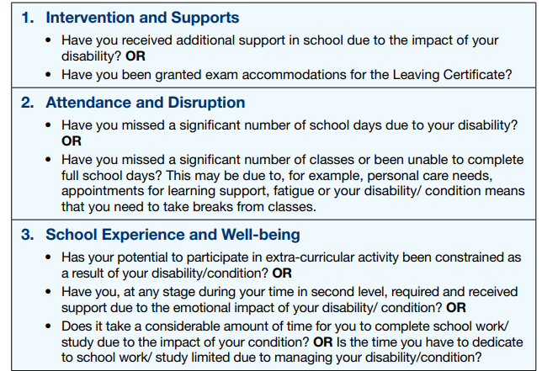
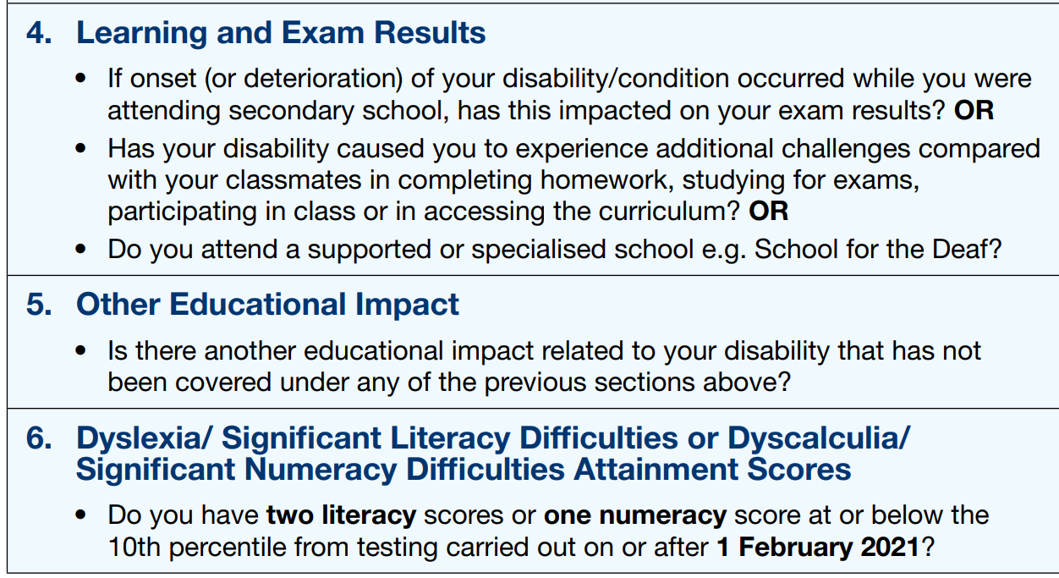
Meeting DARE’s Educational Impact Criteria
Applicants must meet a combination of *two indicators
* Applications with Specific Learning Difficulty must meet indicator 6 + one other. All others any two indicators.
Notes:
Page 3 handout

Slide 20

IMPORTANT
HEAR/DARE Applications are embedded within the CAO application, if you do not tick on the relevant box, within the CAO application, you will not gain access to the HEAR & DARE applications.
The information appears after the Qualifications Sections in the CAO application
Disability
If you wish to disclose a disability or Dyslexia/ Significant Literacy Difficulties or Dyscalculia/ Significant Numeracy Difficulties or apply to the Disability Access Route to Education (DARE) click on the
'Modify Disability (& DARE Application) Status' button below.

Slide 21


Higher Education Access Route (HEAR) (Further Information )
(for school-leavers from socio-economically disadvantaged backgrounds)
The Higher Education Access Route (HEAR) is a third level admissions scheme for school leavers from socio-economically disadvantaged backgrounds.
You must complete all relevant Sections (1-8) of the online HEAR application by 17:00 on 1 March 2025 to be considered for HEAR
Click on the HEAR Application button below to complete your online HEAR application.
SUSI - Maintenance/Fee Grant Application (Further Information)
All new student Maintenance/Fee Grant applications will be made online to SUSI (Student Universal Support Ireland) through their website at www.susi.ie (see also www.studentfinance.ie).
Please refer to the SUSI web site for details of courses that may be eligible for student grant funding from SUSI.
Online SUSI Eligibility Indicator Thresholds
If you wish to apply for a grant, you may indicate this on your CAO online application. CAO will then provide your Identification, Contact and Offer/Acceptance details to the grant authority (SUSI).
.
Notes:
Indicator https://www.susi.ie/eligibility-reckoner-app-irish/

Slide 22
DARE and HEAR Timelines
DARE & HEAR closing date |  | 1 March 2025 at 17:00
Supporting documents closing date |  | 15 March 2025
Notification of eligibility |  | June 2025
Review and Appeals Application |  | Late June 2025
HEAR/DARE offers |  | August 2025
College Orientation |  | Late Aug /Early Sept 2025
Notes:
Page 2

Slide 23

Further Information: www.accesscollege.ie

