Slide 1


APPLIED MATHS
Leaving Certificate
New Specification 2021

Slide 2
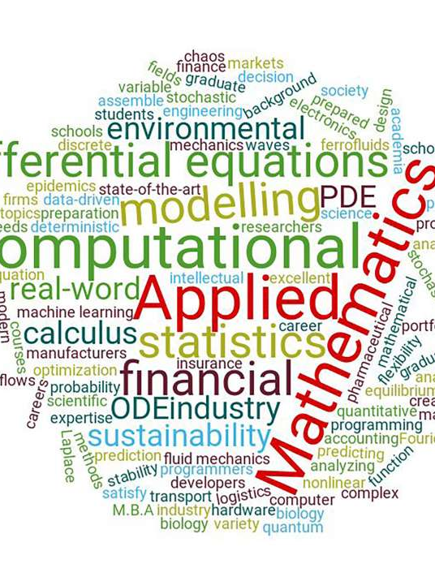
What is Applied Maths?
Maths in the “real world”
Modelling real-life problems
Makes you think
Learn useful skills
  Problem solving
  Logical thinking
  Analytical thinking

Slide 3
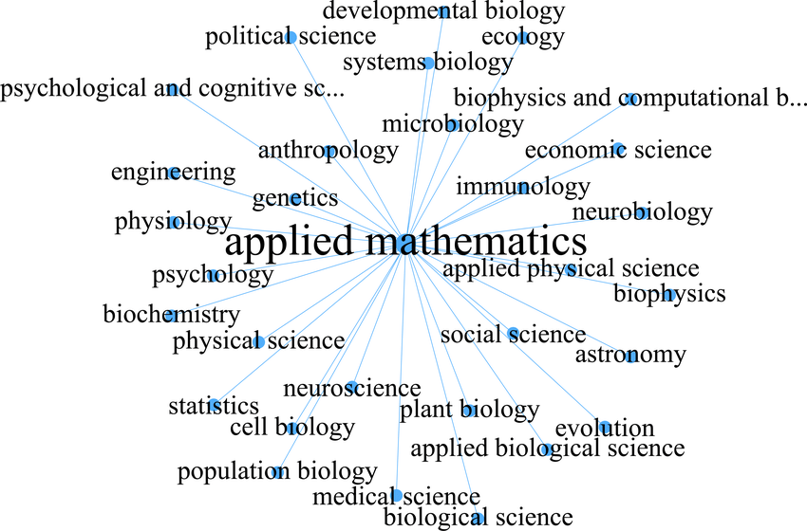
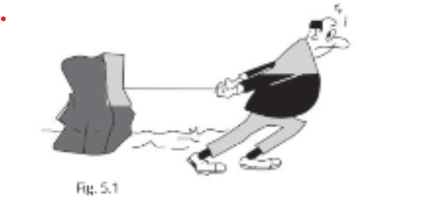
Who needs Applied Maths?
Used in:
Computer Science
Engineering
Physics and Maths
Data Science and Statistics

Slide 4
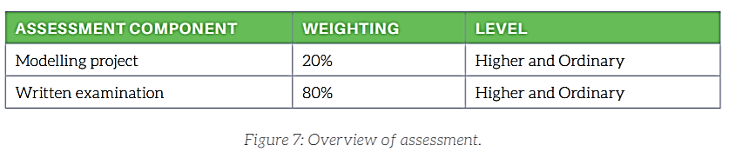
Assessment

Slide 5
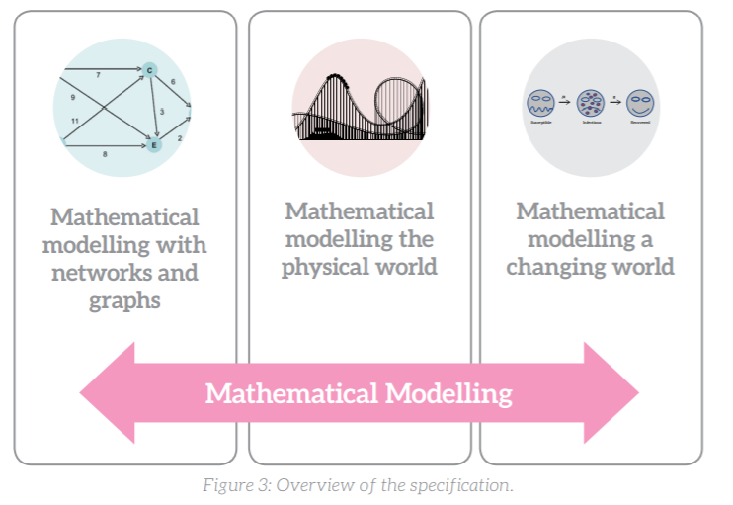
Course Outline- Modeling Project (20%)
Students choose a scenario that can be analyzed and solved using mathematical techniques.
Examples include optimizing traffic flow, analyzing the spread of a disease, or modeling the trajectory of a projectile.

Slide 6
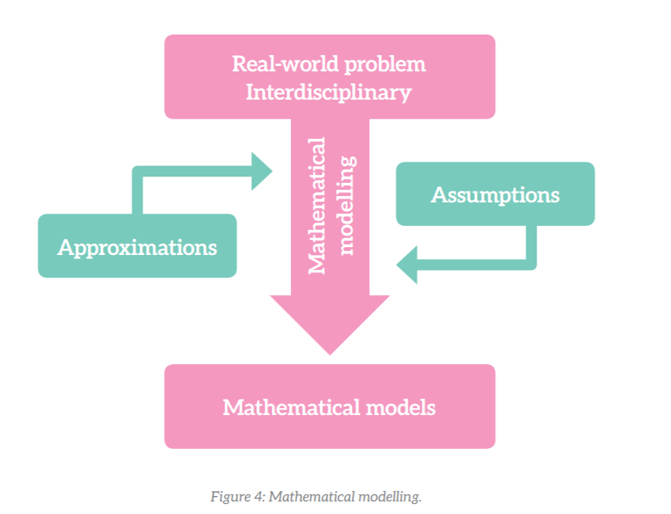
Mathematical Modelling

Slide 7
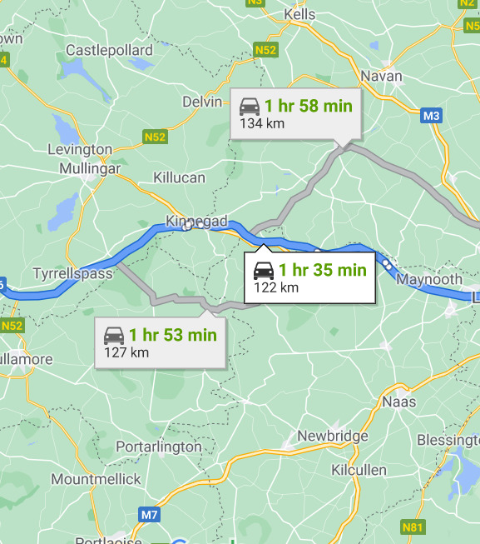
Graphs and Networks
Shortest path between locations
Most efficient way to do a project

Slide 8
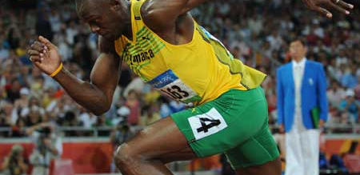

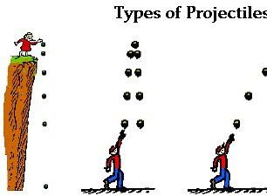
Modelling the Physical World
Accelerated motion
Projectiles: Objects travelling through the air
Impacts & collisions
Objects connected together
Motion in circles

Slide 9
Modelling in a Changing World
Population growth
Carbon dating
Spread of disease
Financial Markets

Slide 10

Written Exam (80%)
Linear Motion: Study of motion in a straight line.
Projectiles: Analysis of objects launched into the air under gravity.
Newton’s Laws of Motion: Applications of force and motion principles.
Circular Motion: Motion of objects in circular paths.
Work, Energy, and Power: Energy transfer and efficiency calculations.
Collisions: Momentum conservation and energy in collisions.
Simple Harmonic Motion: Vibrations and oscillatory motion.
Gravity: Orbital motion and the effects of gravitational forces.
Statics: Equilibrium of forces acting on rigid bodies.
Moments of Inertia: Rotational dynamics.

Slide 11

Exam Format
The exam has 10 Questions to Do 8
So you have loads of Choice

Slide 12

Statistics on Results
Over 41% of Students got a H1 in Leaving Cert Applied Maths

Slide 13


Slide 14

Is Applied Maths for me?
Do I enjoy doing maths?
Am I willing to learn?
If you would like more information, please ask Me or
Email or on Teams

