Slide 1














Leaving Cert
Economics
Mr. Power

Slide 2
What is Economics?
Leaving Cert Economics is concerned with understanding the workings of a modern economy from both a Macro and Micro level.
The course looks at how we get our incomes, how we use them, the supply of resources and the production and exchange of goods and services.

Slide 3


Economics could be for you if….
.
Anyone considering a future career in any area of business, journalism, communications or finance
Students who enjoyed Junior Cert Business.
Students who take an interest in politics, current affairs, or psychology.

Slide 4





Economic Strands
(Overview)
Strand 1
Strand 2
Strand 3
Strand 4
Strand 5
What Is Economics About?
How Are Economic Decisions Are Made
What Can Markets Do ?
Relationship Between Policy and Economic Performance
How Is The Economy Influenced By International Economics

Slide 5
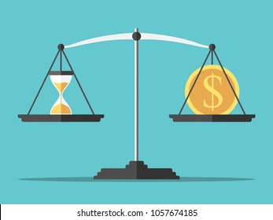
STRAND 1: WHAT IS ECONOMICS ABOUT?
1.1 Economics as a way of thinking
1.2 The economic concepts of scarcity and choice
1.3 Economic, social and environmental sustainability

Slide 6

STRAND 2: HOW ARE ECONOMIC DECISIONS MADE?
2.1 The market economy
2.2 The consumer
2.3 The firm
2.4 Government intervention in the market

Slide 7
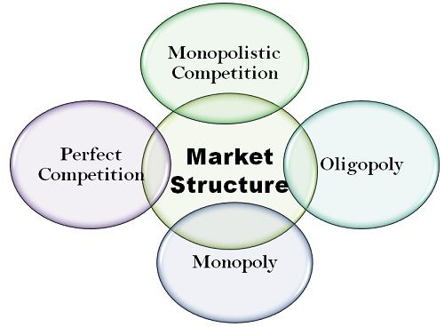
STRAND 3: WHAT CAN MARKETS DO?
3.1 Market structures
3.2 The labour market
3.3 Market failure

Slide 8
STRAND 4: WHAT IS THE RELATIONSHIP BETWEEN POLICY AND ECONOMIC PERFORMANCE?
4.1 National income
4.2 Fiscal policy and the budget framework
4.3 Employment and unemployment
4.4 Monetary policy and the price level
4.5 Financial sector

Slide 9

STRAND 5: HOW IS THE ECONOMY INFLUENCED BY INTERNATIONAL ECONOMICS?
5.1 Economic growth and development
5.2 Globalisation
5.3 International trade and competitiveness

Slide 10

Current Exam Structure (As of 2024)
Short Questions (Approx. 30 Minutes)
In the exam, this is section A of the paper. There are 10 short questions and you are required to answer 8 out of these. There may be internal choice. This section of the paper is worth 100 Marks. (Approx. 12/13 Marks per Question)
Long Questions (Approx. 2 Hours)
In the exam this is Section B of the paper. You will be supplied with 6 questions in total and you are expected to answer 4 (there will not be enough time to attempt any more). Generally, they are split 50/50 with the first 3 focusing on 'microeconomics' and the final 3 focusing on 'macroeconomics’. This section of the paper is worth 300 marks. (Each Question is worth 75 Marks)
.

Slide 11
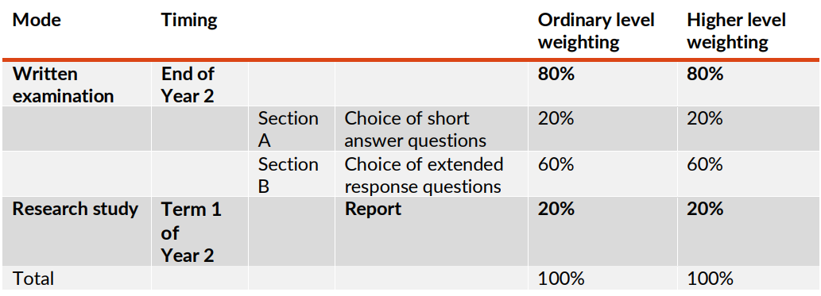
Final Exam:
Current Layout
The exam is 2 hours and 30 minutes and includes two sections: short questions and long questions.

Slide 12
The Research Project
The research study will be based on a brief issued annually by the State Examinations Commission
The Research Study Report is completed during Term 1 of Year 2 (Sixth Year). The research study should take approximately 20 hours to complete over a 6 – 8 week period.
Students are afforded an opportunity to research into and analyse an economic issue, problem or question, to evaluate findings and reflect on their own learning.
Example: How the COVID 19 pandemic has shaped policy in 2020 for sustainable development in Ireland
(The effects on Irish Government finances of COVID 19 from January 2020 to December 2020)

Slide 13
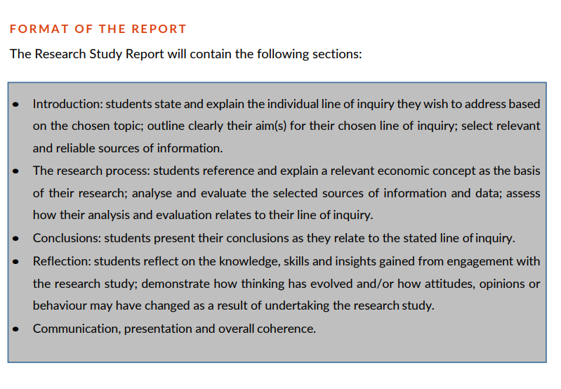
The Project Format

Slide 14

Careers
Banking
Insurance
Finance
Marketing
Politics
Journalism
Current Affairs

Slide 15



Thank you

