Slide 1
LCVP
Leaving Certificate
Transiton Year
LCA
Senior Cycle Options

Slide 2
St Ailbe’s School

Slide 3
Format
Introduction/Overview – Mr Ruaidhri Devitt
Transition Year – Ms Claire Long
Leaving Certificate Applied – Ms Helen Kennedy
Leaving Certificate Established – Ms Edel Merrigan
Leaving Certificate Vocational Program
Subject Outline – Ms Noreen Ryan
Cognitive Ability Testing
Q & A - Ms Noreen Ryan/Ms Edel Merrigan/Ms Helen Kennedy /Ms Claire Long

Slide 4
Routes from Junior Cycle to Senior Cycle
Transition Year then/Or
Leaving Certificate Established
(LCE)
or
2. Leaving Certificate Vocational Program
(LCVP = LCE+ Links Module)
or
3. Leaving Certificate Applied
(LCA)

Slide 5
Transition Year
Ms Claire Long

Slide 6
Leaving Certificate Applied
Ms Helen Kennedy

Slide 7
Leaving Certificate Vocational Program (LCVP)
Leaving Certificate Established with an additional link module - mainly business.
This subject comprises of 2 additional link modules covered over 2 years.
Enterprise Education
Preparation for Work
Students also do work experience as part of this program.

Slide 8
LCVP
Approximately 80% of students nationally use LCVP for CAO Points
Unless you are doing all Higher level subjects and expect to get 500+ points, LCVP is a very worthwhile subject. Those that use it generally increase their points.
Our results – above the national average – better chance of a distinction = 66 points

Slide 9
LCVP Assessment – Exam in may
60% | Students prepare a portfolio of work including a CV, Career Investigation, An enterprise/action plan, a summary report. Pre-corrected
40% Exam | Case Study Question worth approx. 10% students get the case study to prepare before the exam.

Slide 10
Leaving Certificate Established

Slide 11
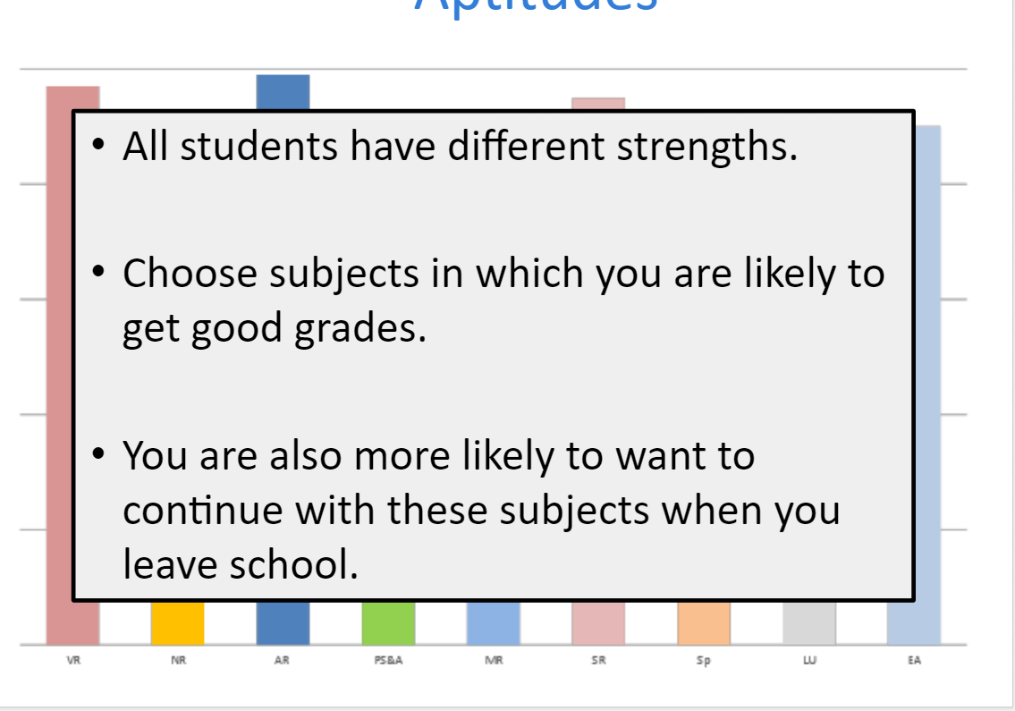
Subject Choice – What to Consider

Slide 12
Students normally take 7 Subjects College Entry based on your best 6 results
English
Irish (Unless Exempt)
Maths
LCVP
+ 4 others

Slide 14
Do You Enjoy The Subject

Slide 19
Percentage of H1 grades vary between subjects

Slide 20
Subject Combination
Project work - substantial percentage of the overall grade.
Ease the burden of studying on students.
Having a practical focus can also add variety to your Leaving Cert subject combination.
Timing of Assessment/Oral can also ease or add to the burden – time management skills.

Slide 22
Specific Subject recommendations
24 SUBJECTS –
3 CORE
LCVP
4/20

Slide 28
We offer French to Leaving Cert.
NUI Universities still require it for some courses such as Medicine and Dentistry
Also to study a course with a language qualification – e.g. Business and French – need to have the language at LC
If you are unsure then take a language

Slide 32
Subject Guides – Careersportal.ie

Slide 33
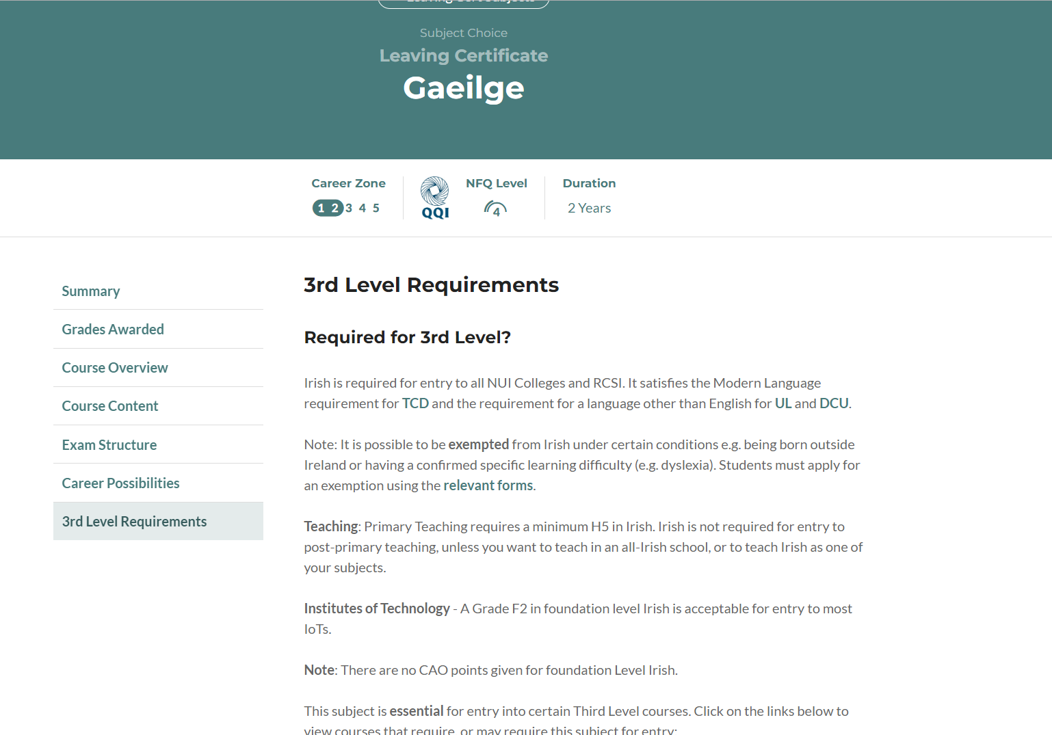

Slide 34
Aptitude testing

Slide 35
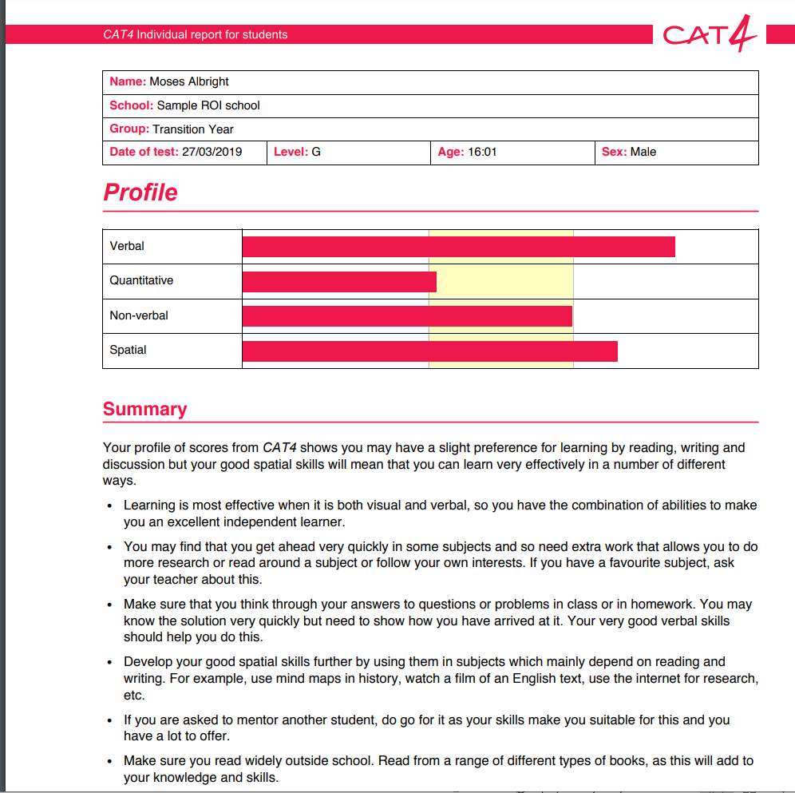
Shapes and Patterns
Shape and Space Togetheer

Slide 37
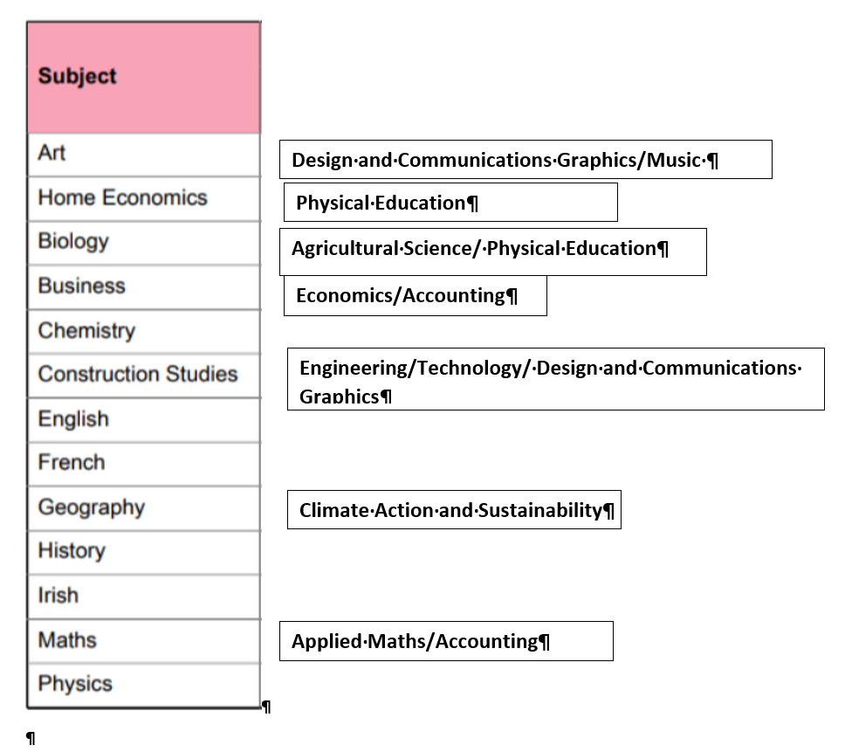

Slide 38
In school supports
Career Guidance Classes from 1st
CAT test with subject recommendations
Subject Choice Exhibition of PowerPoint presentations by a teacher in each subject.
Meet and greet with students doing the subject
Career Guidance In class support and 1:1 support
Speak to any subject teacher

Slide 39
Further Help
Subject Teachers
Guidance Counsellors
Other Pupils
Qualifax.ie
Careersportal.ie
CAO.ie
Employees in the job you are interested in

