Slide 1



Leaving Certificate Irish

Slide 2
Exam Layout
Leaving Cert Irish is examined through an oral exam and a written exam.
The oral exam is worth 40%.
The written exam (2 papers) is worth 60%.
The oral exam is done around Easter of 6th year.

Slide 3
Scrúdú Cainte – Oral Exam
40% of your overall result
Easter of 6th year
Breakdown:
Comhrá (conversation), Filíocht (poetry), Sraith Pictiúr (picture sequences)
12-15 minutes.

Slide 4
Litríocht - Literature
5 poems – HL and OL
5 prose (stories) - HL and OL
Drama/Novel - Higher Level only

Slide 5
Páipéar 1 – Paper 1
Ardleibhéal - Higher Level
I – An Chluastuiscint (Aural/Listeing) - 60 marc
II – An Cheapadóireacht (Composition/Essays) - 100 marc (answer 1)
Gnáthleibhéal - Ordinary Level
I – An Chluastuiscint (Aural/Listeing) - 60 marc
II – An Cheapadóireacht (Composition/Essays) - 100 marc (answer 2x50 –100 marc)

Slide 6
Páipéar 2 – Paper 2
Ardleibhéal - Higher Level
I - Léamhthuiscint (Reading Comprehension) - 100 marc (2x50)
II - Prós (Prose/Stories) - 30 marc
III - Filíocht (Poetry) - 30 marc
IV - Litríocht Bhreise (Drama/Novel) - 40 marc

Slide 7
Páipéar 2 – Paper 2
Gnáthleibhéal - Ordinary Level
I - Léamhthuiscint (Reading Comprehension) - 100 marc (2x50)
II - Prós (Prose/Stories) - 50 marc (2x25)
III - Filíocht (Poetry) - 50 marc (2x25)

Slide 8
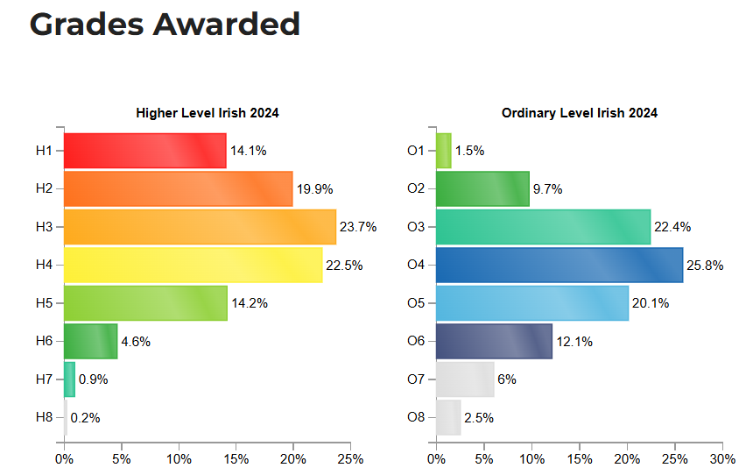

Slide 9
Bonnleibhéal - Foundation Level
Oral – 40%
4 blocks of set questions. 8-10 minutes.
Written Exam – 60%
There is 1 written exam. There are no prescribed poetry or prose (stories) in the Founation Level course.
The paper consists mostly of Reading Comprehensions and One listening section.

Slide 10
Míle buíochas
Please don’t hesitate to ask any Irish teacher if you have any further questions.

