Slide 1

LC MUSIC
SUBJECT CONTENT

Slide 2

Why study music ?
Students can get up to 50% of the total marks in the musical activity that best suits their talent before they even sit the written paper.
Develop your creativity and knowledge in this area and continue your studies in a wide range of colleges.

Slide 3

MARKING THE EXAM
There are 400 marks available in total for the entire LC Music exam at both Higher and Ordinary Level.

Slide 4
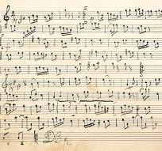
LC MUSIC – THE EXAM
TWO SECTIONS :
Written paper - 50%
Practical exam - 50%

Slide 5
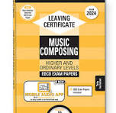

EXAM STRUCTURE (Higher and Ordinary)
Examined in June in 6th year
PAPER 1
LISTENING PAPER 25%
90 minutes duration
6 questions on paper
Four set works Q 1 – 4
Irish music Q 5
General listening skills Q 6
Paper 2
COMPOSITION 25%
90 minutes duration
Two questions on paper
Melody writing
Harmony

Slide 6
THREE MAIN COMPONANTS in music performing/composing/listening
HIGHER ORDINARY
PERFORMING 100 MARKS- 25%
COMPOSING 100 MARKS - 25%
LISTENING 100 MARKS - 25%
Electives for extra 25% (HL only)
Choose one from the following :
PERFORMANCE ELECTIVE:
COMPOSITION ELECTIVE:
LISTENING ELECTIVE:
PERFORMING 100 MARKS - 25%
COMPOSING 100 MAKRS - 25%
LISTENING 100 MARKS - 25%
Ordinary Level do not take an elective.
The highest mark gained in the listening , composing, practical will be doubled to make up the remaining 25 % or 100 marks.

Slide 7
PRACTICAL - PERFORMANCE
Examined in 6th year normally around Easter
Candidates may perform as a soloist or as part of a group or both.
Examples:
Solo singing/group singing, solo instrumental/group instrumental,
Music technology
Rehearsing and conducting a musical group
Improvisation

Slide 8

Electives (higher level only ) what’s involved ?
Choice – performance/listening/composition
PERFORMANCE ELECTIVE
50% of the marks are awarded by April.
Higher level: can choose one activity from the following :
One activity : 6 pieces of your choice marked at higher level.
Or
2 activities example 4 pieces on one instrument/voice and 4 on another
Or
4 on one instrument/voice and music technology

Slide 9

UNPREPARED TEST -
Sight reading
Aural memory
Improvisation

Slide 10
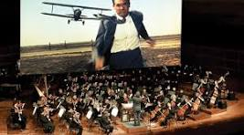

Career Possibilities
Sound engineering
Media studies
Teaching
Film
Music Production
Games
Music and the Performing Arts
Composition
Music at third level
Music Technology

