Slide 1

Leaving Certificate
Applied

Slide 2
Leaving Certificate Applied Programme
Preparation for adult and working life – Work Exp.
Recognition of a range of talents
Active Learning
Interaction with community and employers
Classroom based assessments - tasks
Access to further education and training

Slide 3
Leaving Certificate Applied Programme
Preparation for adult and working life – Work Experience 1 day per week.
Recognition of a range of talents
Build their CV through practice and certified courses
Completion of key assignments Yr1 & Yr2
Access to further education and training

Slide 4
Course Design
Sessions (4)
Sept to Jan and Feb to June
Modules
  Approx. 10 modules per session
  Total: 40 modules
Student Tasks
7, over 4 sessions

Slide 5
Modules
Maths
English & Communications
Ag. Science
Science
2 Languages –French/Irish
Arts
Leisure & Recreation
Graphics & Construction
ICT
Social Education
Vocational Preparation Task
Personal Reflection Task

Slide 6
Assessment
Attendance/ Participation – 90%
Continuous Assignments
External Examiner Interviews – Tasks
Final Exams

Slide 7
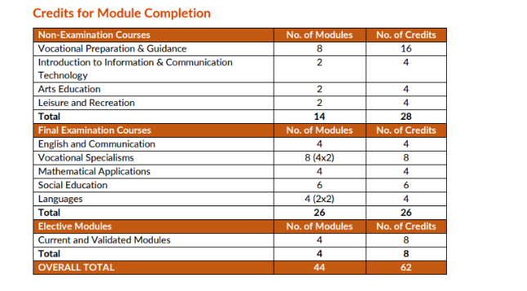
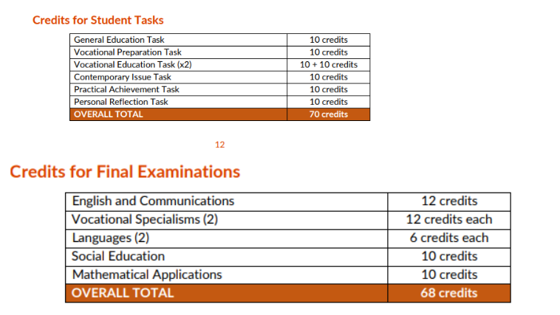
Breakdown of Assessment and Credit allocation

Slide 8
Certification
Pass……………. 60%-69%
Merit…………… 70%-84%
Distinction….. 85%-100%

Slide 9

Tipperary ETB Further
Education Courses
Over the last two years, St Ailbe’s and Tipperary ETB have collaborated to create opportunities for students to engage in meaningful learning opportunities.
By allowing students to participate in courses run by Tipperary ETB
This allows students to enhance their CV by attending these courses
Certified courses
Insight into the various courses and opportunities out there once they leave secondary school
Enhances opportunities to engage in areas of interest through their work experience

Slide 10
Tipperary ETB Further
Education Courses Pathways
Constructions Skills Certificates –
Location: Tipperary FET College, Constructions Skills Training Centre, Tipperary Town
Content:
Introduction to Health & Safety,
Interactive Demonstrations (Drylining and Plastering),
Information talk on Progression Options through FET and Apprenticeships.
Manual Handling certificate ,
Abrasive Wheel Training certificate,
Hospitality and Culinary Arts – Tipperary FET College/LC Pathways
Location: Tipperary FET College, Thurles – Archers town
Content:
Culinary Arts: Coffee House Confectionary,
Introduction to Barista,
Primary Food Safety Certificate (HACCP)
Safe Pass certificate
First Aid certificate

Slide 11

Career Progression
Students from LCA have gone on to Further education courses and Third Level colleges.
Students have also joined local apprenticeship courses
Post Leaving Certificate (PLC) course
Tipperary ETB Further Education Training courses.
Limerick College of Further Education
Completion of PLC and continued their studies in Munster Technological University (MTU)

Slide 12
Interview
LCA 2025/2026
Students must undertake an interview prior
to being accepted on the course
One Month Probation period

Slide 13
Leaving Certificate
Applied

