Slide 1

Leaving Cert PE
An Introduction to the Course

Slide 2

Assessment
Written Exam 50% (Higher or Ordinary Level)
Physical Activity Project (PAP) 20% (Higher or Ordinary Level)
Performance Assessment Video (PAV) 30% (Common Level)

Slide 3
5th Year We will be concentrating on the Exam Content
6th Year we will be completing your PAP and PA

Slide 4

6th Yr Work That We Need to Talk about NOW

Slide 5
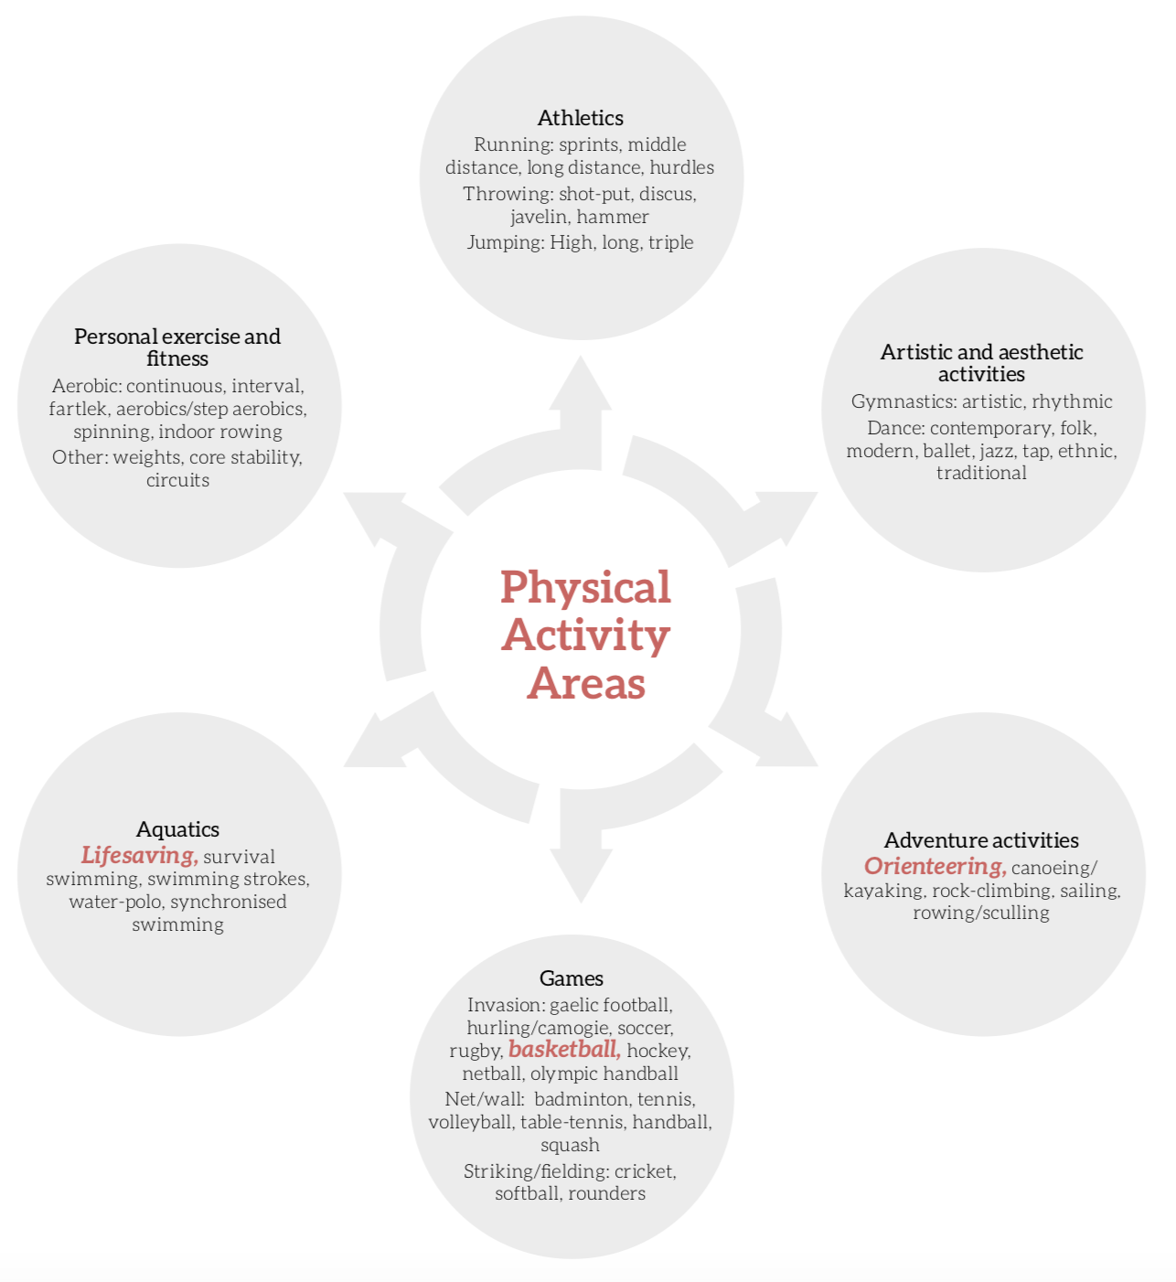
The Strands of Physical Activities for PAP and PAV
Choose an activity from one of these strands that you are most knowledgeable in.
Now choose a second one from a different strand for backup

Slide 6
What the PAP looks like…..
You will do this in the activity that you are most knowledgeable in.
PAP
Analysis of How you Perform
Setting Goals
Practice/Training
Results
Video 1
Video 2
Video 3
+ 1600 word document
Type in Word document

Slide 7
What the PAV looks like…
You must provide an 8-minute video on how you perform in one of these activities.
    Association Football (Games Strand)
    Circuit training and Fartlek training (Personal Exercise and Fitness Strand)
    Middle Distance Running (Athletics Strand)
The Catch…..your chosen activity for your PAV cannot be in the same strand as your chosen activity for your PAP.
That is why I asked you to pick a backup activity
EG: If you have chosen the discus for your PAP you cannot choose the 100m sprint for your PAV as they are in the same strand.

Slide 8

Back to 5th Year and Exam Content

Slide 9
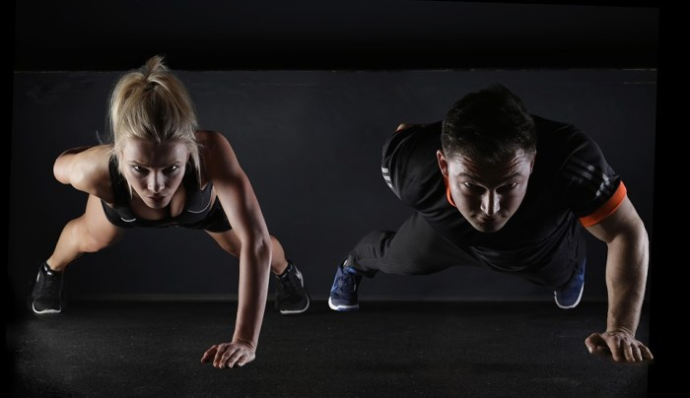
The Two Strands of Exam Content
These will be studied in 5th year and revised briefly before your exams in 6th year.
Strand 1:
Making Our Way Towards Optimum Performance
Strand 2:
Relevant Contemporary Issues in Physical Activity

Slide 10
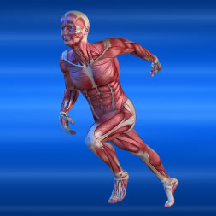
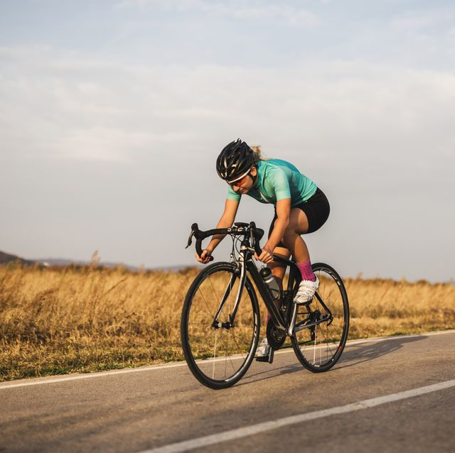
Strand 1
How the body moves- Muscles/Bones/Ligaments/Tendons
Skilled Performance & the Acquisition of Skill
Analysing Skill & Technique
Physical Demands of Performance
Principles of Training
Psychological Preparation for Performance
Diet and Nutrition
Analysing Performance in Sport
Safe Practice in Sport
The Role of the Coach & Officials
Planning for Optimum Performance
WHAT TOPICS ARE COVERED IN THE THEORY CLASSES?
Time table for LCPE
40mins x 3
Double Practical Class

Slide 11
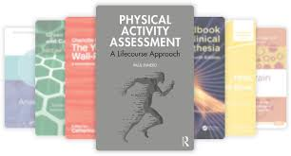
WHAT TOPICS ARE COVERED IN THE THEORY CLASSES?
Strand 2-
Contemporary Issues in Physical Activity
Physical Activity Participation
Promoting Physical Activity and Pathways to Excellence
Ethics and Fair Play
Physical Activity and Inclusion
Technology, Media and Sport
Gender and Physical Activity
Business and Enterprise in Physical Activity and Sport

Slide 12
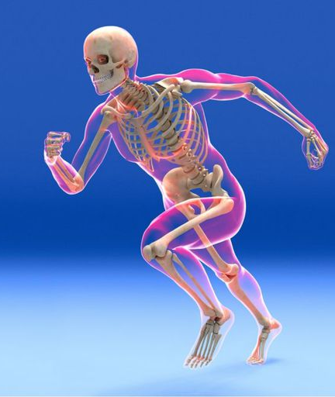
Strand 1: Making Our Way Towards Optimum Performance
Intro:
How the Body Moves
The Muscular System
The Skeletal System

Slide 13

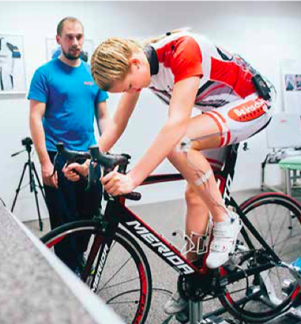
Strand 1 Topics (Making Our Way Towards Optimum Performance)
Topic 1:
Skilled Performance and the Acquisition of Skill
Analysing Skill and Technique

Slide 14



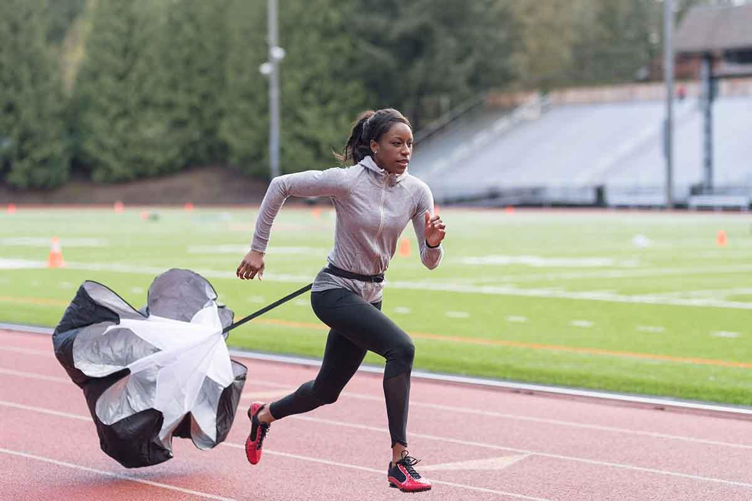
Strand 1 Topics (Making Our Way Towards Optimum Performance)
Topic 2:
Physical Demands of Performance
Principles of Training
Psychological Preparation for Performance
Diet and Nutrition

Slide 15
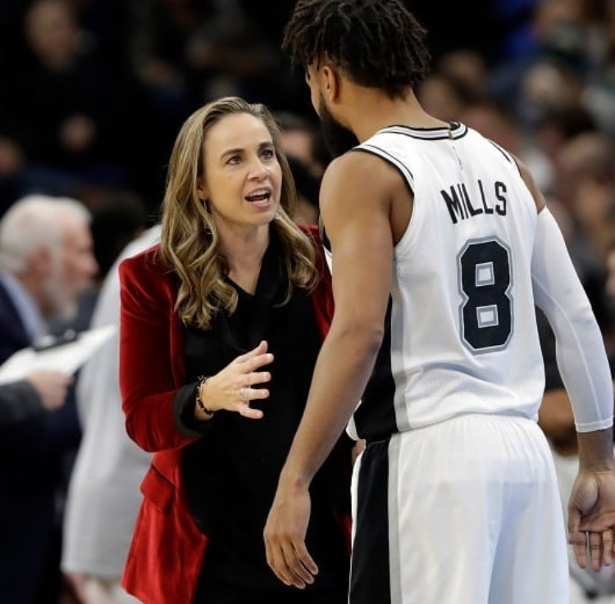
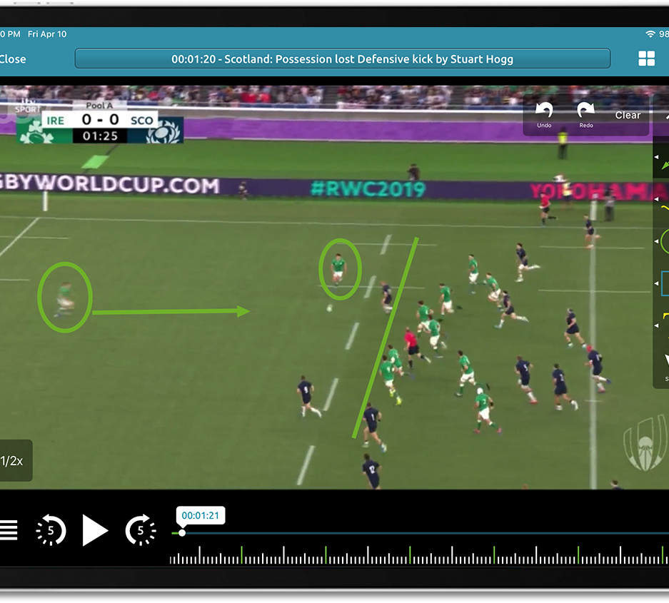
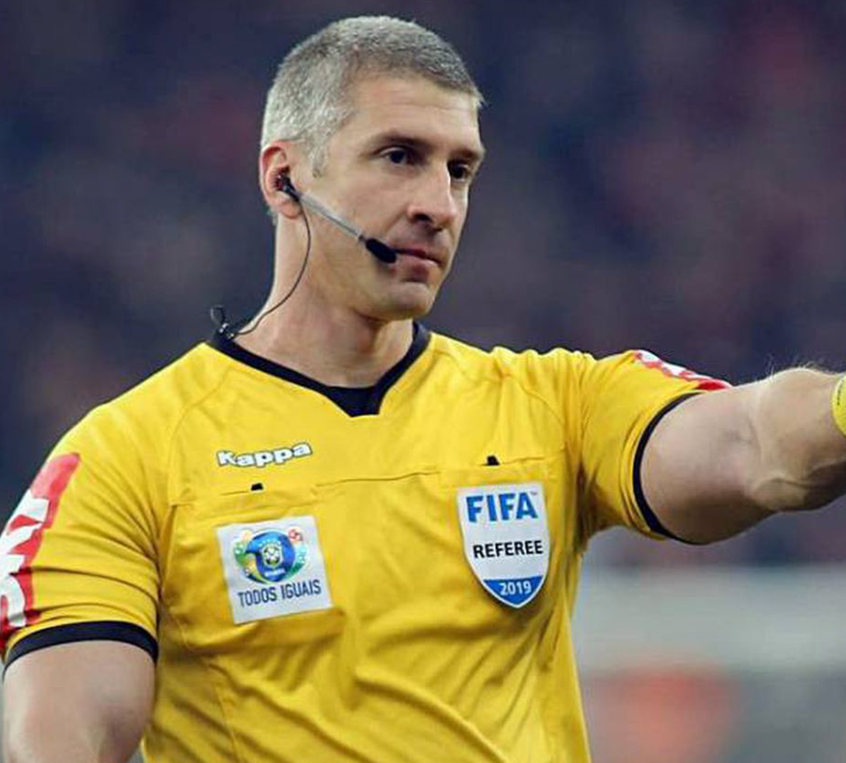
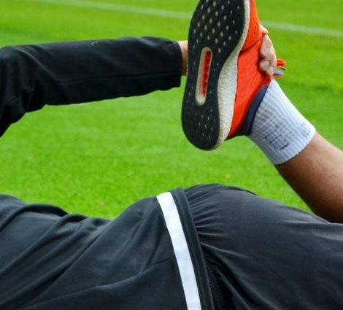
Strand 1 Topics (Making Our Way Towards Optimum Performance)
Topic 3:
Analysing Performance in Sport
Safe Practice in Sport
The Role of Coach and Official

Slide 16
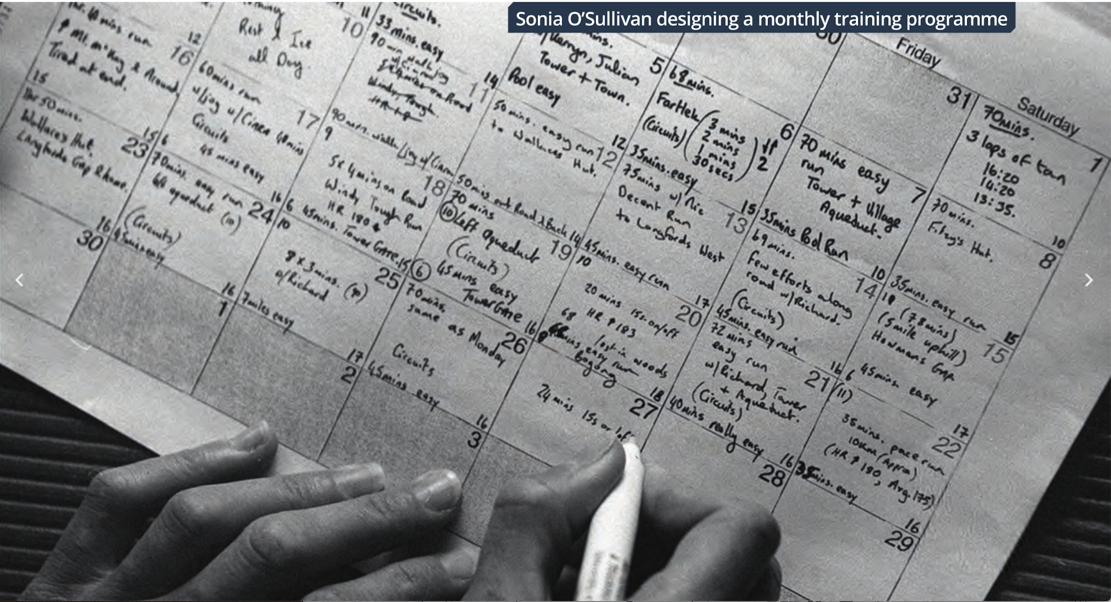
Strand 1 Topics (Making Our Way Towards Optimum Performance)
Topic 4:
Planning for Optimum Performance

Slide 17
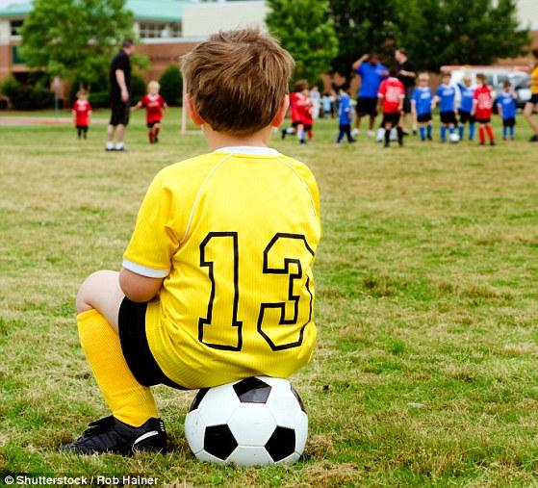
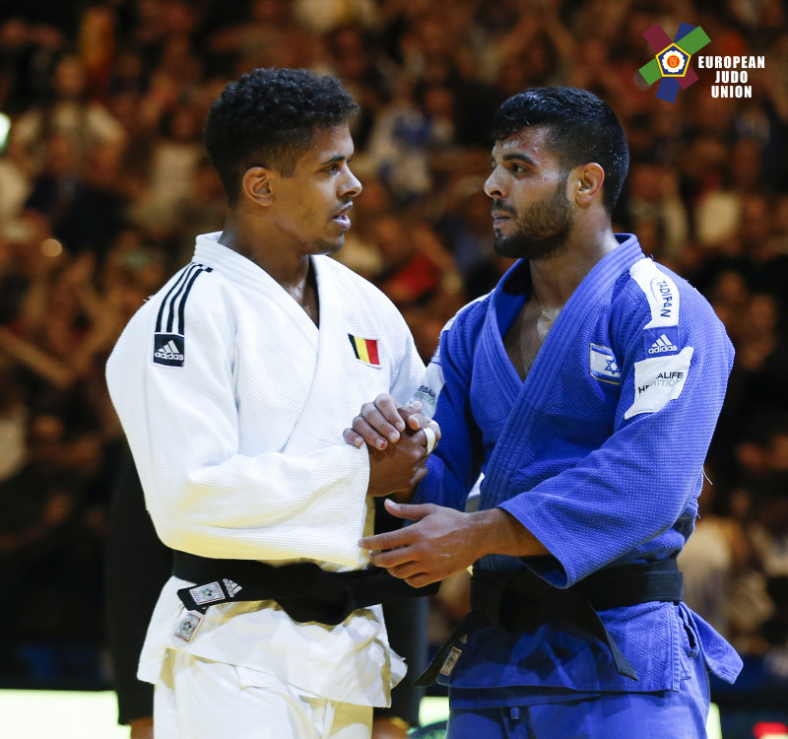

Strand 2: Relevant Contemporary Issues in Physical Activity
Compulsory Topics
Topic 1:
Participation in Physical Activity
The Promotion of Physical Activity and Building Pathways to Excellence
Topic 2:
Ethics and Fair Play in Sport

Slide 18

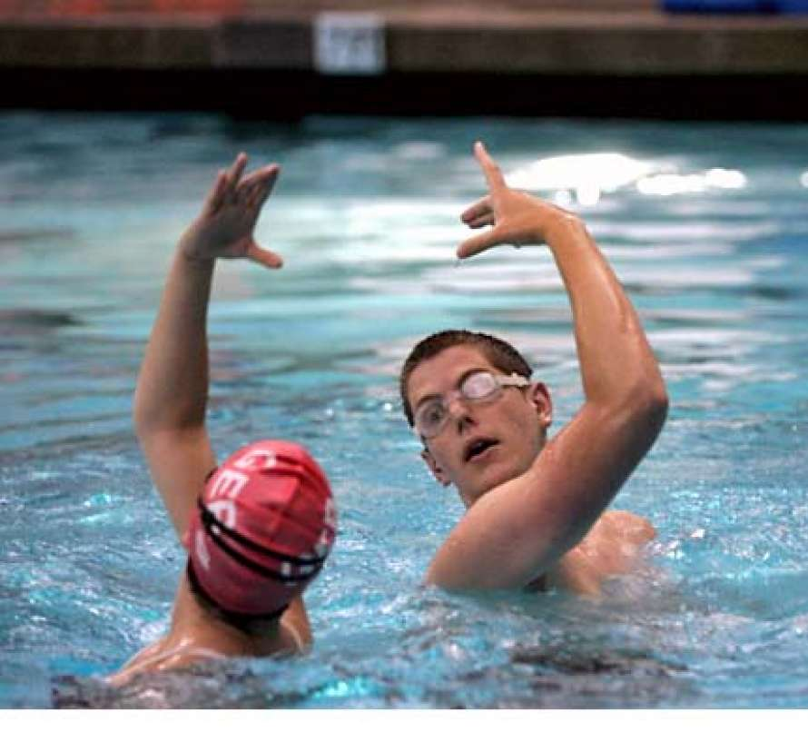
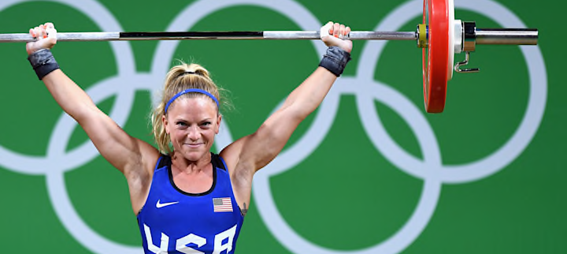
Strand 2 Topics (Relevant Contemporary Issues in Physical Activity)
Topics That Change Every 2 Years (You study the 2 topics that are prescribed to you)
Topic 3: Inclusion in Physical Activity
Topic 4: Technology, and Media in Sport
Topic 5: Gender in Physical Activity
Topic 6: Business and Enterprise in Physical Activity in Sport

Slide 19
What do we already know?
Competition time!
In groups of 3
Name of as muscles as possible.
(2 mins)
The Muscular System
The Skeletal System

