Slide 1

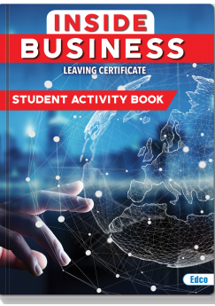

Leaving Cert Business

Slide 2

Why study Business for your Leaving Certificate
Business is a very beneficial subject for anyone interested in pursuing a career in:
1. Finance
2. Enterprise
3. Law
4. Communications
5. Marketing
6. HR

Slide 3
What type of students should study Business
Students who have an interest in current affairs and what is happening in the business world
Students who are willing to and enjoy learning keywords and definitions. The course is very factual and requires a lot of learning containing only a few mathematical elements
Students who have an organised mind and like answering questions in bullet point format rather than in long essay format
Students who have studied Business Studies for their Junior Certificate

Slide 4
Course Content
There are 7 Units on the Leaving Cert Business course.
Unit 1: People in Business
Unit 2: Enterprise
Unit 3: Management 1
Unit 4: Management 2
Unit 5: Marketing
Unit 6: Domestic Environment
Unit 7: International Environment
Each year, specific units are selected which will be studied in preparation for the ABQ (Applied Business Question).

Slide 5
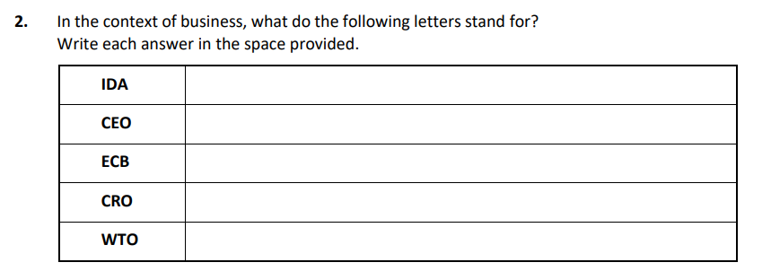
Exam breakdown:
Section 1: Short Questions (80 marks)
Answer 8/12 questions
Each question is worth 10 marks
Short questions equate to 20% of the exam

Slide 6
Exam Breakdown:
Section 2: Applied Business Question (ABQ)
- This question is worth 80 marks which equates to 20% of the exam
- The units for Leaving Certificate students in 2027 are 4, 5 and 6.

Slide 7
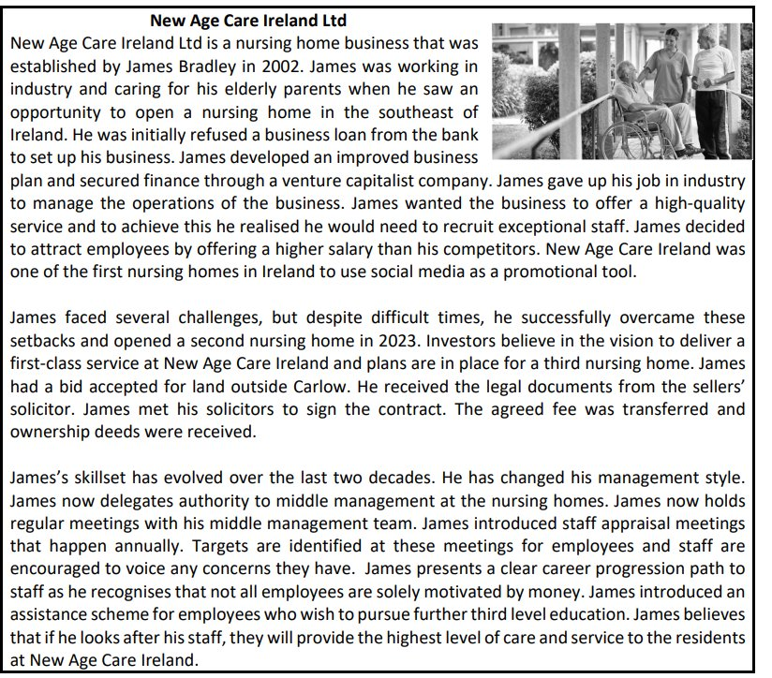

Slide 8
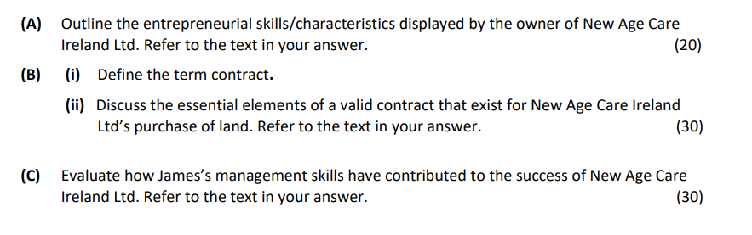

Slide 9
Exam Breakdown:
Section 3: Long questions
You must answer 4/8 long questions
Each question is worth 60 marks which is 240 marks, equating to 60% of the exam

Slide 10
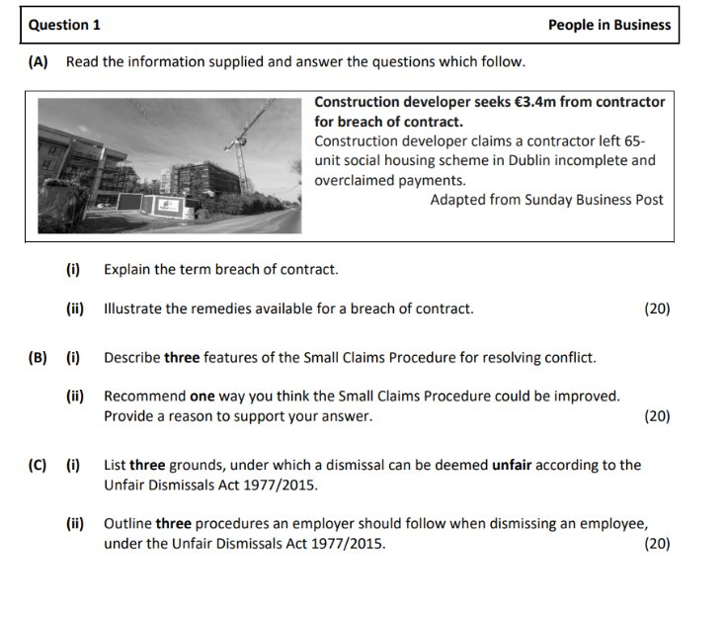

Slide 11
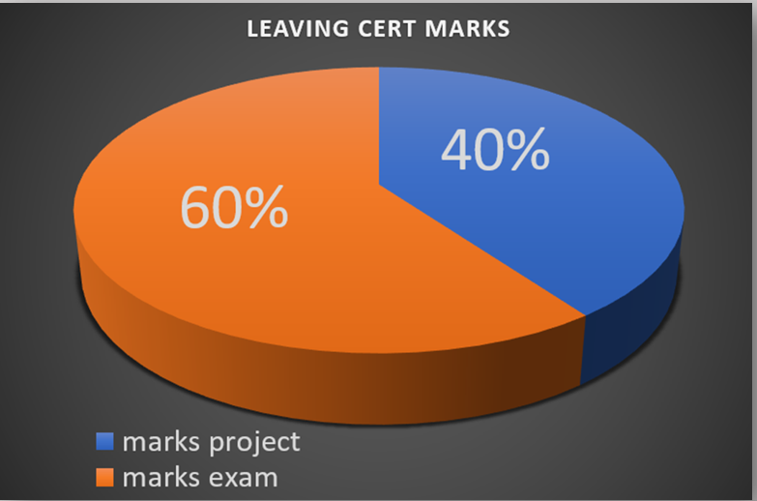
Leaving Cert Reform: Business 2025
Business written paper will now be worth 60% of your overall grade.
Business Alive Investigative Study will be worth 40% of your overall grade.
The brief for this project will be issued by the State Examinations Commission in Term Two of 5th year. Students will work on their Investigative Study over a period of up to 20 hours. This project will be submitted in 6th year.

Slide 12
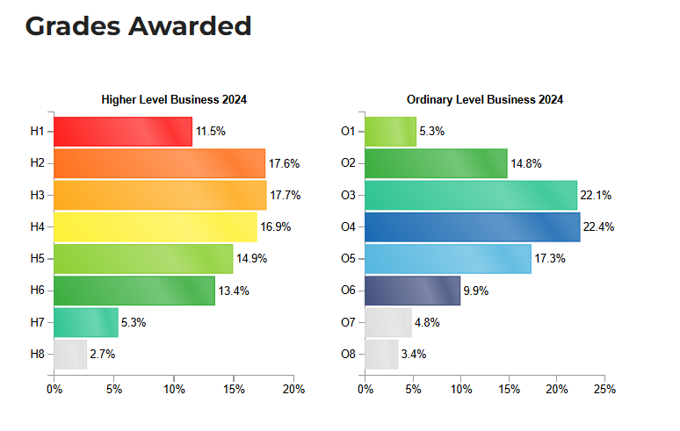
Grades awarded in 2024

