Slide 1




Leaving certificate Technology
Mr. Ryan and Mr. Roche

Slide 2
Overview
In Leaving Certificate Technology, students apply their knowledge and skills creatively in a design-based approach to solving everyday technological problems while being mindful of the impact on natural resources and on the environment.
The syllabus comprises of core areas of study, which are mandatory, and five optional areas of study, from which students choose two.
Leaving Certificate Technology is assessed at two levels, Ordinary level and Higher level, by means of an examination paper and a student project.

Slide 3
Differences between lc and jc Technology
The main difference between Leaving Cert and Junior Cert Technology is that the Junior Cert is studied at common level while Leaving Cert is split into both Higher Level and Ordinary Level.
Another notable difference is the progression of the subject. The Junior Cert course introduces students to basic design, problem-solving and practical skills while the Leaving Cert expands theses concepts into more advanced areas of Engineering, Design and Innovation.
Exam structure and breakdown is also significantly different and there is weighted more so towards theory than the Junior Cert.

Slide 4
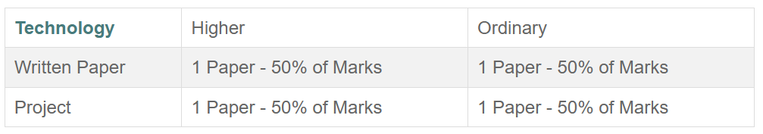
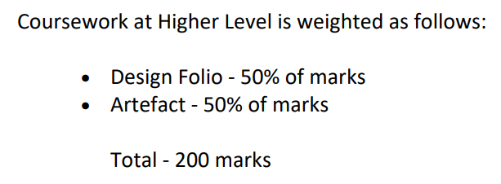
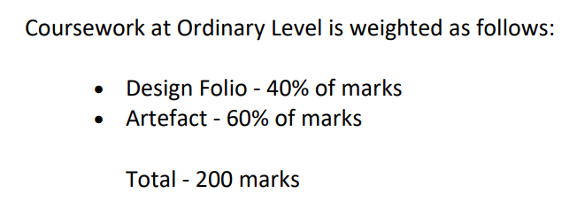
Leaving Cert Technology Exam structure
This is compared to a common level Junior Cert structure where the project is worth 70% and the exam is worth 30%.

Slide 5
Why Study Technology?
This subject aims to boost a student's ability to apply knowledge and skills to evaluate technology.
Technology will help you to solve many of the technological problems you may experience in everyday life.
This subject teaches you to think about a problem and then use your knowledge and skills to design a solution to that problem.
It will teach you skills in the use of basic tools and equipment.
You will also be able to identify many different types of materials and have a basic understanding of electronic circuits and gear systems.

Slide 6
What kind of student would technology suit?
Students do not need to have taken Technology at Junior Cert to do this course. It would however be an advantage if students had taken one of Technology, Woodwork, Graphics or Engineering as this subject consolidates, extends and refines knowledge, skills and techniques acquired at Junior Cert level in these subjects.

Slide 7
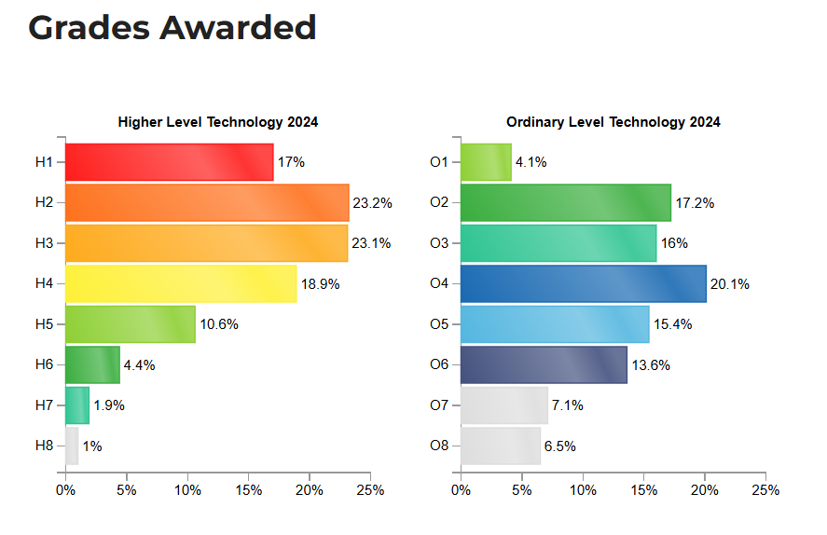
Grades awarded for Technology in 2024

Slide 8
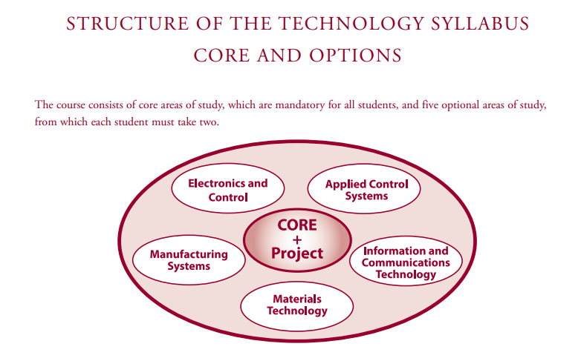

Slide 9
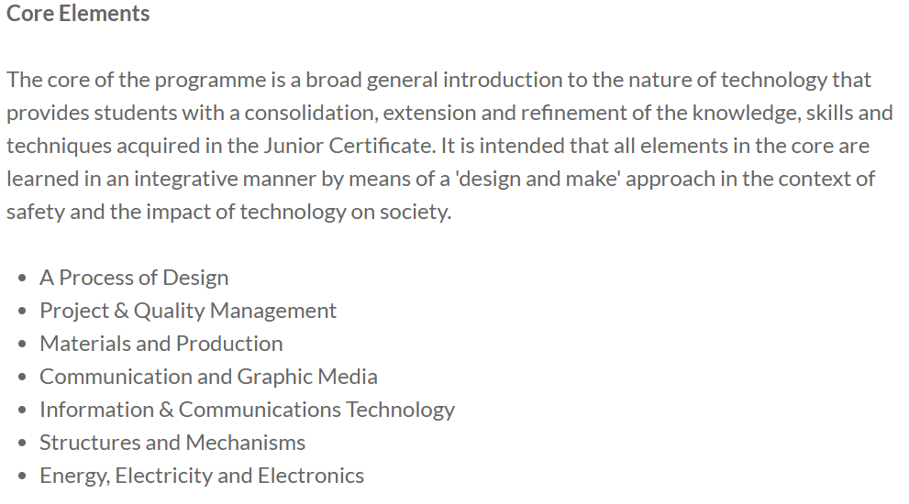

Slide 10
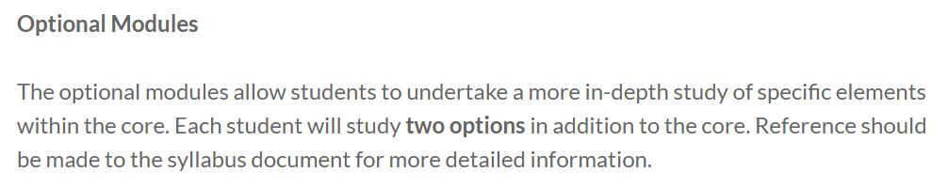
The 5 optional module out of which students will have to study any 2 are as follows:
Electronics and Control
Applied Control Systems
Information and Communication Technology
Manufacturing Systems
Materials Technology

Slide 11
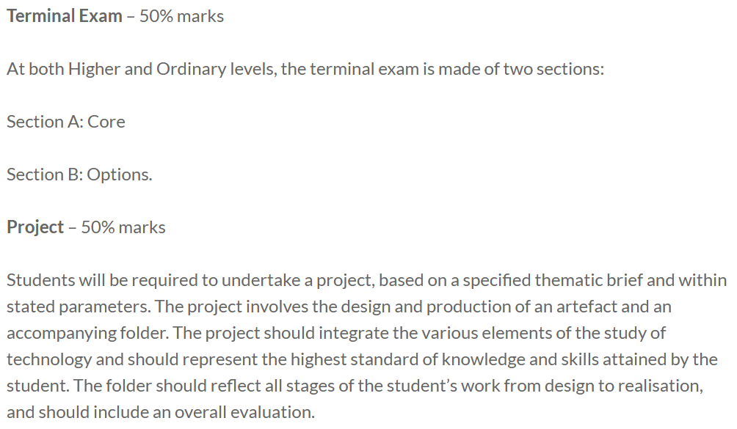

Slide 12
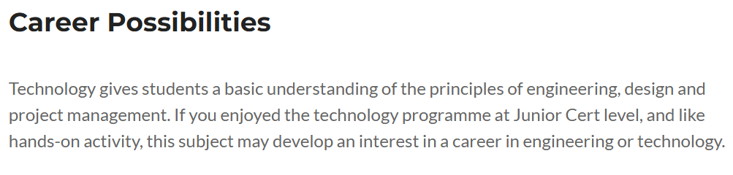
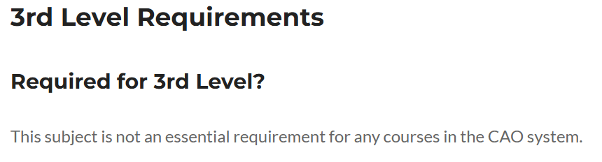

Slide 13
PREVIOUS Leaving cert PROJECT EXAMPLES

Slide 14
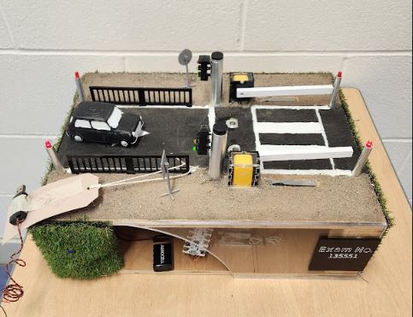

Slide 15
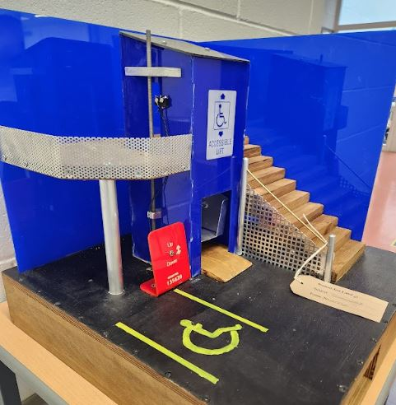

Slide 16
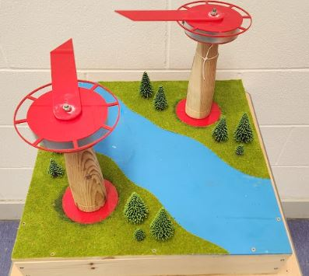

Slide 17
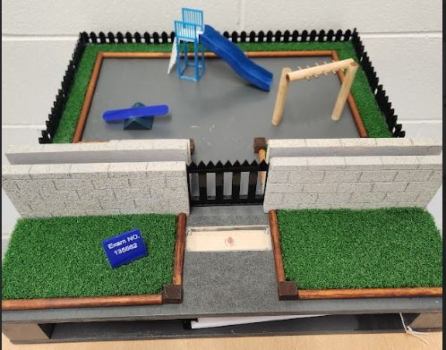

Slide 18
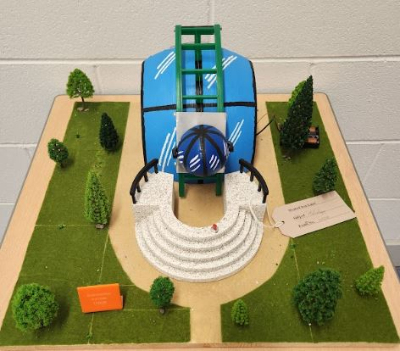

Slide 19
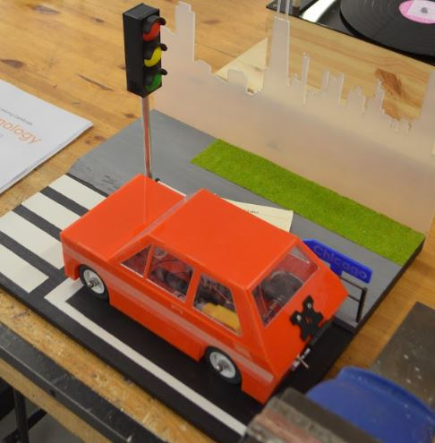

Slide 20
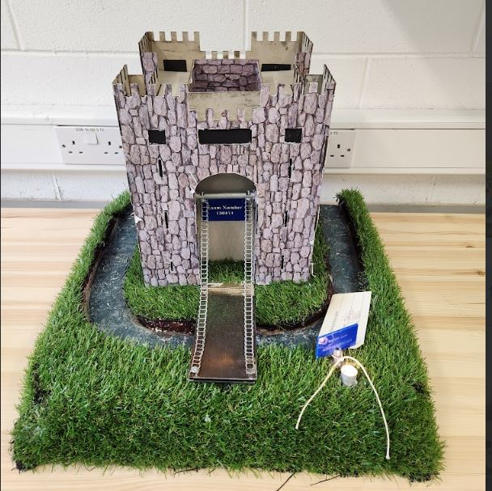

Slide 21
If you have any questions or queries about technology for leaving CERT, FEEL FREE TO CALL INTO ONE OF THE PRACTICAL CLASSROOMS AND INQUIRE.

