Slide 1
Leaving Certificate Biology

Slide 2
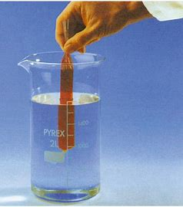
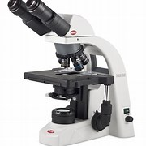
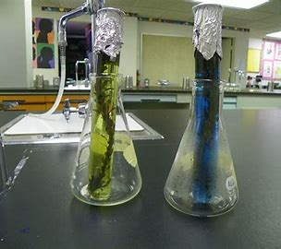
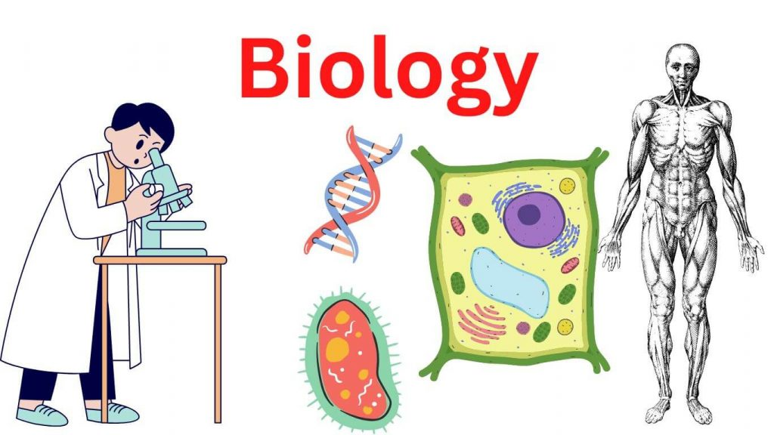
Biology is the study of living things

Slide 3
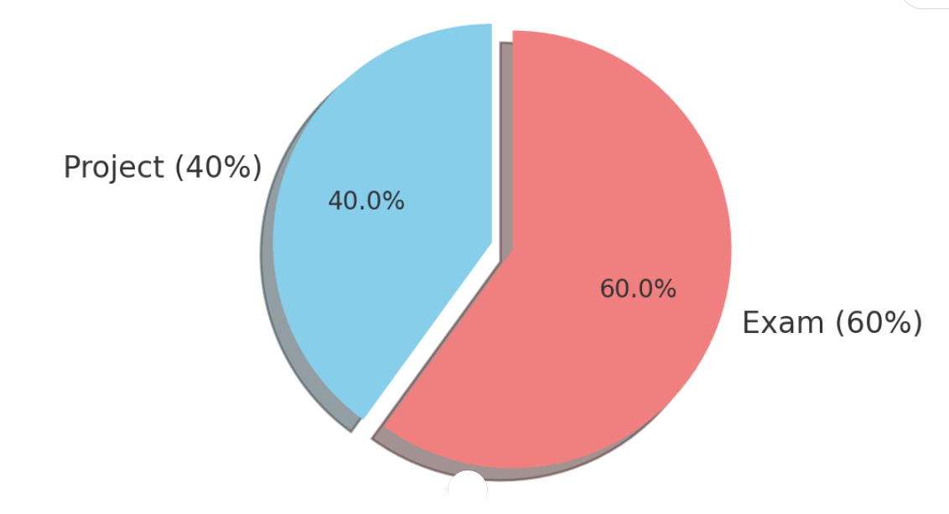
EXAMINATION SPLIT
40% Project. Receive a brief with guidelines and must carry out experiment to satisfy the brief and guidelines.
60% Final Exam. This is a combination of short answer questions, experimental questions and long answered questions.

Slide 4
Biology overview
There are 3 units in leaving certificate biology. Each unit contains many different sub units and chapters.
The study of life
The cell
The organism.

Slide 5
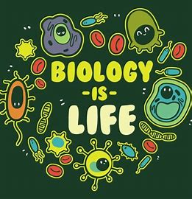
1- The study of life
The scientific method
The characteristics of life
Nutrition
Principles of ecology
Eco System study

Slide 6
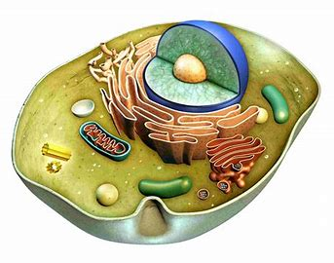
2- The cell
Cell structure
Cell metabolism
Cell continuity
Cell diversity
Genetics

Slide 7
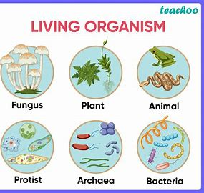
3 -The organism
Diversity of the organism
Organisation and vascular structures
Transport and Nutrition
Breathing system and excretion
Response to stimuli
Reproduction and growth

Slide 8
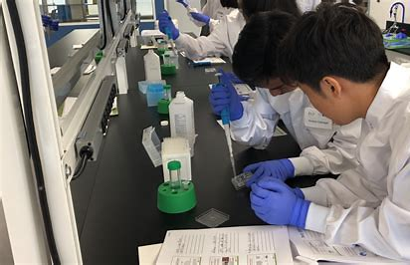
Experiments
Currently there are 22 practical activities that students must carry out.
Experimental questions appear every year in the biology paper.

Slide 9
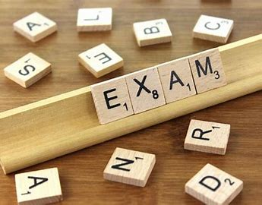
THE EXAM
Currently the Biology exam layout is:
Section A – Answer 5 out of 7 questions. (100 marks)
Section B – Answer 2 out of 3 Experiment questions (60 marks)
Section C – Answer any 4 of 7 long questions. (240 marks)
Overall 400 marks.

Slide 10
The PROJECT
In term 2 of 5th year students will receive an investigative brief from the SEC.
This allows students to develop their own thinking and ideas on areas they would like to explore in relation to the brief. Students will design an appropriate investigation to explore this particular area.
Students are also required to carry out scientific research and an experiment on an issue within the brief.
Students will receive headings and guidelines (word count) for their experimental write up and will receive guidance from their teacher.
Students will design their own investigation.

Slide 11
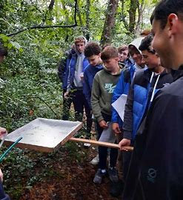
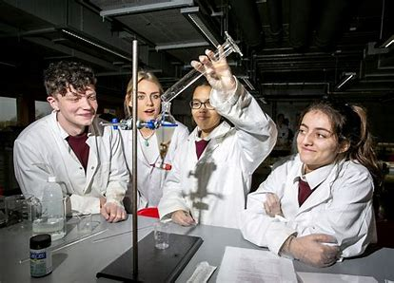
BIOLOGY TRIPS
In 5th year students get the opportunity to go on an ecology fieldtrip. This gives students the opportunity to gain a real hands on insight into the world of science outside the classroom by investigating ecosystems and habitats.
In 6th year students go on a day trip to the University of limerick where they will set up and carry out experiments on the syllabus. This provides students the opportunity to revise experiments and also working with others and learning from each other.

Slide 12



FURTHER EDUCATION
Biology is a huge stepping stone for many third level courses. Furthermore it is often a specific requirement for some courses.

