Slide 1

Leaving Certificate Engineering
Mr. Doherty, Mr. Doyle, Mr. Roche

Slide 2
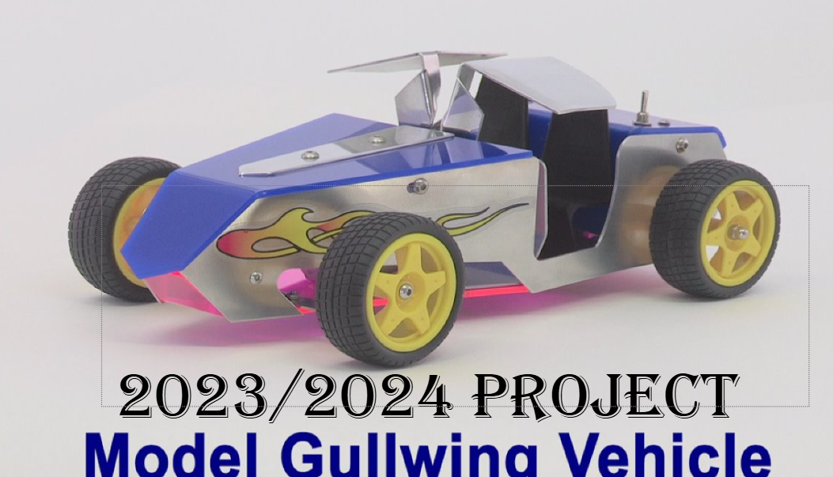
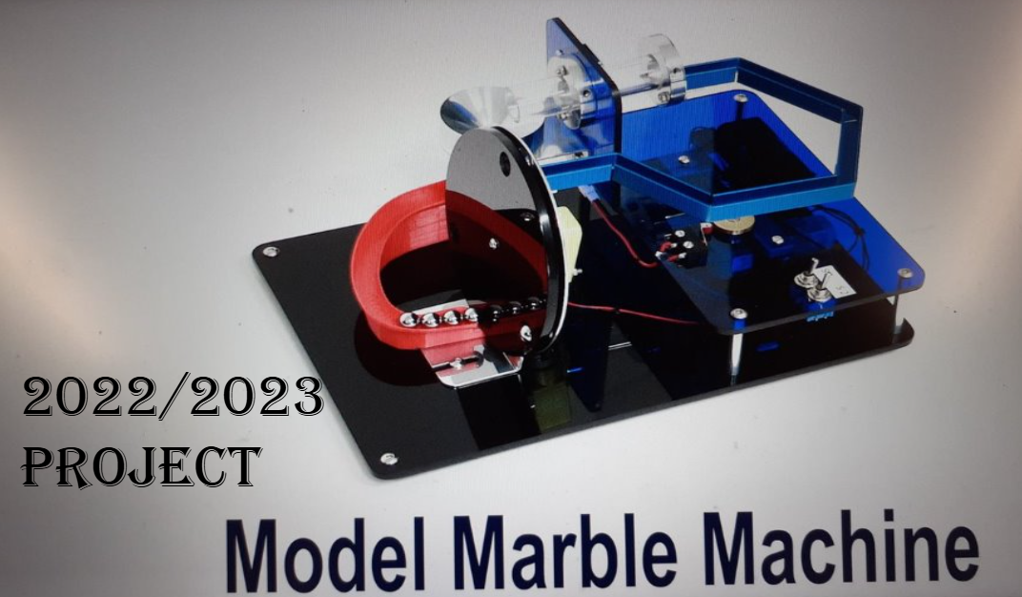
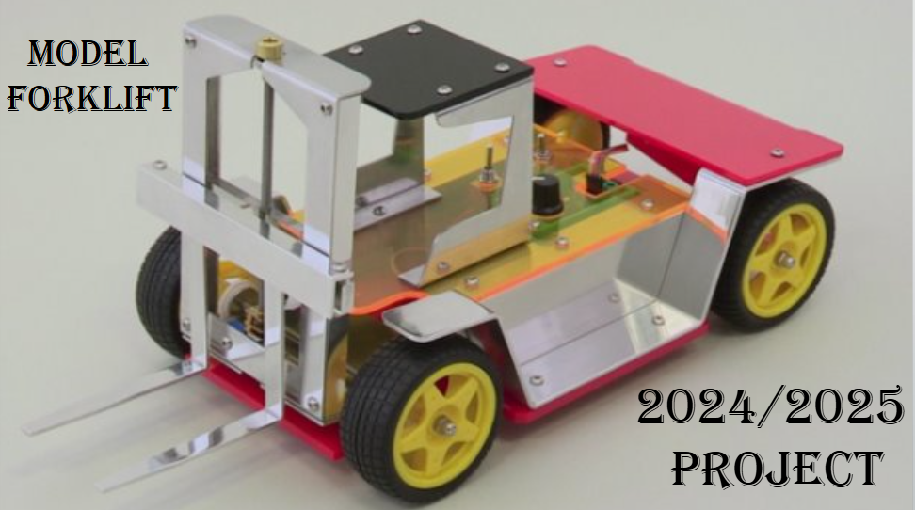
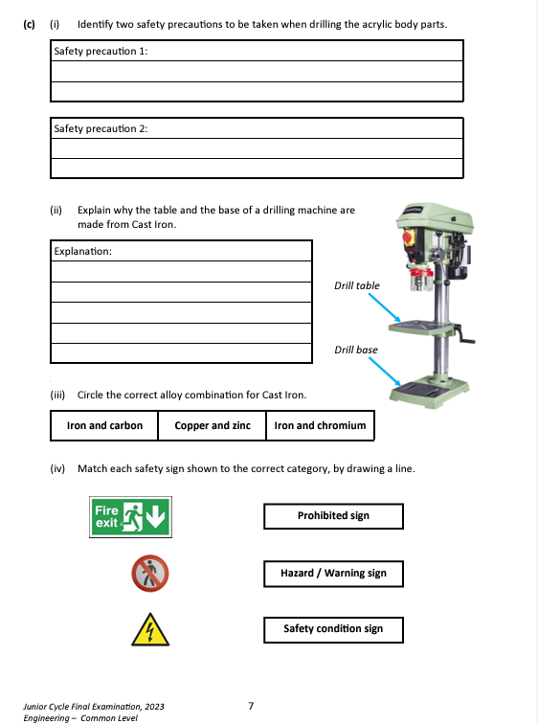
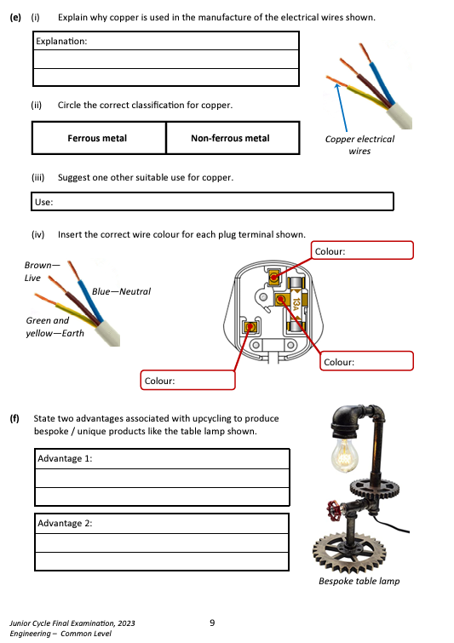
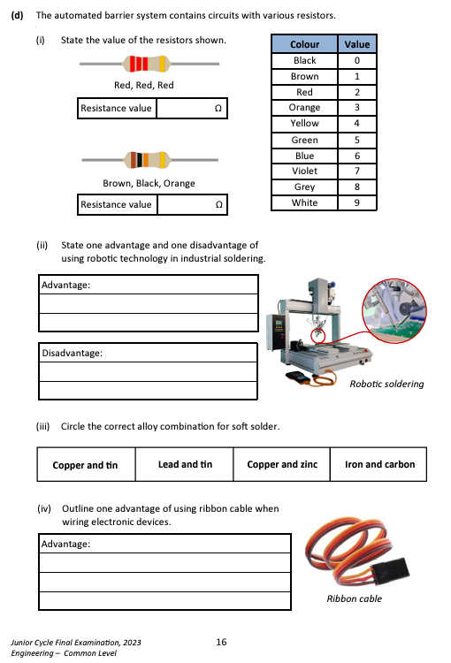
Junior cycle Engineering (Common level)
Project work 70%
Theory exam 30%
1hr 30mins
Variety of topics

Slide 3
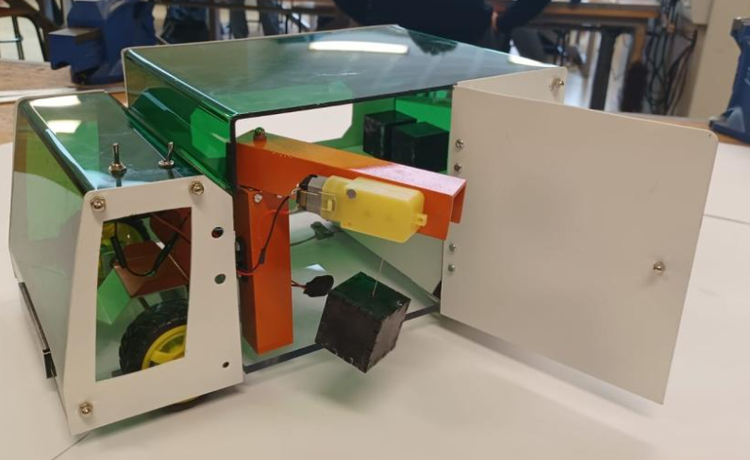
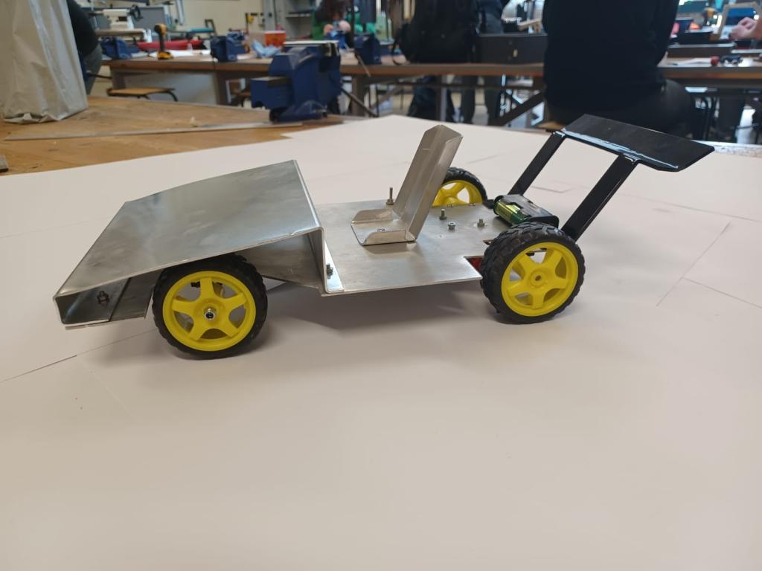
Leaving Certificate
The main change from junior cycle is there is Two different levels Higher level and Ordinary level
The subject is still practical and theory based.
V
Ordinary Level
Higher Level

Slide 4
Higher Level
Engineering

Slide 5
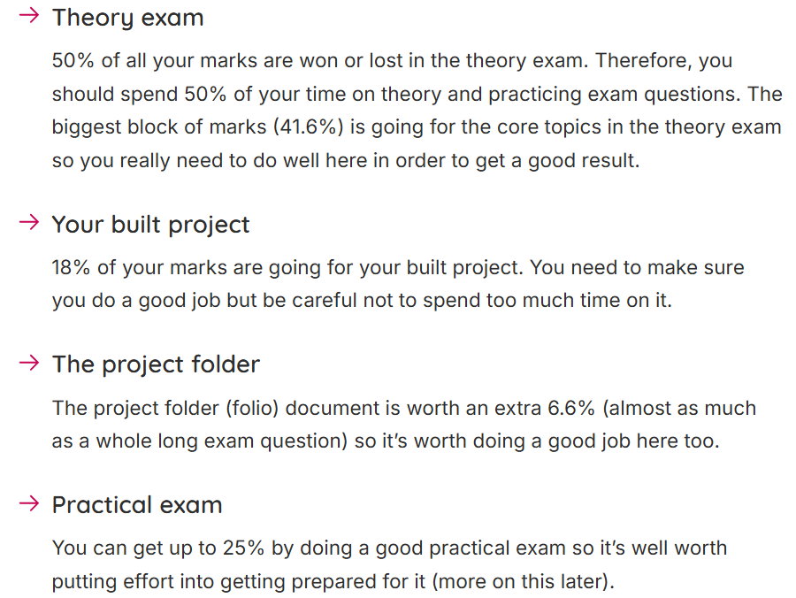
Higher level Engineering
50% of the subject is already completed before exam in June

Slide 6
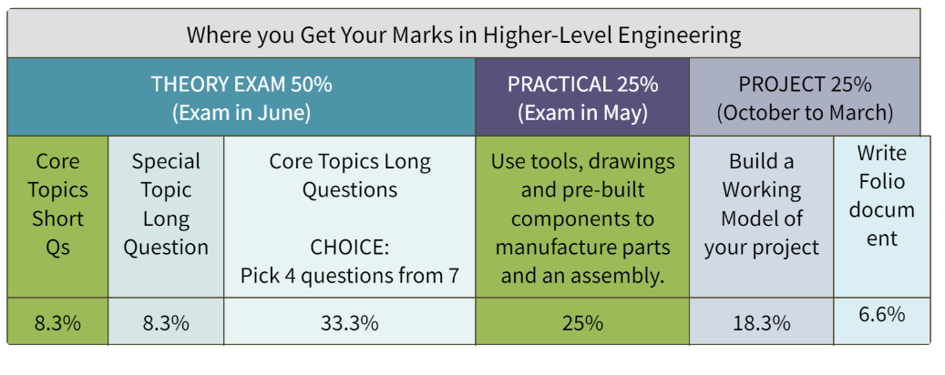
Higher level Engineering
50% of the subject is already completed before exam in June

Slide 7
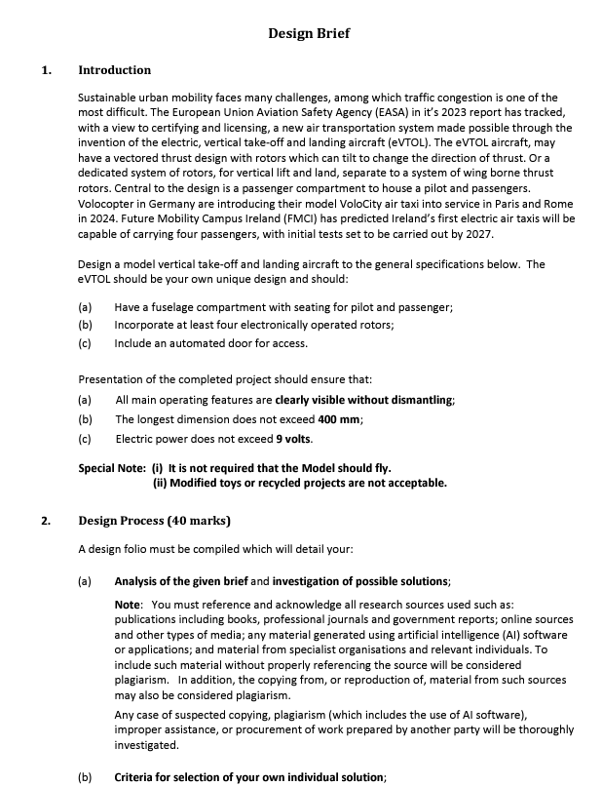
Higher level Project (25%)
Given a brief and make a project that meets the criteria of the brief.
Brief changes every year
You have until October until March to make the project
Project 18.3%
Folder for project 6.7%
Overall this is 25%

Slide 8
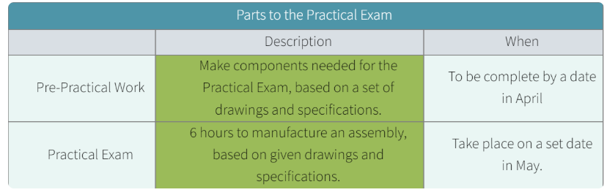
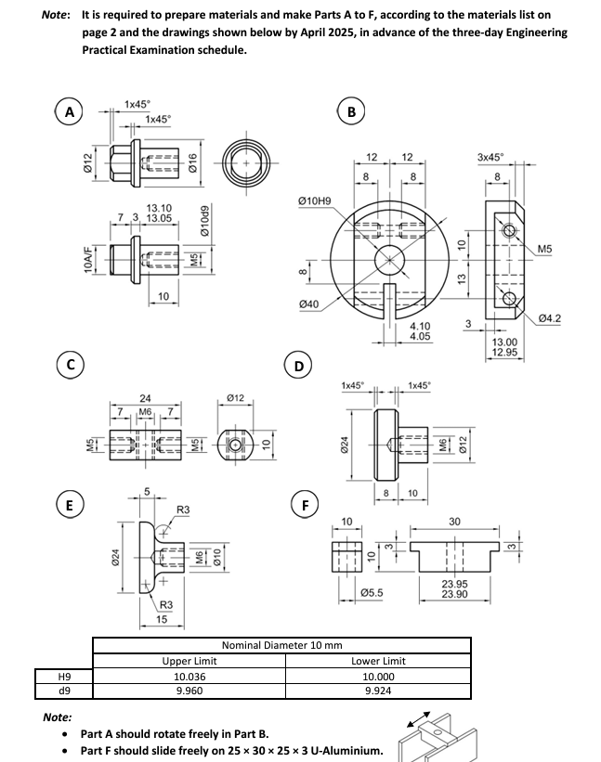
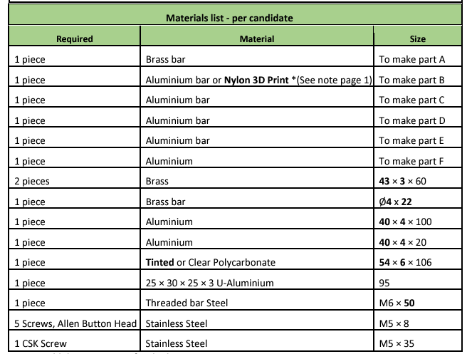
Practical exam (25%)
Practical exam is common both higher and ordinary complete same practical exam
Pre practical work takes place usually between September –October before the project come out and any outstanding pieces are finished after the project is completed.
6 hours to manufacture the day exam with a break in the middle.

Slide 9
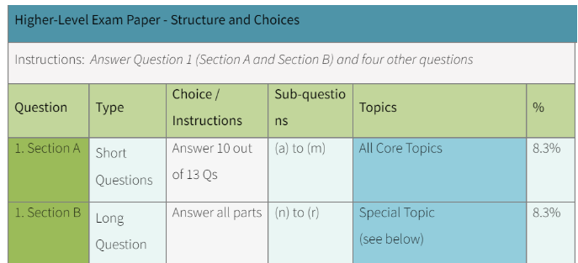
Higher level exam paper- Structure and Choices

Slide 10
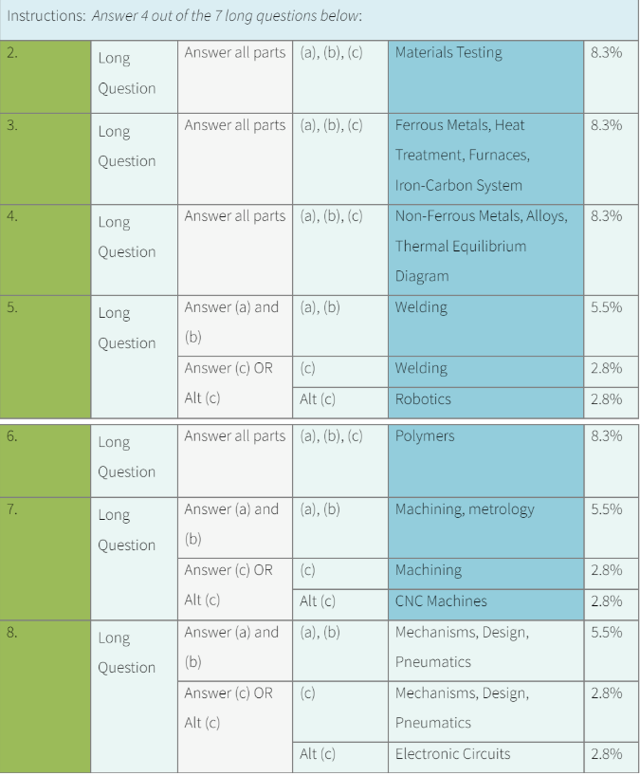
Higher level exam paper- Structure and Choices

Slide 11
Ordinary Level
Engineering

Slide 12
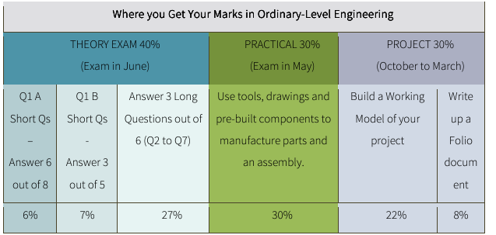
Ordinary level Engineering
60% practical 30% Project and folder
30% Practical exam
40% theory exam

Slide 13
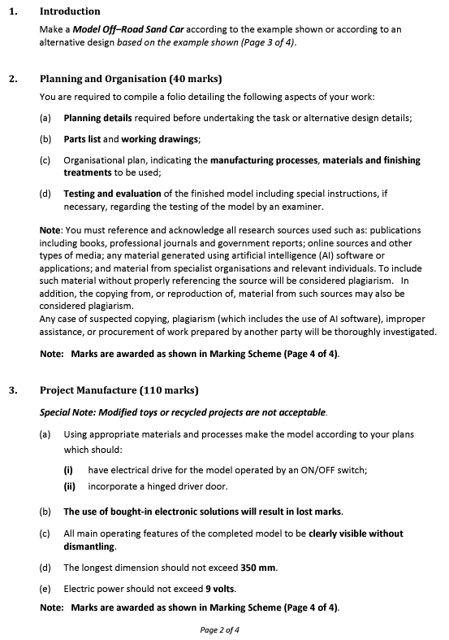
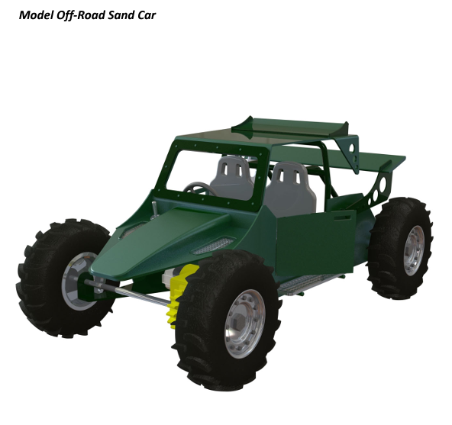
Ordinary level Project (30%)
Given a brief and make a project that meets the criteria of the brief.
Brief changes every year
Ordinary level given picture in brief
You have until October until March to make the project
Project 22%
Folder for project 8%
Overall this is 30%

Slide 14
Practical exam (25%)
Practical exam is common both higher and ordinary complete same practical exam
Pre practical work takes place usually between September –October before the project come out and any outstanding pieces are finished after the project is completed.
6 hours to manufacture the day exam with a break in the middle.

Slide 15
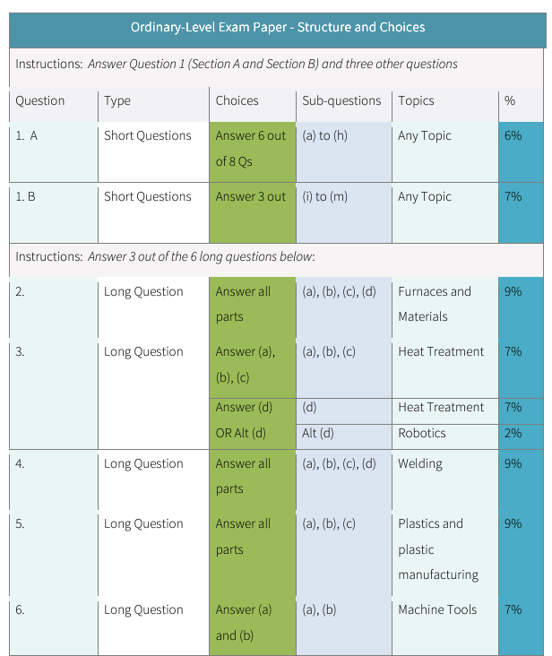
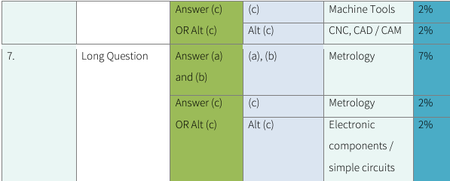
Ordinary level exam paper- Structure and Choices

Slide 16
To summarise LC Engineering
Ordinary Level Engineering
60% practical 30% Project and folder
30% Practical exam
40% theory exam
Up to 60% can be achieved before sitting exam in June
Higher Level Engineering
50% practical 25% Project and folder
25% Practical exam
50% theory exam
Up to 50% can be achieved before sitting exam in June
If you have any questions feel free to call in to the engineering room email or send an email to mdoherty@ailbes.com

