Slide 1
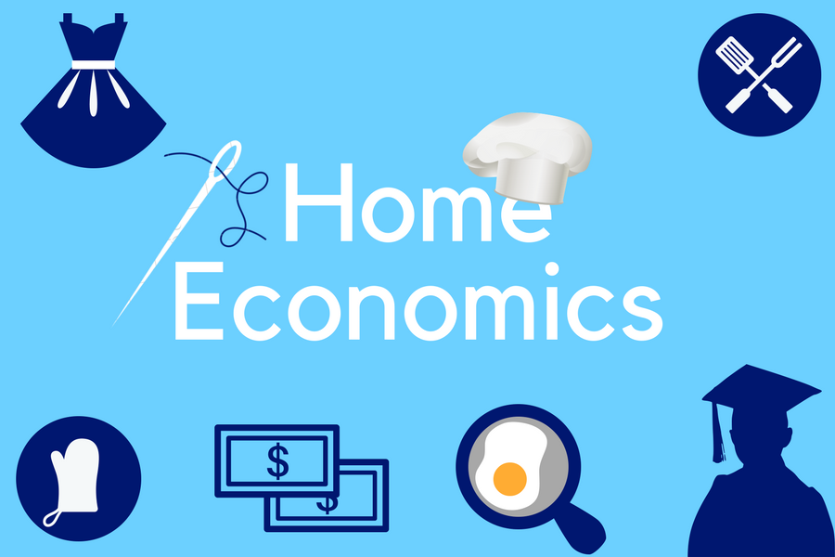
Leaving Certificate

Slide 2
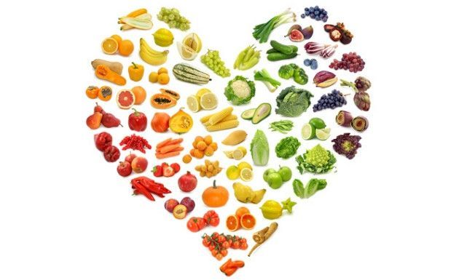
What is home economics?
Home Ec teaches practical life skills and knowledge focused on nutrition, well-being, resource management, and the relationships between individuals, families, and society.

Slide 3
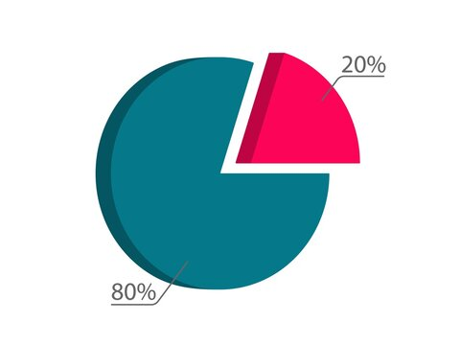
Structure of the course
Written paper: 80%
Coursework journal: 20%

Slide 4
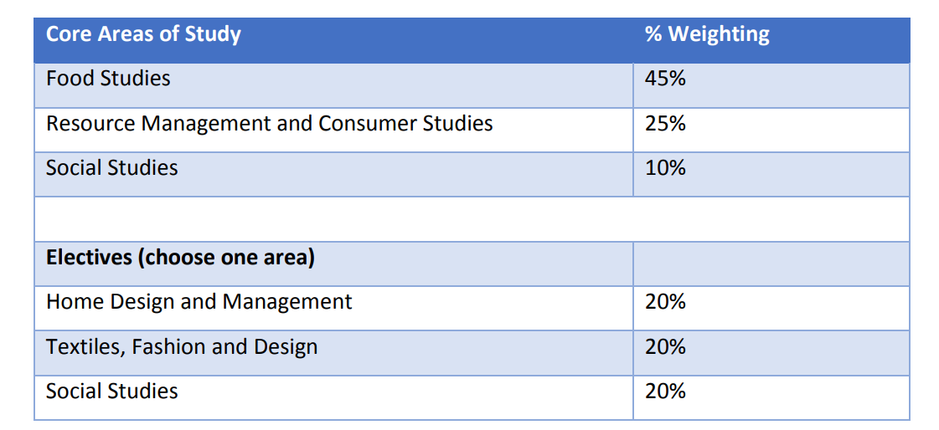
Written paper (80%)

Slide 5
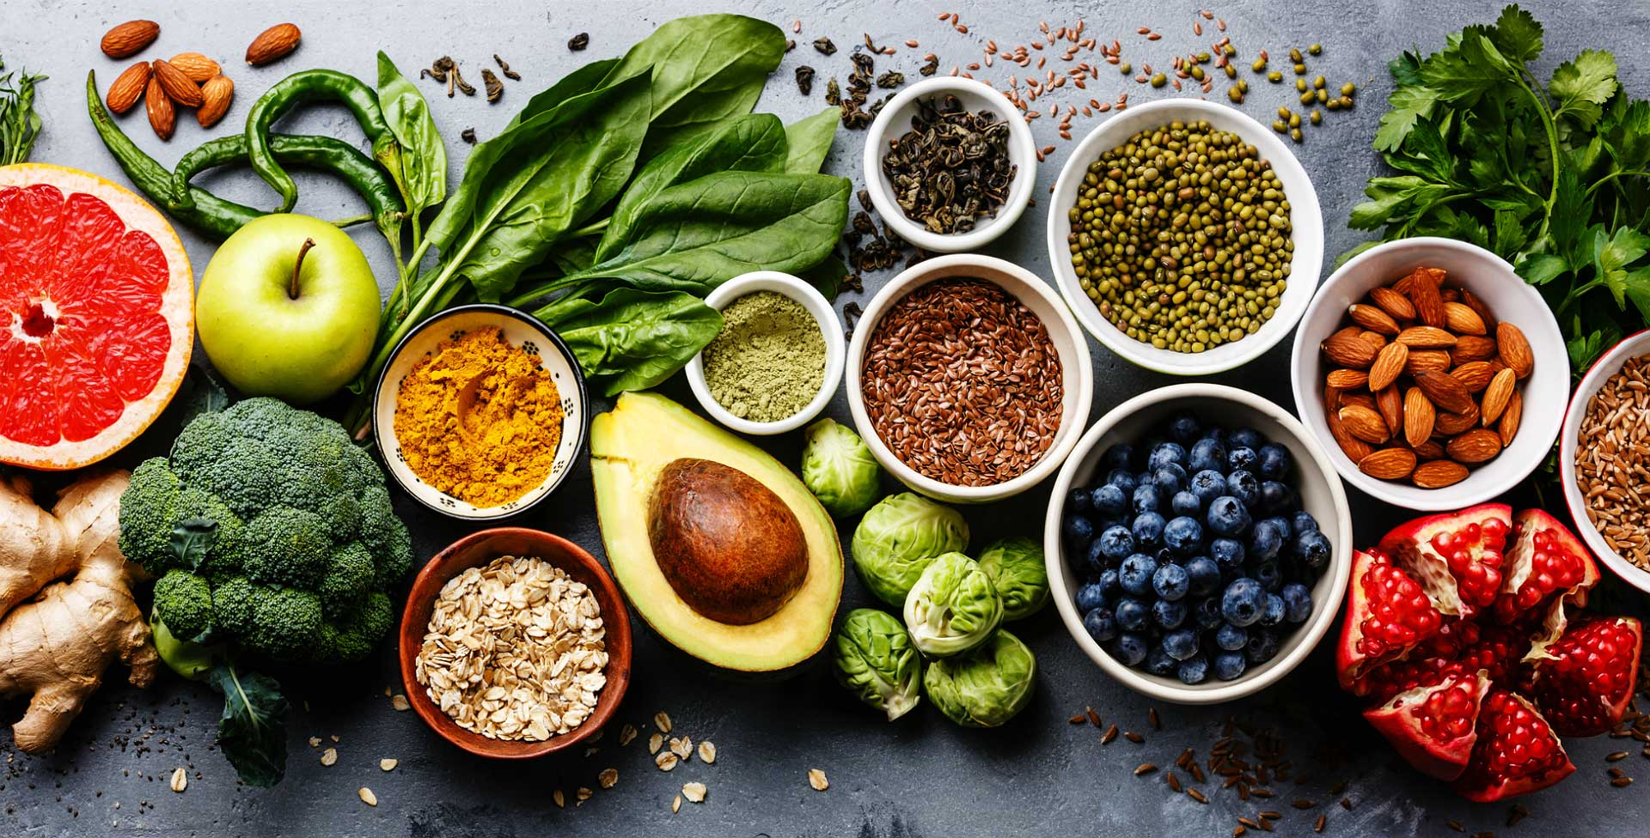

Food studies (45%)
Food science & nutrition (nutrients, food choices)
Diet and health (energy, the Irish diet)
Preparation and processing of food (food groups, Irish food industry, food legislation, food safety etc.

Slide 6

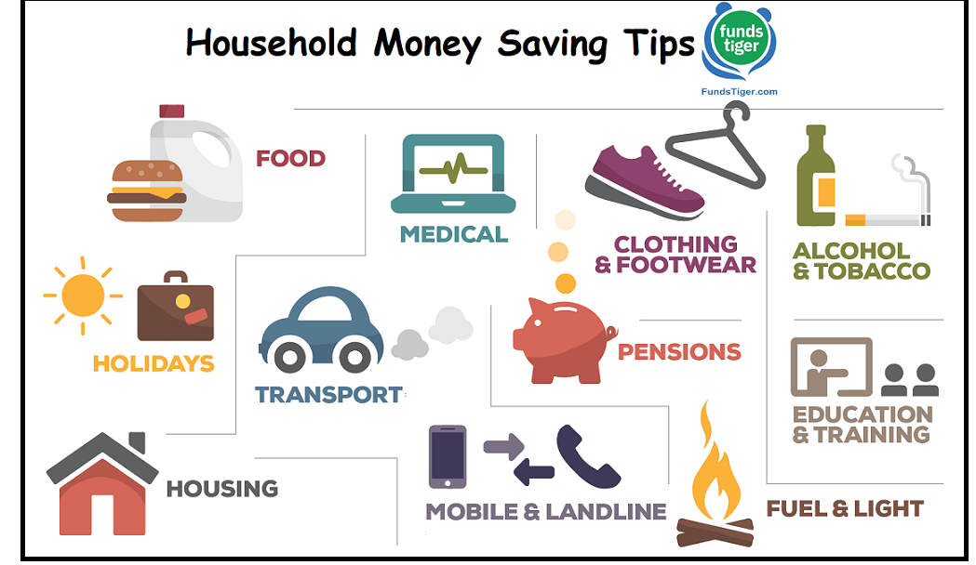
Resource management and consumer studies (25%)
Family resource management (communication, decision making)
Household finances (budgeting, insurance, saving schemes)
Household technology (refrigerator, food processor)
Textiles (care labels & symbols, types of fabric)
Consumer studies (consumer research, rights & responsibilities)

Slide 7

Social studies (10%)
The family in society
Sociological terms & concepts
Marriage
The family as a caring unit
Family Law

Slide 8
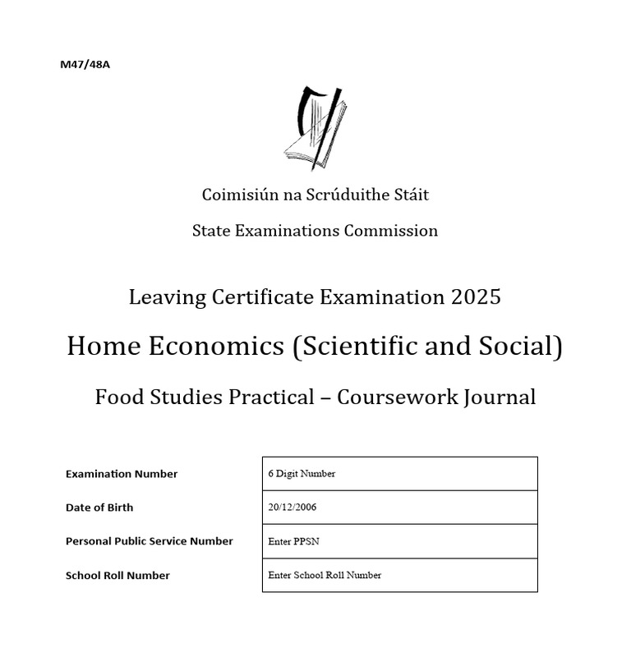
Coursework journal- 20%
Project worth 20%

Slide 9
Coursework journal- 20%
4 assignments completed mostly in 5th year and submitted at the start of 6th year
Assignments cover areas like: Nutritional analysis and meal planning. Cooking and food preparation techniques. Evaluation of dietary needs for specific groups (e.g., children, athletes, elderly)
Each assignment has 3 main components:
        Research and Investigation: Gathering information on the topic, such as dietary guidelines and nutritional needs.
        Implementation: Preparing a meal or dish based on the research.
        Evaluation: Reflecting on the process, outcomes, and learning points

Slide 10
Differences between JC and LC Home Ec
Junior Cycle
Leaving Certificate
Basic nutrition and healthy eating.
Simple meal planning and cooking.
Basic textiles work (e.g., sewing and mending).
Introduction to budgeting and resource management.
Family and social awareness at a beginner level.
Detailed food science and nutritional analysis.
Complex meal planning for specific dietary needs.
Advanced resource management, sustainability, and consumer studies.
In-depth exploration of social and family studies.

Slide 11

THE EXAM
Currently the Home Ec paper layout is:
Section A – Answer 10 out of 14 questions. (60 marks)
Section B – Answer 3 of 5 Long questions (180 marks)
Section C – Elective question (80 marks)

Slide 12

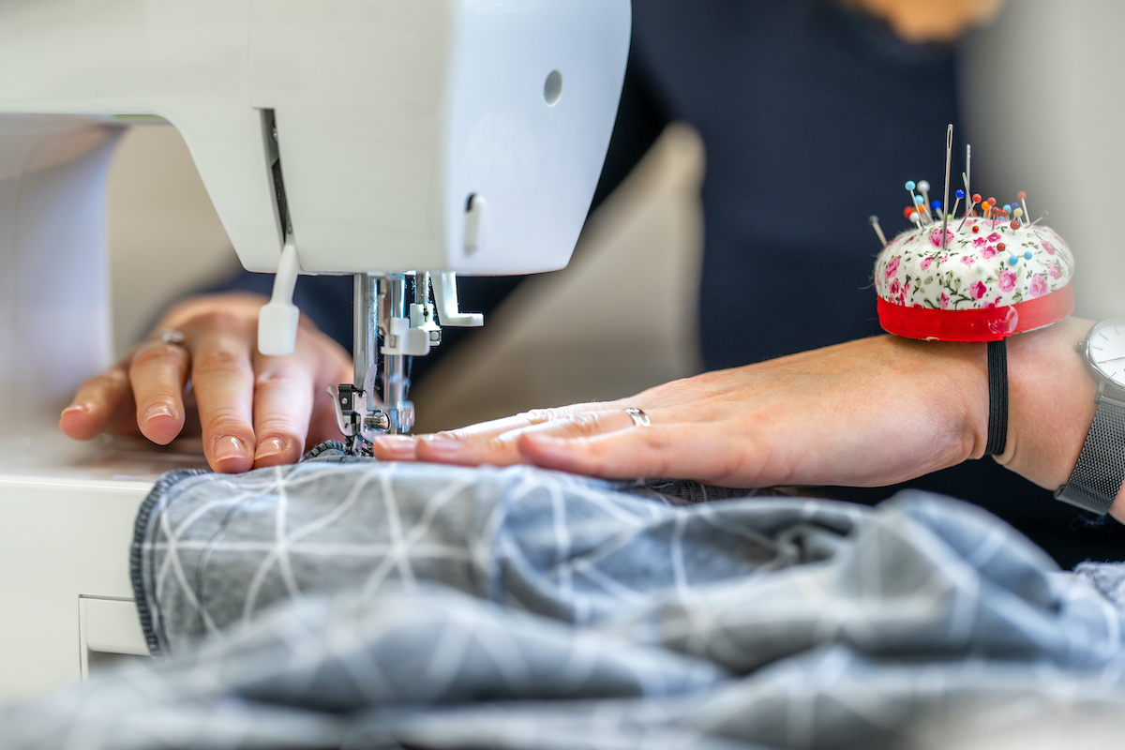
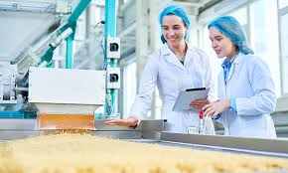
Career possibilities
This subject provides a good foundation for careers in a wide range of areas including
Health
Nutrition
Education
Tourism
Textiles & Design
The Food industry
Science
Social Studies

Slide 13

3rd level requirement?
Not considered a “science subject”
Required for Home Economics teaching, or the study of Home Economics in St. Angela’s College Sligo
Science subject or Home Economics required for Home Economics teaching in Mary Immaculate College Thurles
Science subject or Home Economics required for Home Economics teaching in MTU, Cork
Science subject or Home Economics required for Food science in Grangegorman Dublin

