Slide 1
Welcome to
Leaving Certificate Mathematics
What to Expect and Why It Matters
"Maths is the language in which the universe is written."
- Galileo Galilei

Slide 2
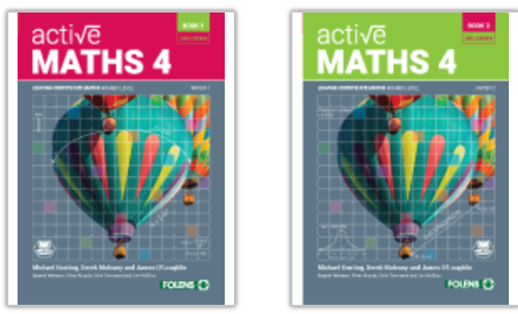
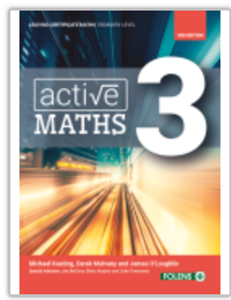
What Level Should You Choose?
Three levels available:
  Higher Level: For those who enjoy problem-solving and
  aim for university courses needing strong maths skills.
  Bonus points (25 CAO points) for passing at this level!
  Ordinary Level: Covers essential maths concepts with manageable challenges. Ideal for most career paths.
  Foundation Level: For students who need a more practical approach and don’t require higher-level maths for their future plans.

Slide 3

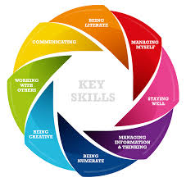
How to Decide Your Level
Factors to consider:
  Your performance in Junior Cycle maths
    Higher Merit/Distinction
  Career aspirations
  Enjoyment and interest in maths
  Speak to your teacher for guidance

Slide 4
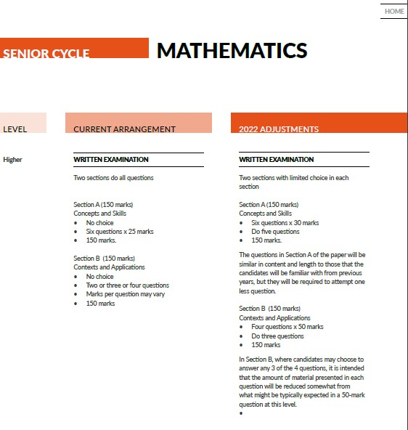
What’s on the Course?
2 Papers with a small amount of choice in each
Strands of the Leaving Cert maths course:
  Algebra
  Functions
  Trigonometry
  Calculus
  Geometry
  Probability & Statistics
  Complex Numbers
  Financial Maths

Slide 5

Real-World Applications
Topics connect to everyday life:
Financial Maths → Budgeting and investing
Trigonometry → Engineering and architecture
Statistics → Data science and medicine
Calculus → Physics and technology

Slide 6
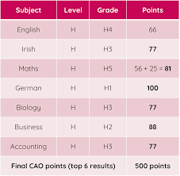
Why Study Maths?
Maths Unlocks Careers
Industries and jobs linked to maths:
  STEM fields (Engineering, IT, Physics)
  Finance and Banking
  Actuarial Science
  Architecture
  Research and Academia
  Teaching
  Practical Jobs (Electrician/Plumbing/Farming)

Slide 7
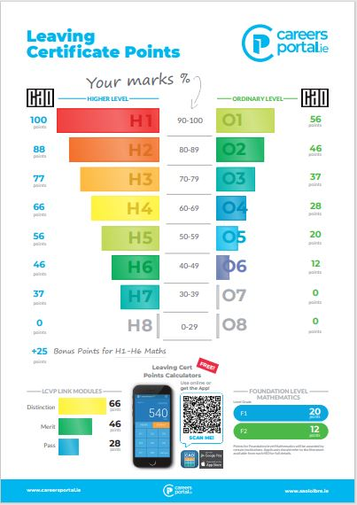
Other Skills
Problem-solving
Analytical thinking
Perseverance
Logical reasoning

Slide 8
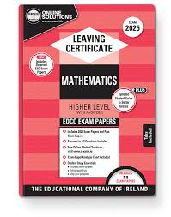
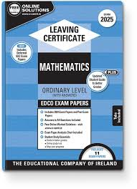
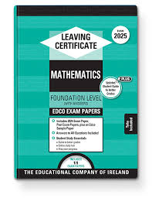
How to Succeed in Maths?
Strategies for Success
Tips to excel:
  Consistent practice (“little and often”)
  Ask questions when stuck
  Use past papers early
  Study in groups to share ideas

Slide 9


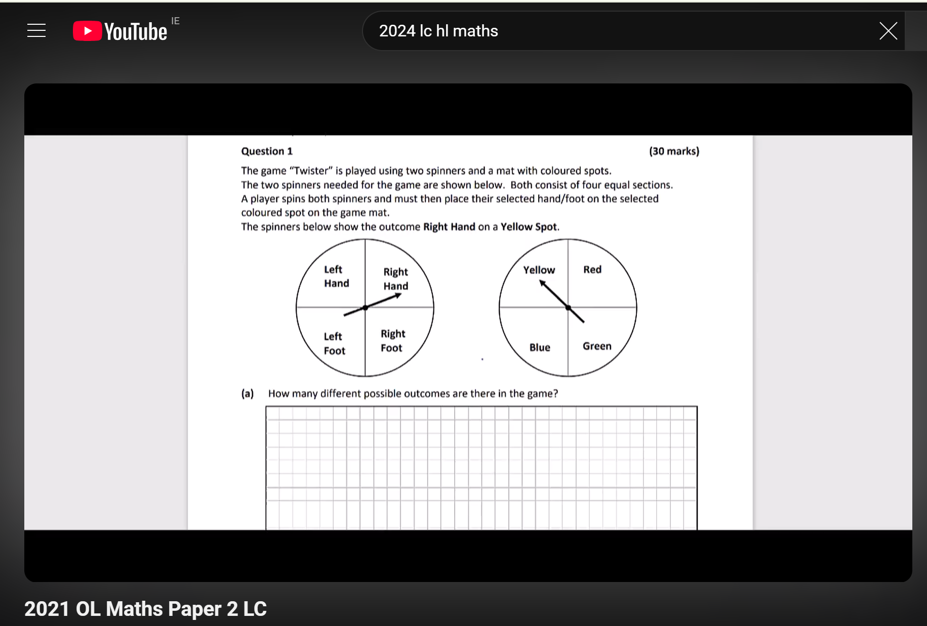
Resources You Can Use
Online tools:
Studyclix
Websites: Khan Academy
YouTube channels for tutorials
Mobile apps like GeoGebra
Examrevision.ie

Slide 10
Any Questions?
Thank You

