Slide 1


Leaving Cert Business

Slide 2

Why study Business for your Leaving Certificate
Business is a very beneficial subject for anyone interested in pursuing a career in:
1. Finance
2. Enterprise
3. Law
4. Communications
5. Marketing
6. HR

Slide 3
What type of students should study Business
Students who have an interest in current affairs and what is happening in the business world
Students who are willing to and enjoy learning keywords and definitions. The course is very factual and requires a lot of learning containing only a few mathematical elements
Students who have an organised mind and like answering questions in bullet point format rather than in long essay format
Students who have studied Business Studies for their Junior Certificate

Slide 4
Course Content
There are 3 strands on the Leaving Cert Business course.
Strand 1: Exploring the Business Environment (9 chapters September-December)
Strand 2: Understanding Enterprise (8 chapters January-May)
Strand 3: Leading in Business (6 chapters September – February
All underpinned by the Unifying Strand which is Investigating Business (Project)

Slide 5
Exam Breakdown
2 hours 30 minutes for Higher Level/Ordinary Level
Overall paper is worth 300 marks
5 questions on the paper
Q1= 90 marks
Q2-Q5= 70 marks each
Q1 is compulsory and you then answer any other 3.

Slide 6
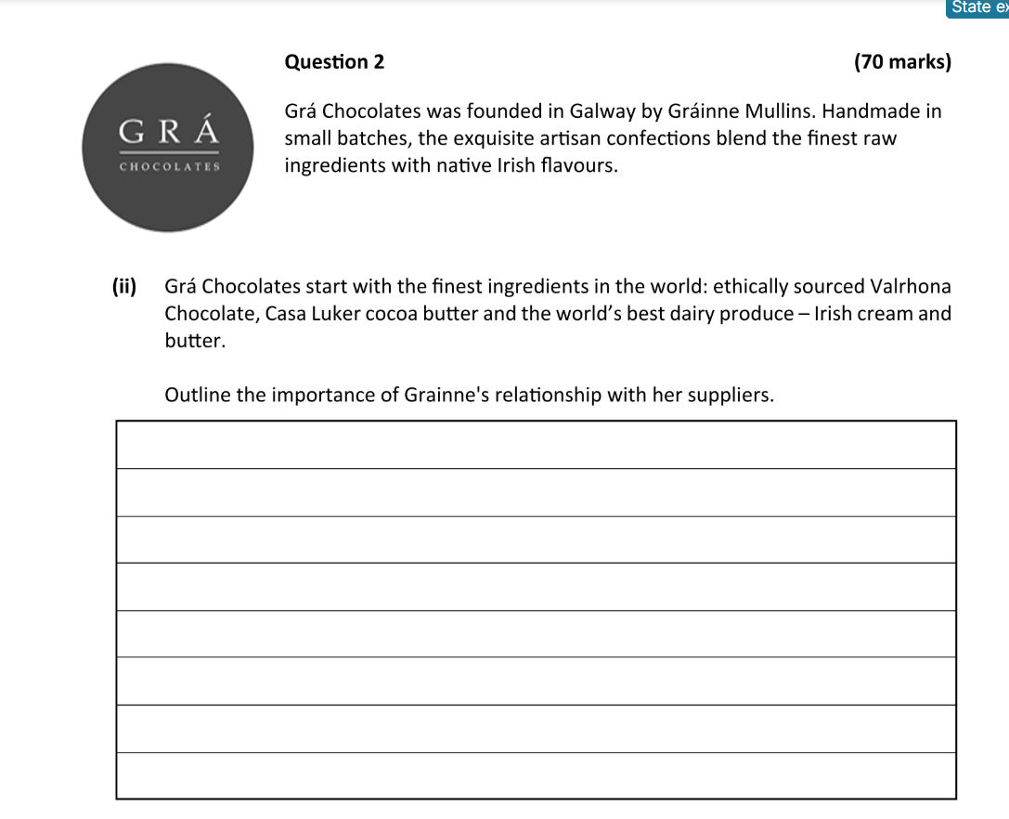
Sample Questions

Slide 7
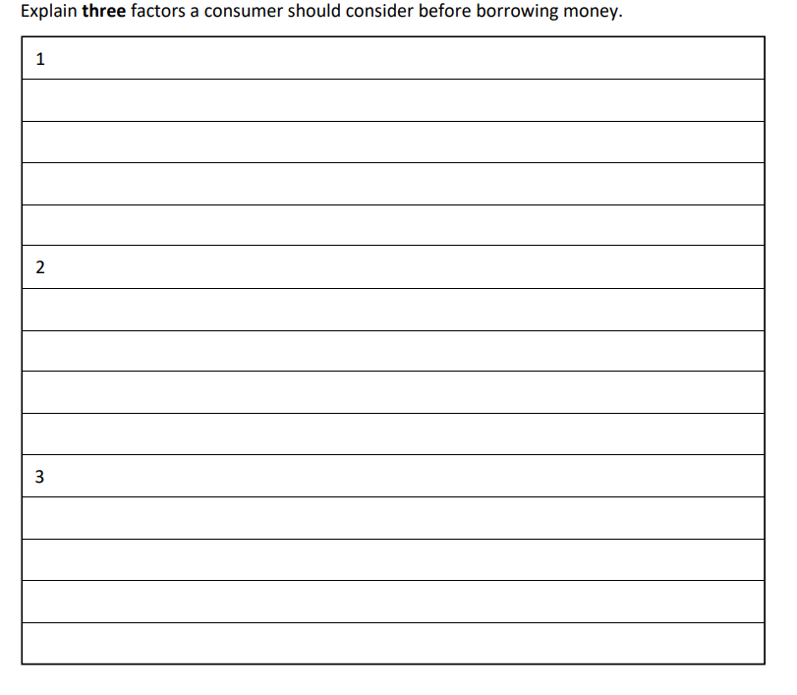
Sample Question

Slide 8
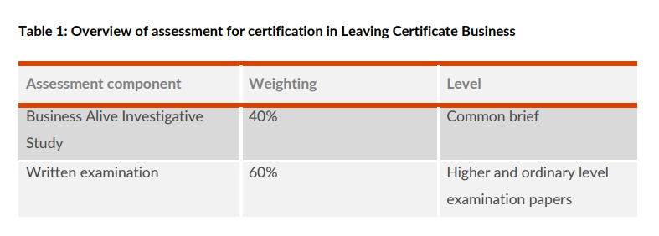
Overview of Assessment

Slide 9
Business Alive Investigative Study 40%
A common brief will be published annually by the SEC in Term 2 of Year 1.
This brief sets out the theme of the investigation.
20 hours have been allocated for this project.
1500-word count.

Slide 10
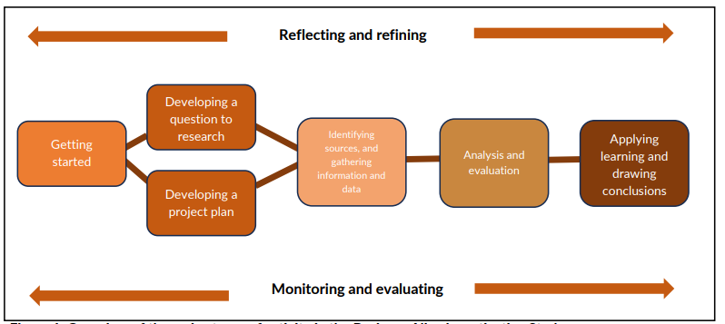

Slide 11
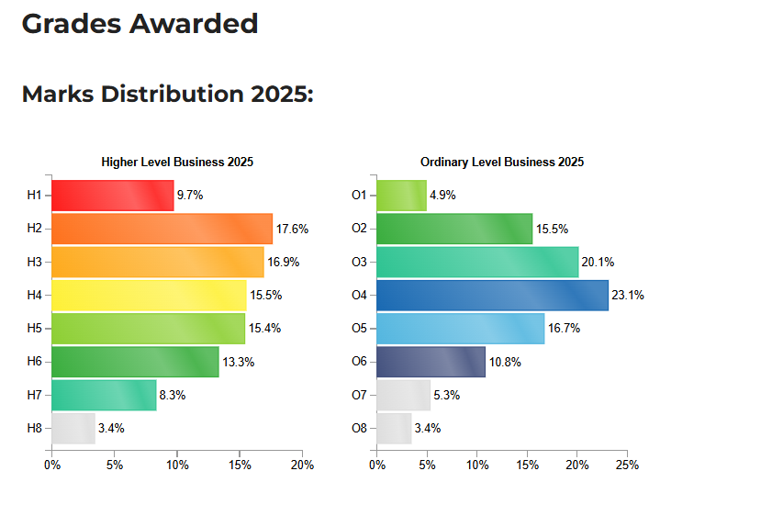
Grades awarded in 2025

Slide 12

Leaving Cert Accounting
Why study Accounting for your Leaving Certificate
Business is a very beneficial subject for anyone interested in pursuing a career in:
Accounting
Actuary
Marketing
Finance
Tax Consultant

Slide 13
What type of students should study Business
Students who like working with numbers
An organised student who likes order
Students who have studied Business Studies for their Junior Certificate
The subject is numerically based but theory must also be learned

Slide 14

Course Content
Financial Statements Preparation
Farm Accounts
Club Accounts
Company Accounts
Financial Statements Analysis and Interpretation
Budgeting
Break-even Analysis
Cost Classification
Accounting Theory and Principles

Slide 15
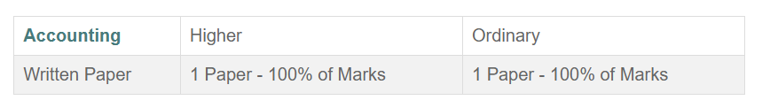
Exam Breakdown
The exam is 3 hours in duration. The exam paper is made up of three sections, the first two are based on the Financial Accounting section of the course and the third covers the Management Accounting section. Questions must be answered from all sections of the exam paper.

Slide 16
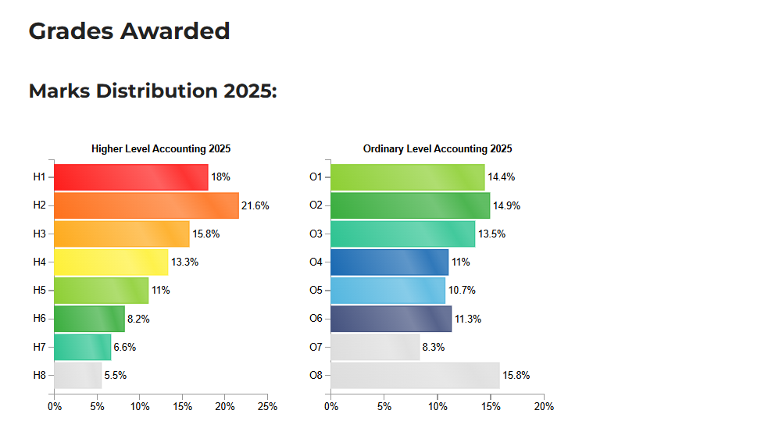
Grades Awarded in 2025

