Slide 1
Climate Change and Sustainable Development
A newly introduced Leaving Certificate Subject

Slide 2
5TH YEARS September 2025
St. Ailbe’s school is only 1 of 49 schools in Ireland who are offering this subject to 5th year students

Slide 3
Climate Action and Sustainable Development holds an immediate and significant relevance for our daily lives.
The subject is broad, interesting and covers topics that effects ALL OF US.

Slide 4
By studying Climate Action and Sustainable Development, students gain an appreciation of the role of community and society in the complex ecology of the planet and of its sustainable development.
They experience the powerful impact of collective action, and develop their capacity to positively impact society

Slide 5
HOW DOES THIS SUBJECT EFFECT ME AND WHY SHOULD I STUDY IT

Slide 6
Significant Weather Events
Weather describes the day to day conditions of the atmosphere.
Recall the significant weather events that happened this year in Ireland, Europe and globally using the graphic organiser.

Slide 7
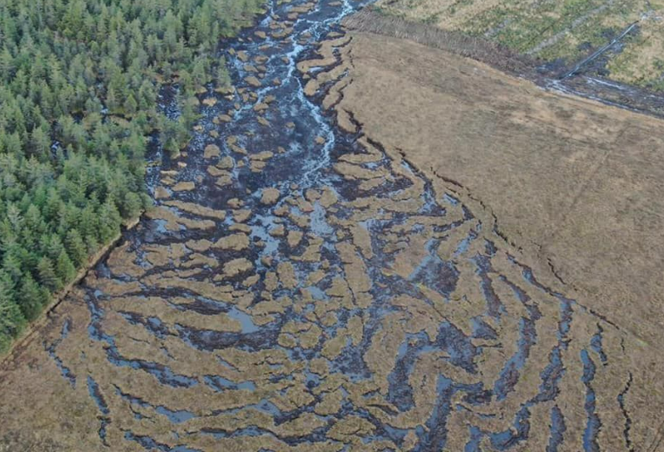
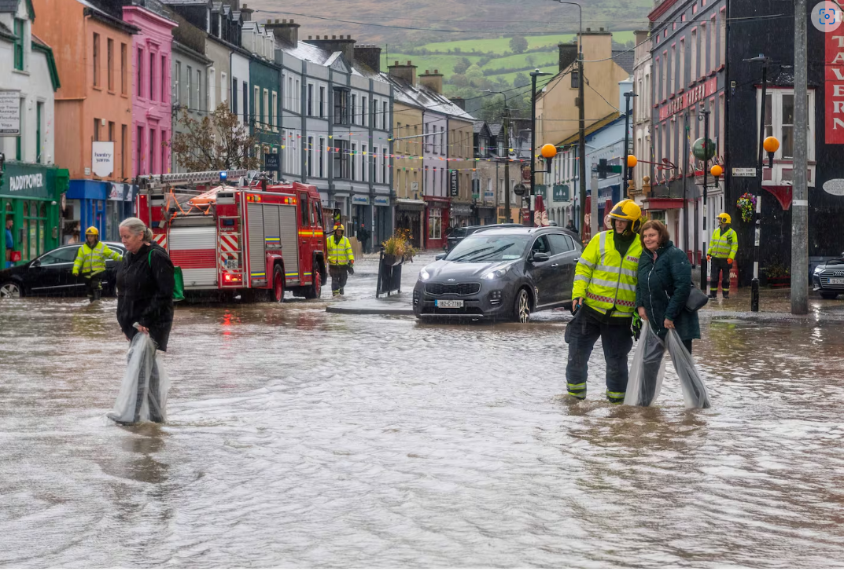
The summer of 2024 was the hottest on record for Europe and globally
2024
Over 370.000 hectars of forest have been destroyed by wildfires in the first nine months of 2024.
WILDFIRES IN LOS ANGELES CURRENTLY
‘Exactly what we were afraid of’ – inquiries launched into landslides amid fears of ‘serious pollution’ | Irish Independent
Floods in Valencia, in October, killed 230 people and destroyed homes and businesses.
Cork floods: Clean-up operation after 65mm of rain recorded in some areas – The Irish Times

Slide 8
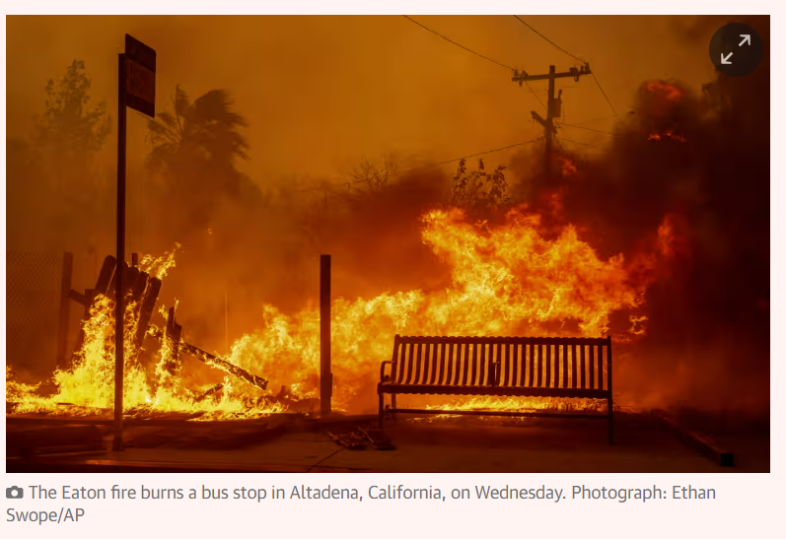
Before and after footage shows extent of LA fires' destruction

Slide 9
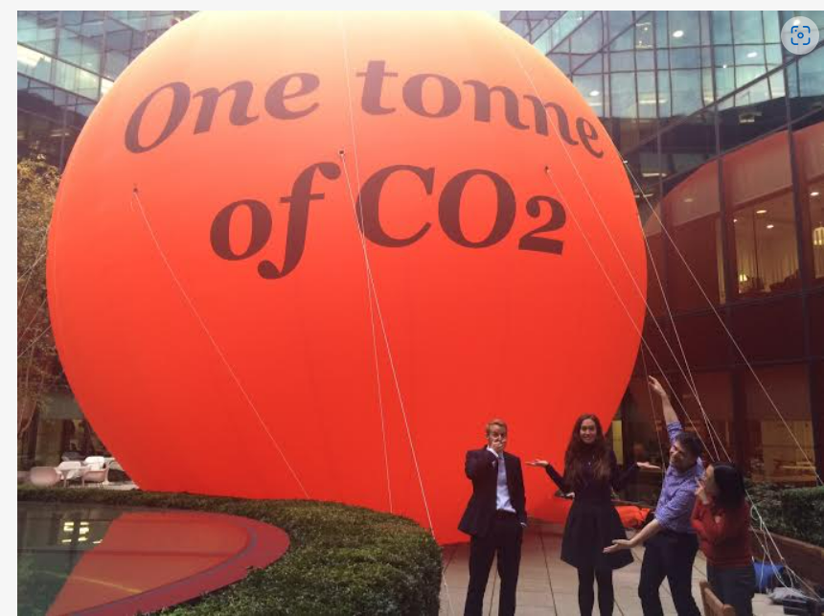
Last year Ireland emitted 61mt of greenhouse gases
Each of us was on average responsible for 1 tonne of greenhouse gas emissions per month
A real bubble / animation combo — Carbon Visuals

Slide 10
Climate Change and Sustainable Development gives students a scientific understanding into Climate Change, looks at the effect of Climate Change in Ireland and across the world and looks at what Sustainable Development may look like in the future

Slide 11
The Leaving Certificate Climate Action and Sustainable Development subject is split into 4 strands
Strand 1 – Earth Systems, Life and the Environment
This strand builds students' knowledge of climate science and environmental systems.

Slide 12
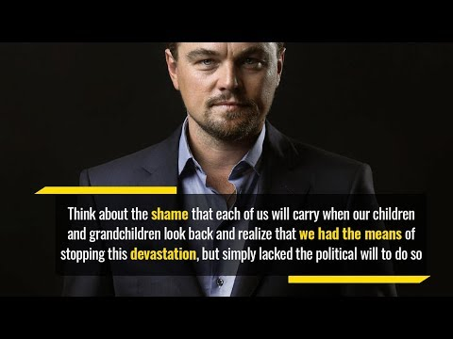
Climate Change - What is it?
In this video, Leonardo Di Caprio speaks about climate change.
Leonardo DiCaprio's Moving Speech on Climate Change

Slide 13
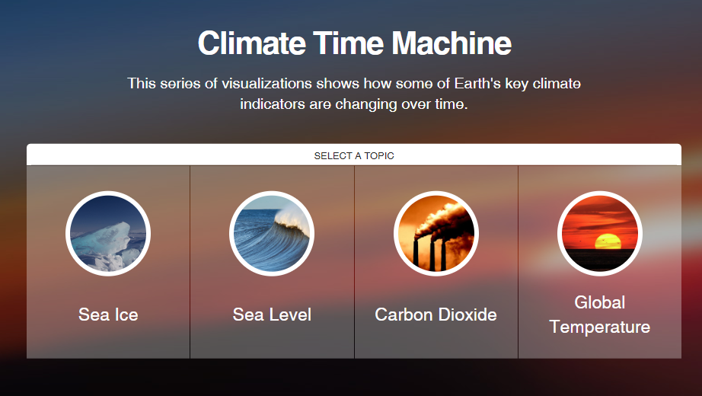
Climate Change - What is it?
Have a look at NASA’s Climate Time Machine to visually see climate indicators changing over time.
Image Source: Nasa

Slide 14
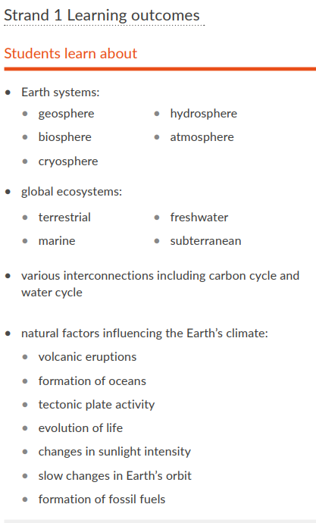
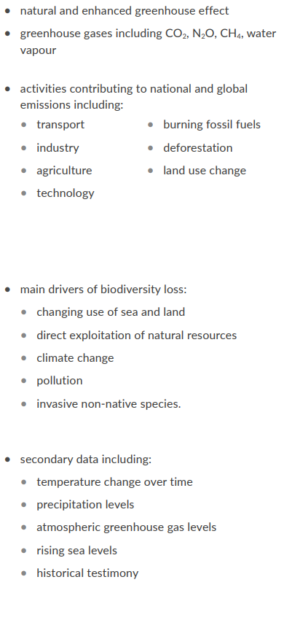

Slide 15
Strand 2 – People, Power and Place
In this this strand, students have an opportunity to explore our place in climate action and sustainable development and the constantly evolving relationship between people and place.

Slide 16
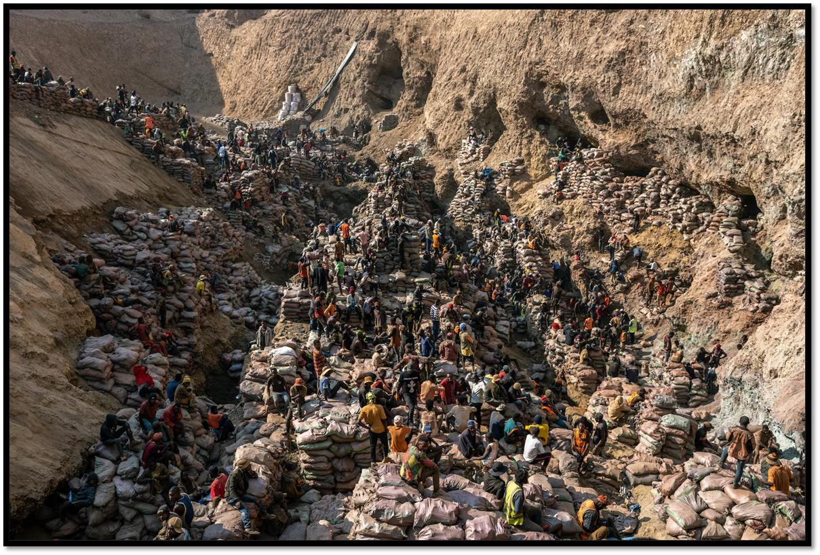
What do you see?/ What do others see?
What made you say that?

Slide 17
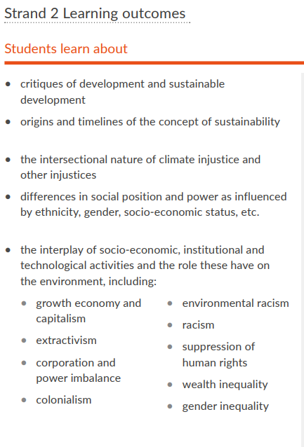
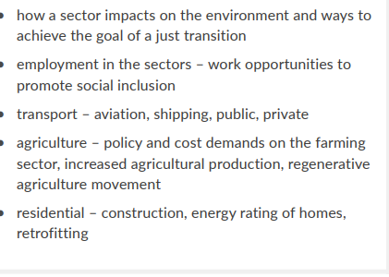

Slide 18
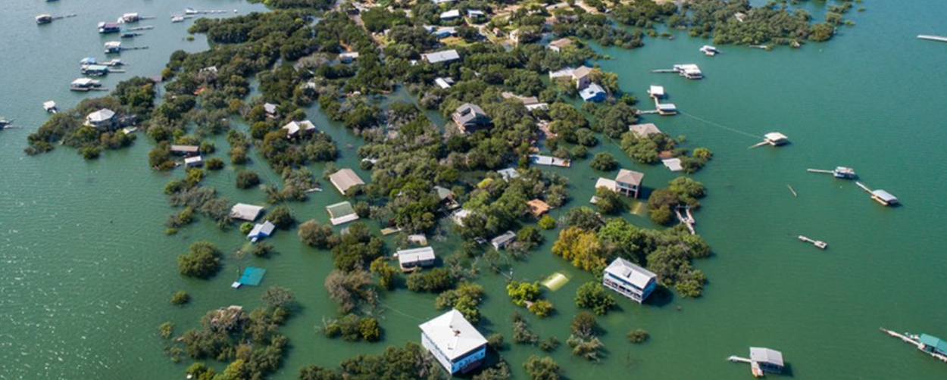
Strand 3 – Global Connections
In this this strand, students explore global thinking and actions. They situate their experiences of climate action and sustainable development in broader issues of decision making and power as evidenced through governance, economic forces and global inequality.
What do you see?

Slide 19
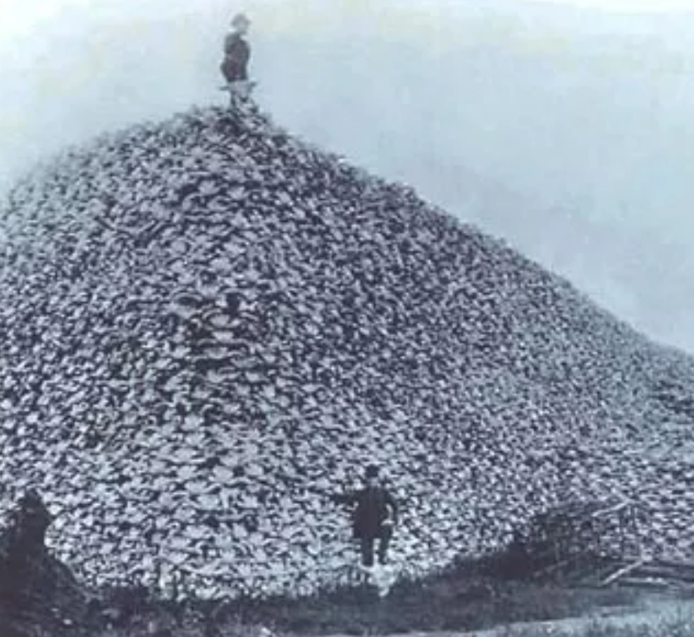
What is happening in this picture?

Slide 20
The most famous photograph of bison extermination is a grisly image of a mountain of bison skulls. It was taken in America in 1892. By the end of the 18th century, there were between 30 and 60 million bison on the continent.
By the time of this photograph, that population was reduced to only 456 wild bison.
We are living through a period of unprecedented species extinction due to human-induced changes to the planet’s ecosystems

Slide 21
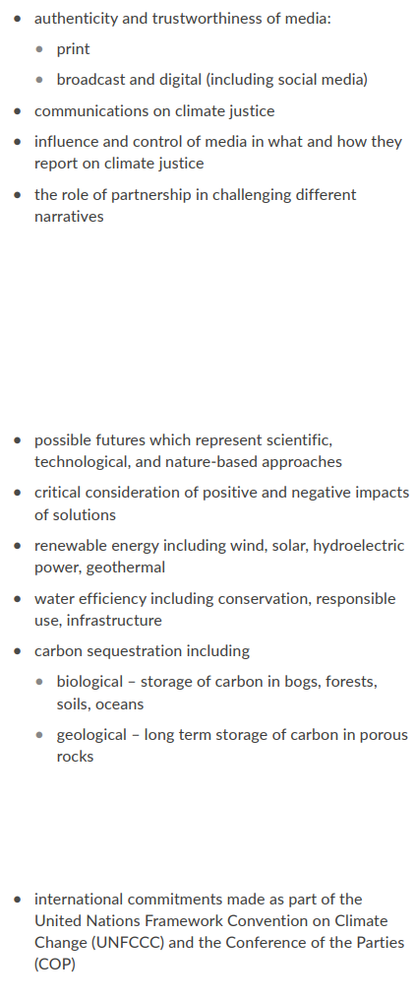

Slide 22
Strand 4 – Applied Learning Tasks
The Applied Learning Tasks strand emphasises the importance of students developing their ability to think and act sustainably.
Over the two years of study, students engage in four Applied Learning Tasks carried out in small groups.

Slide 23
ASSESSMENT
There are two assessment components: a written examination in June of 6th year worth 60% and an additional assessment component comprising an Action Project which is completed over 5th and 6th year worth 40% of the Leaving Certificate mark.
The Action Project provides students with an opportunity to develop a deeper understanding of the concepts and principles they have learned throughout the course.

Slide 24
What kind of student would Climate Action and Sustainable Development suit?
Students who enjoyed subjects such science, geography, business studies, home economics and wood technology in Junior Cycle.
Students who would enjoy learning more about rights and responsibilities, global citizenship, root causes of climate injustice, global inequalities, climate science, and organising of collective action for social change.

Slide 25
DAY TO DAY EXPERIENCE IN THE SUBJECT
Groupwork
Debates
Class discussions
Researching
Peer learning

Slide 26
FUTURE USE OF THE SUBJECT
Climate Action and Sustainable Development builds a solid foundation for students to progress to diverse futures, including participation in society, the worlds of work, further education and training, and higher education.
The learning experienced while studying Climate Action and Sustainable Development can lead to many exciting and rewarding careers and provides a foundation for a diverse range of opportunities in related fields, such as environmental studies, education, business, political and social studies.

Slide 27
ANY QUESTIONS?

Slide 28


THANK YOU!
Lesson activities by:
Inspired by:
Alexander Martensson
Sustainability – Scoilnet Historical photo of mountain of bison skulls documents animals on the brink of extinction

