Slide 1


Say “oui” to French
Leaving Certificate French

Slide 2

Subject Overview
Leaving Certificate French aims to develop learners’ communicative skills in French.

Slide 3

Course Content
Course content for HL and OL is similar in part.
Students will develop their oral, written, listening and reading skills at both Higher and Ordinary Level.

Slide 4
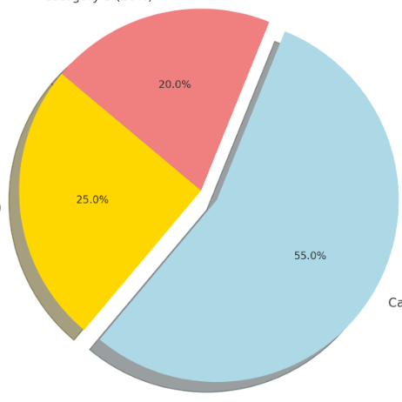
The format of the exam:
Higher Level
  Oral exam: 100 marks - 15 minutes approx – 25%
  Written paper: 220 marks - 2 hours 30 minutes - 55%
  Aural exam: 80 marks - 40 minutes – 20%
Ordinary Level
  Oral exam: 80 marks - 15 minutes approx – 20%
  Written paper: 220 marks - 2 hours 30 minutes – 55%
  Aural exam: 100 marks - 40 minutes – 25%

Slide 5
The oral exam
In the oral exam you will be asked straightforward questions about yourself, your family, school, hobbies and your future plans, and it should all take the shape of an informal conversation rather than an interrogation. If you wish, you can also choose to talk about a document, a photo or a project.
It lasts between 12-15 minutes.

Slide 6
Reading Comprehensions
Higher level
Two comprehensions (60 marks each).
  One question is a literary piece, usually from a novel.
  The other question is usually a journalistic text dealing with current affairs.
Ordinary level
Four comprehensions (40 marks each).
  Usually taken from magazine articles or short stories.

Slide 7
Written section
HL
You have to answer two questions out of eight in the current arrangements in the written section.
Question 1: opinion piece, and you have to write about 100-120 words. There is an option of three questions in Q1).
You then have to answer one of the remaining five questions (90-100 word answers). The types of questions you can expect include a diary entry, an e-mail and opinion questions on current affairs.
OL
You have to do two questions out of three sections- A, B, and C - and each section has two parts, of which you must answer one. (ie: 6 options and you answer 2).
You can expect to have to do such things as write a diary entry, a message, a postcard, or complete a cloze-test (fill in the blanks).

Slide 8
The aural exam
The listening comprehension takes place immediately after the written paper. It is worth 80 marks (20%) to HL students and 100 marks (25%) to OL students.
It has five sections and it lasts 40 minutes.

Slide 9
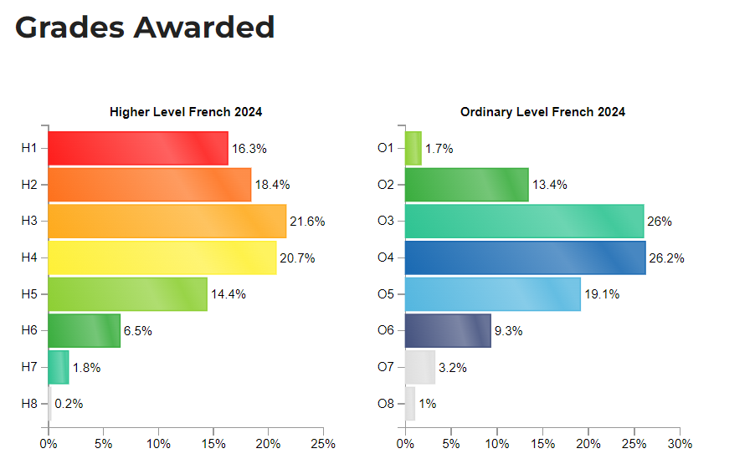
Notes:
H3= 70-79% =77pts
H2=80-89% = 88pts
H5=01=56pts

Slide 10
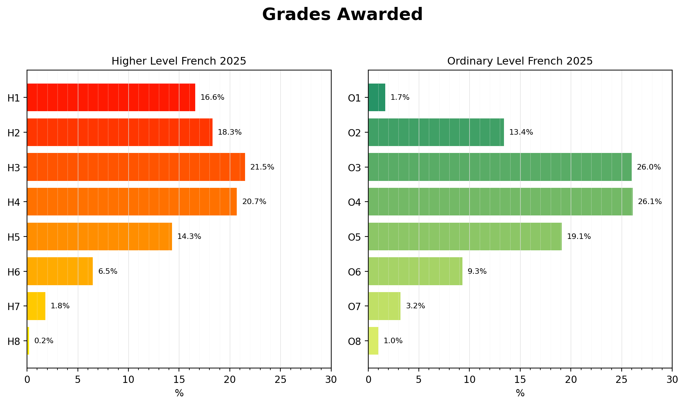

Slide 11
How you can do well
The key to doing well is practice and repetition.
Learning and revising vocabulary on a regular basis. Learn five new words a night – if we learn five new words over 33 weeks in a school year, you could have a vocabulary bank of over 1,650 words.
Listening to French podcasts, TikToks, social media.

Slide 12
Career Possibilities
Teaching
Translation
Interpreting
Linguistics
Journalism
Media
Tourism
Industry

Slide 13
Why choose French?
A third language is a requirement for a number of college courses.
Global Reach: French is spoken by approximately 300 million people across five continents and is the official language of 29 countries.
Travel Benefits: Speaking French helps not only in France but all French speaking countries. It is a great skill to be able to order a French dish or buy a train ticket.

Slide 14


Why choose French
Career Opportunities: another language is a valuable asset in global business.
Anyone who has an interest in financial services, digital technology or pharmaceuticals would have the upper hand at interviews if they can speak French.
Notes:
France is Ireland’s closest EU neighbour. Billions of euros are traded between France and Ireland each year. France is Ireland’s largest customer for lamb and seafood and the second largest for beef and whiskey.
Since Brexit, French has become one of the leading EU languages and France has the 6th largest economy in the world. Anyone who has an interest in financial services, digital technology or pharmaceuticals would have the upper hand at interviews if they can speak French.

Slide 15
Travel
Educational Opportunities
International Relations – EU, UN
Career Opportunities
Ease of learning – one of the easier languages to learn for native English speakers
Cognitive Benefits
Cultural Access
Global Reach
Language of Love

