Slide 1

Geography

Slide 2
Geography at a national level
Leaving Cert Geography is the second most popular optional Leaving Cert subject in Ireland. Approximately, 27,000 students take LC Geography every year. Of this number, 80% take it at higher level.

Slide 3
Teachers in the Geography Department
Ms.Casey
Ms.O’Connor
Ms.Long
Mr.Hayes
Ms.J O’Dwyer

Slide 4



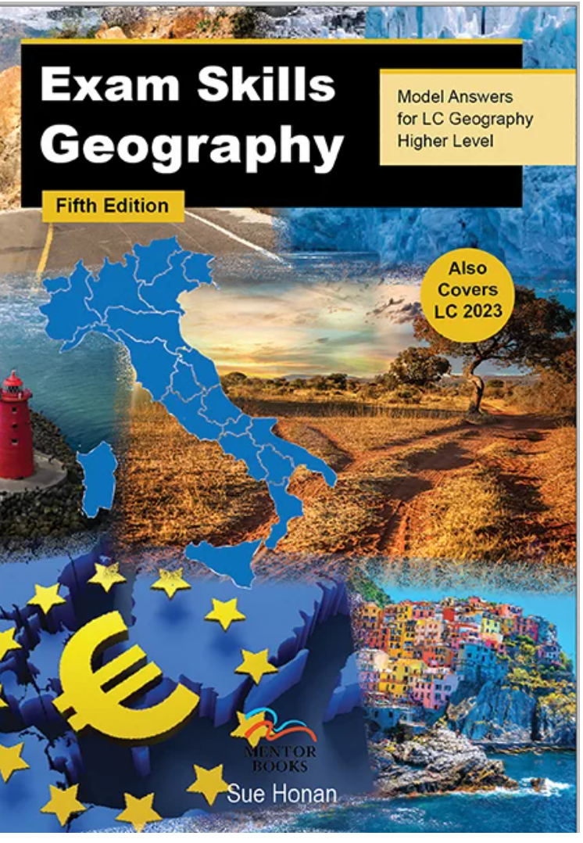


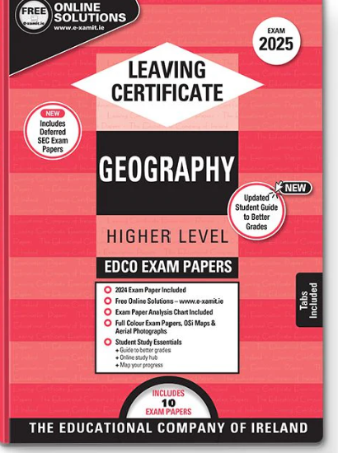
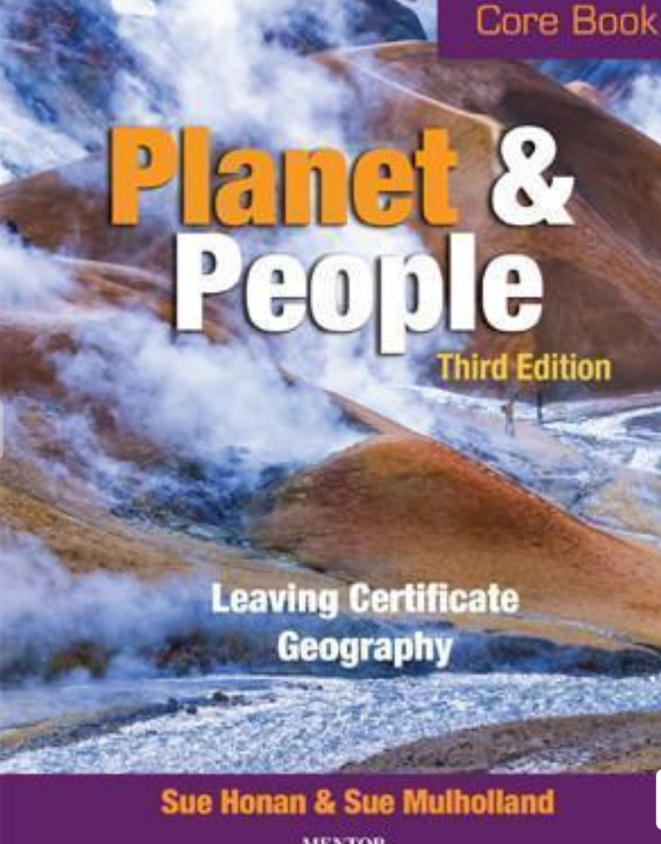
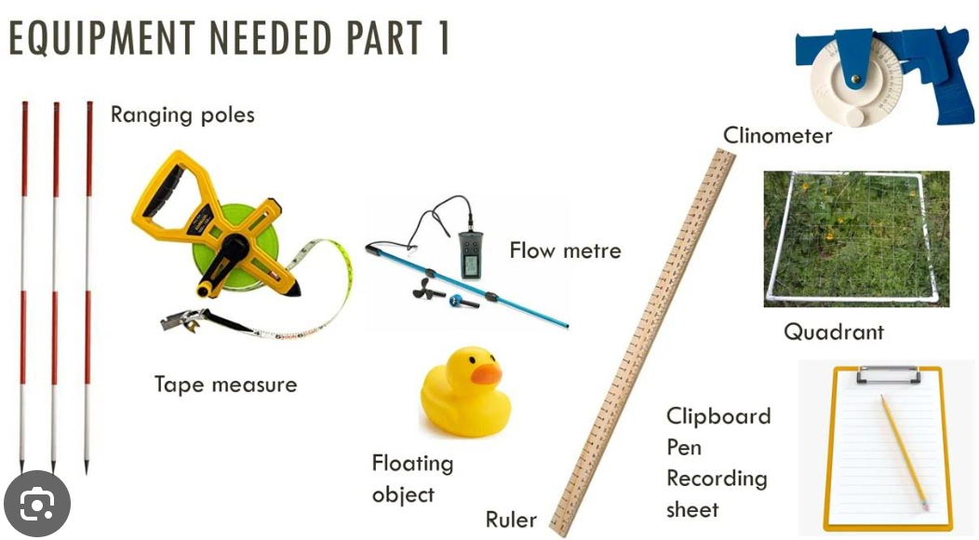


Slide 5
Breakdown of Levels
Leaving Cert Geography consists of four (O.L) or five (H.L) sections which make up the written examination + a fieldwork project. The exam is worth 60% of the marks and the fieldwork is worth 40%.
All students, whether H.L or O.L will submit a fieldwork project, which is handed up in April of the Leaving Cert year.

Slide 6
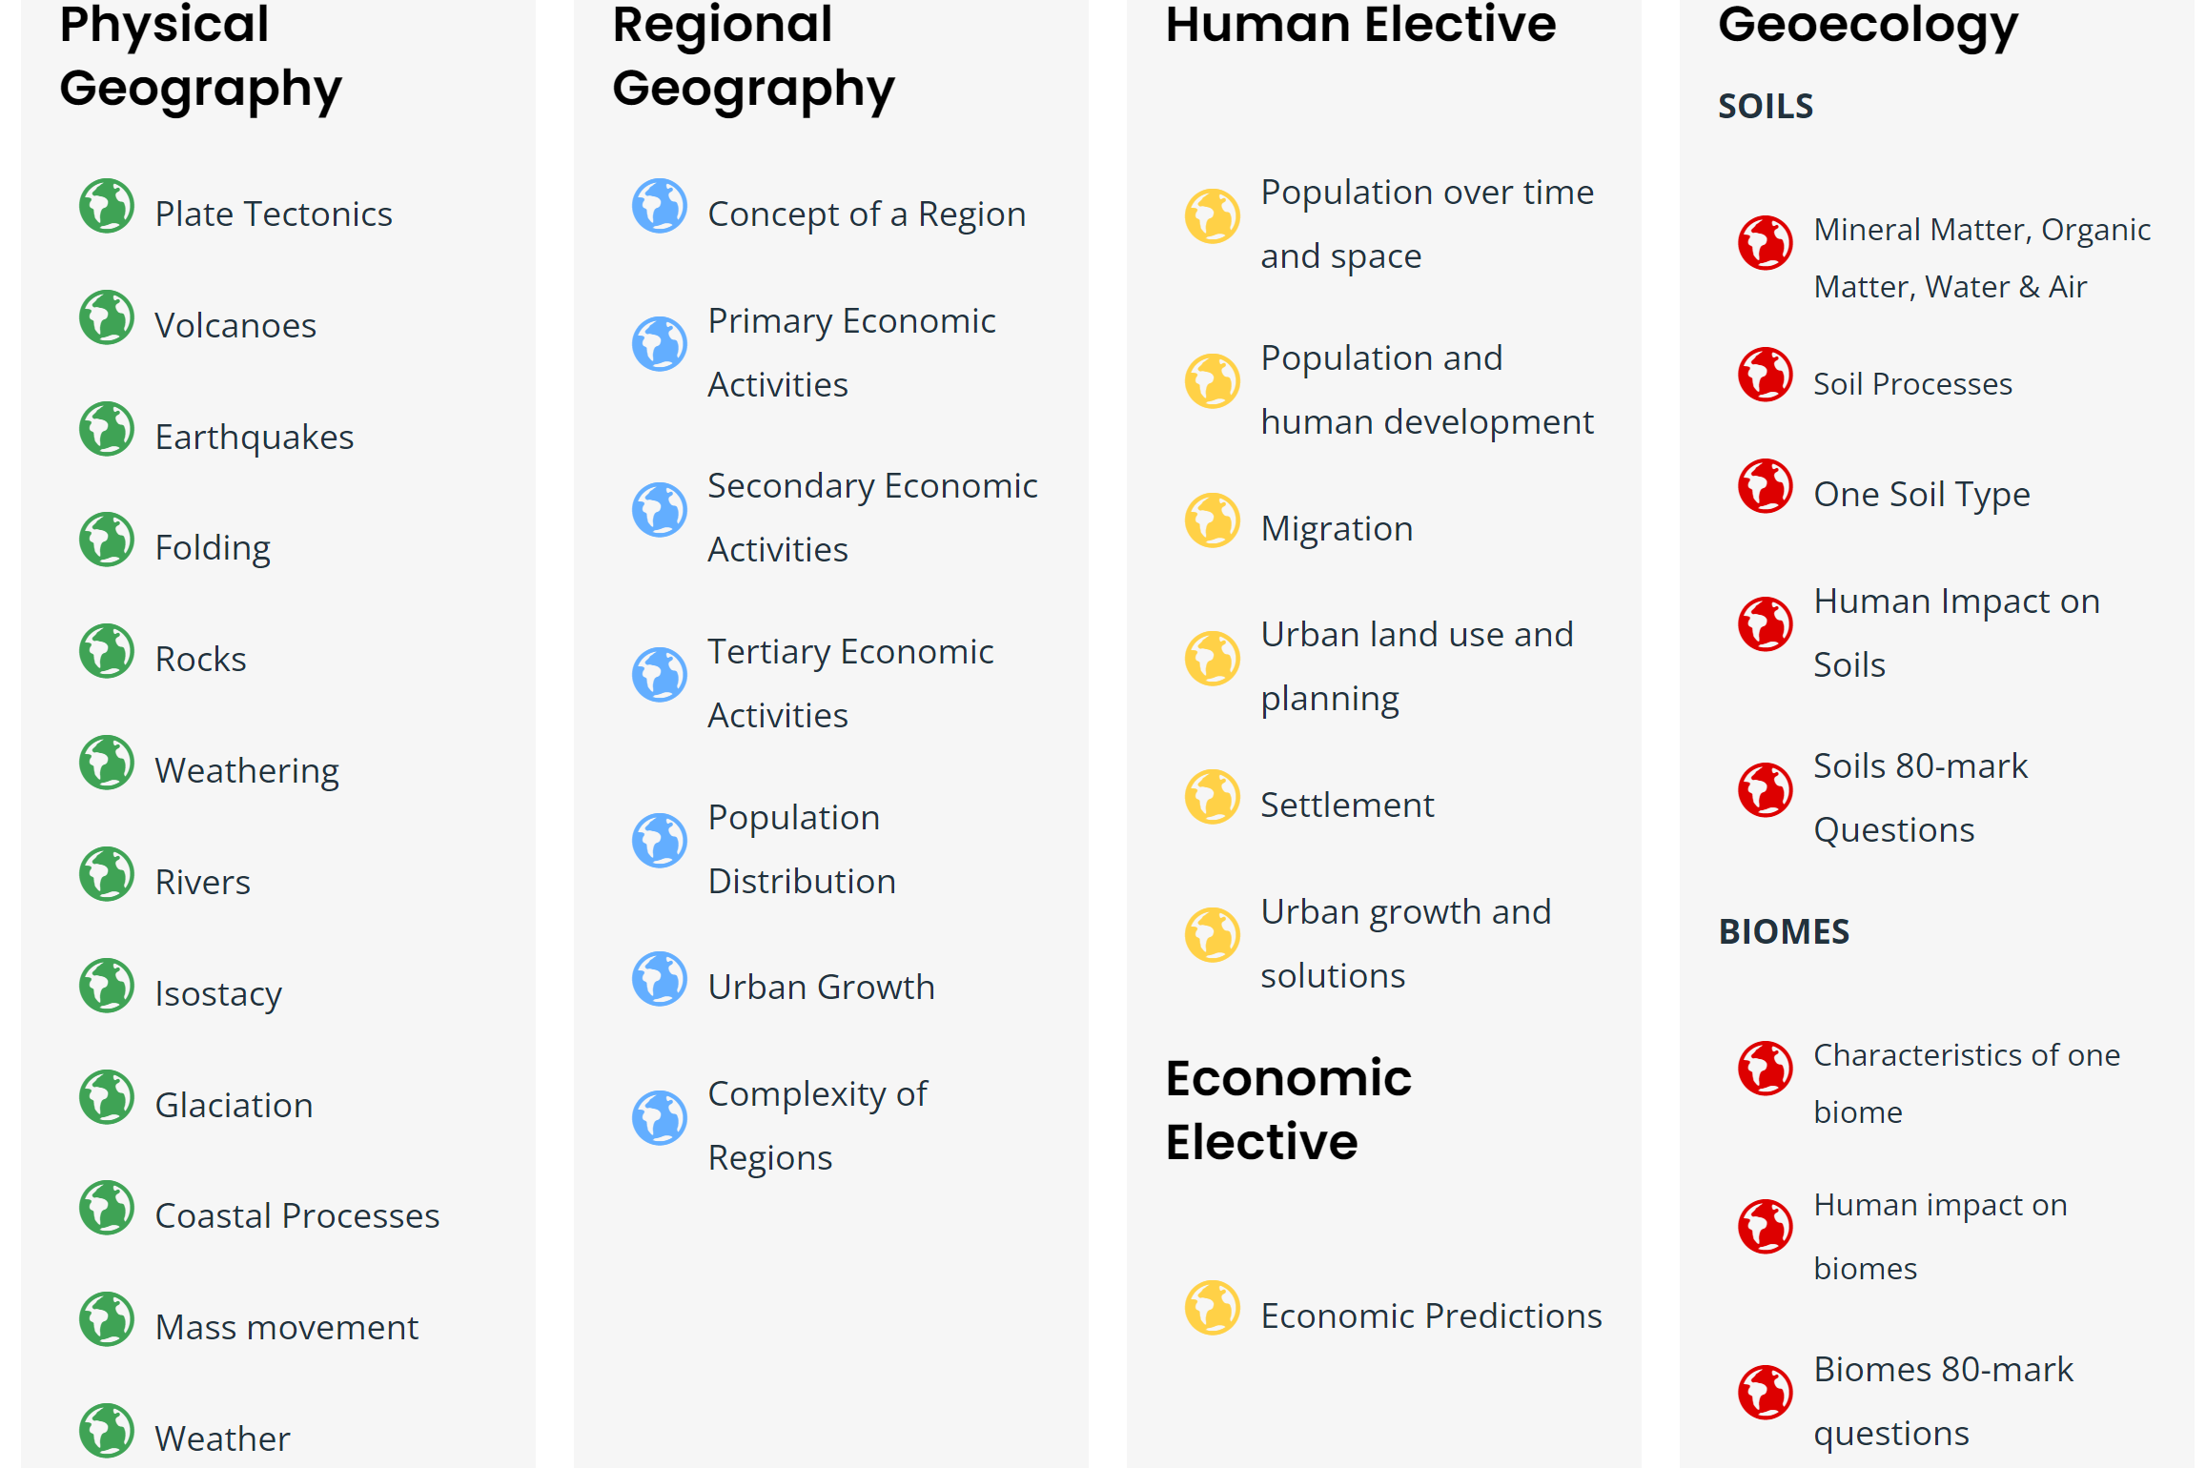
Unifying Topics

Slide 7
New Course 2026
Unifying Strand - Applying geographical thinking and skills
Applying geographical thinking and skills is a Unifying Strand which builds upon learning from the Junior Cycle Geography concept of Geoliteracy and the contextual elements of processes, patterns, systems and scale; geographical skills; and sustainability. The Unifying Strand supports students to develop their disciplinary knowledge including their understanding of the nature of geographical knowledge and how this is generated and communicated through inquiry
Strand 1 - The physical environment
In Strand 1, students focus on physical processes and systems, and human interactions. Students will engage with learning in this strand through the settings specified in the table below and through other relevant local, Irish, international and/or global settings as appropriate. Throughout their study of Strand 1, students will encounter and apply their geographical thinking and skills from the Unifying Strand in an integrated manner
Strand 2 - The human environment
In Strand 2, students focus on key aspects of human geography including human settlement, population, and migration. Students will engage with learning in this strand through the settings specified in the table below and through other relevant local, Irish, international and/or global settings as appropriate. Throughout their study of Strand 2, students will encounter and apply the disciplinary learning outlined in the Unifying Strand in an integrated manner
Strand 3 - The global environment
In Strand 3, students focus on agriculture and fisheries, tourism, globalisation, development and geopolitics. Students will engage with learning in this strand through the settings specified in the table below and through other relevant local, national, international, and/or global settings as appropriate. Through their study of Strand 3, students will encounter and apply the disciplinary learning outlined in the Unifying Strand in an integrated manner.

Slide 8
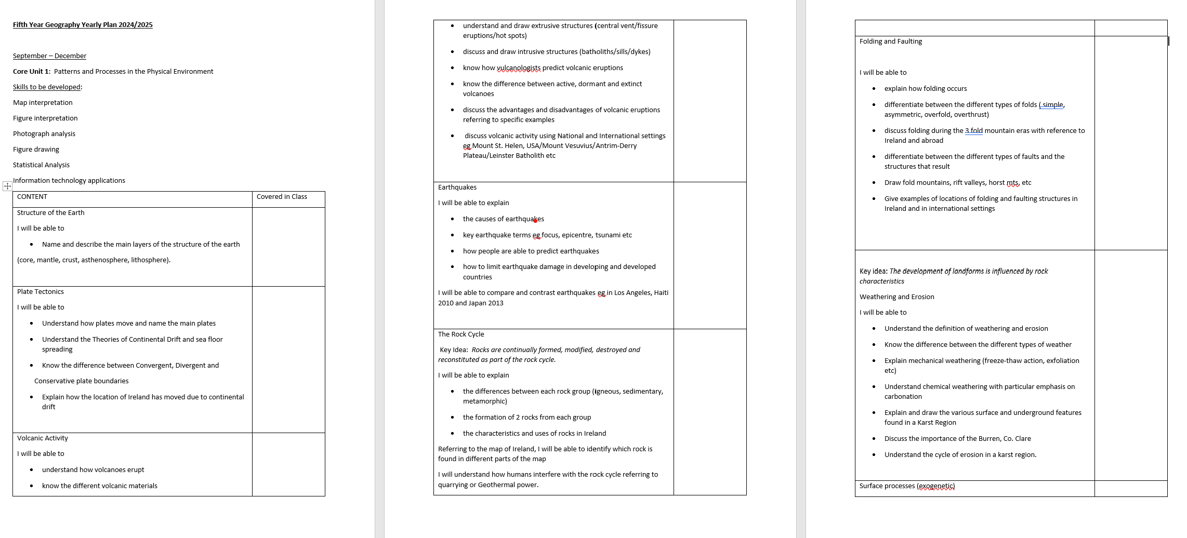
Fifth Year Scheme

Slide 9
The written exam
With seven or more essays to be written, timing is crucial in the written exam
The examiner will be looking for SRPs (single relevant points) in your essay. An SRP can be described as a "single meaty statement" or a sentence or paragraph with one clear and true point. At Higher level, an SRP is worth 2 marks so a typical 30-mark essay will need at least 15 SRPs.
There is one written paper for both Higher and Ordinary levels, which lasts for 2 hours and 50 minutes.

Slide 10
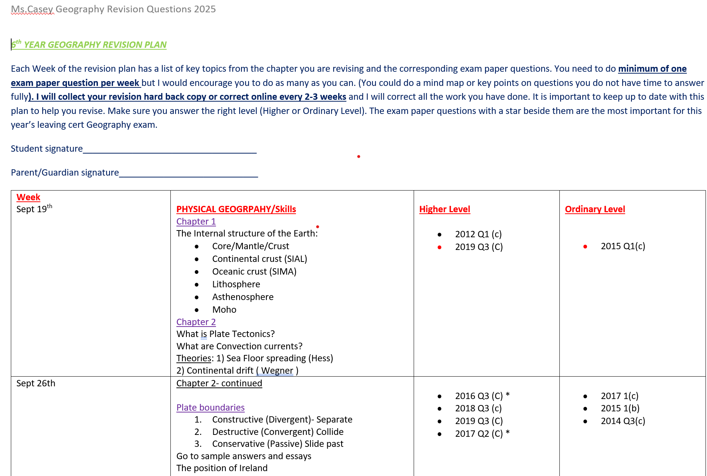
Revision Plan sample

Slide 11
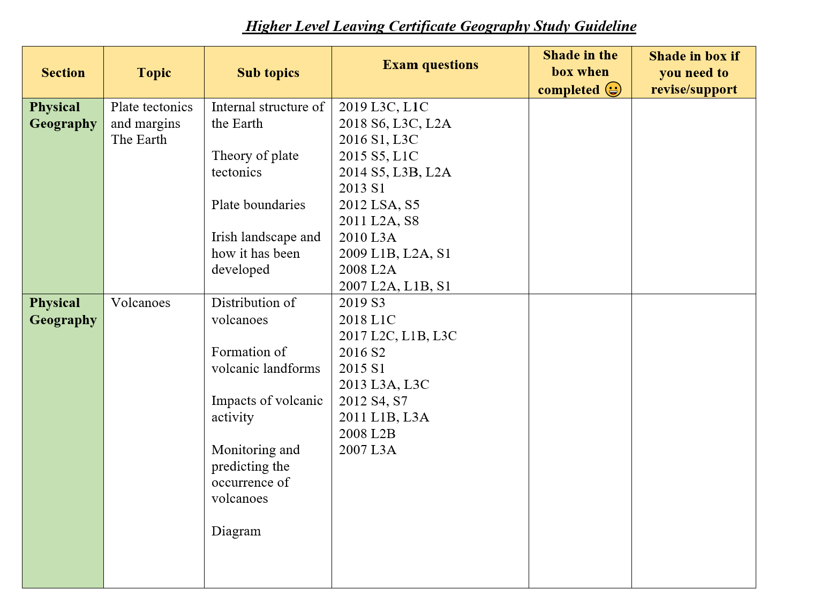

Slide 12
Exam paper part 1
Here you will find twelve short questions and you will be marked out of your best ten.
This section is worth 80 marks and should take you less than 25 minutes to complete.
Worth 16% in Higher Level
Worth 20% in Ordinary level

Slide 13
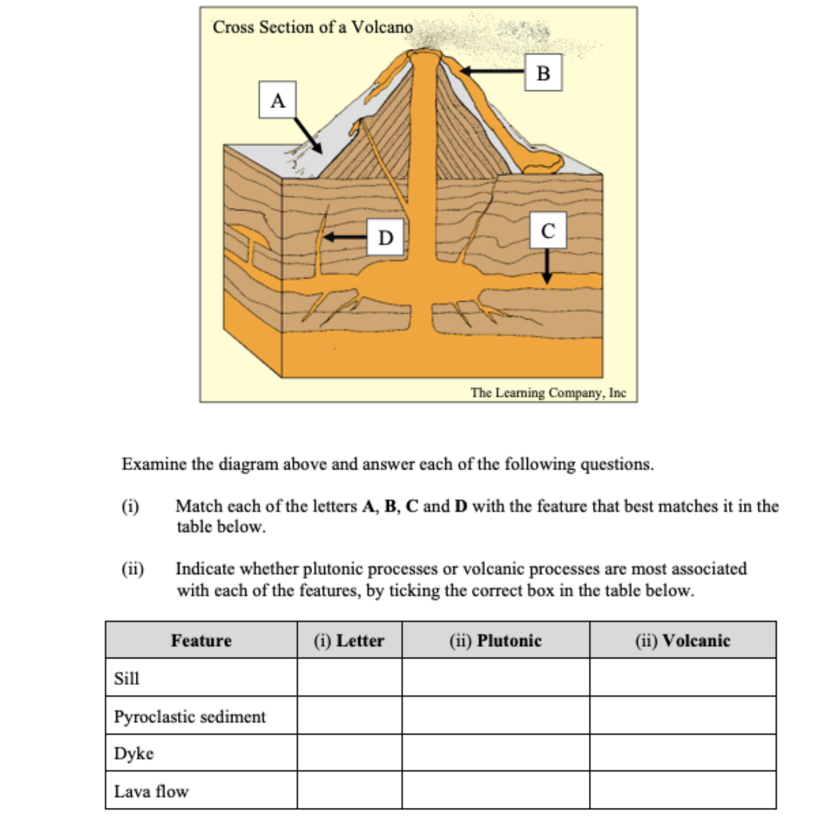

Slide 14
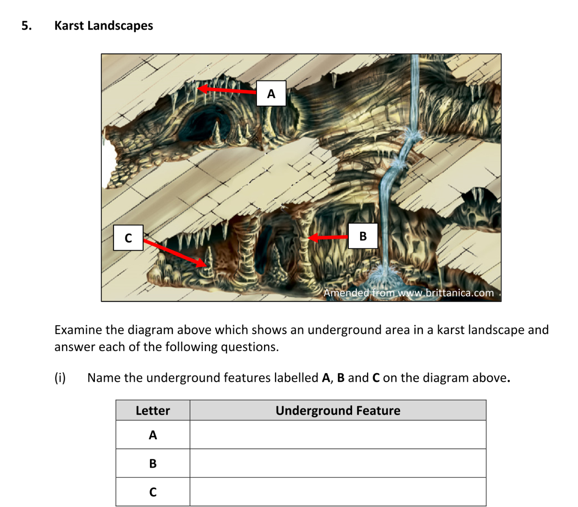

Slide 15
Exam Papers layout part 2-In Process of change for 2026 students
This section has essay-style questions where you have a choice of ONE question from three in each section. Spend no more than 30 mins on each question (80 marks).
Section 1: Physical Geography (Q1, Q2, Q3 - Pick one)16%
Section 2: Regional Geography (Q4, Q5, Q6 - Pick one)16%
Section 3: Human Elective (Q7, Q8, Q9 - Pick one) OR Economic Elective (Q10, Q11, Q12 - Pick one)16%

Slide 16
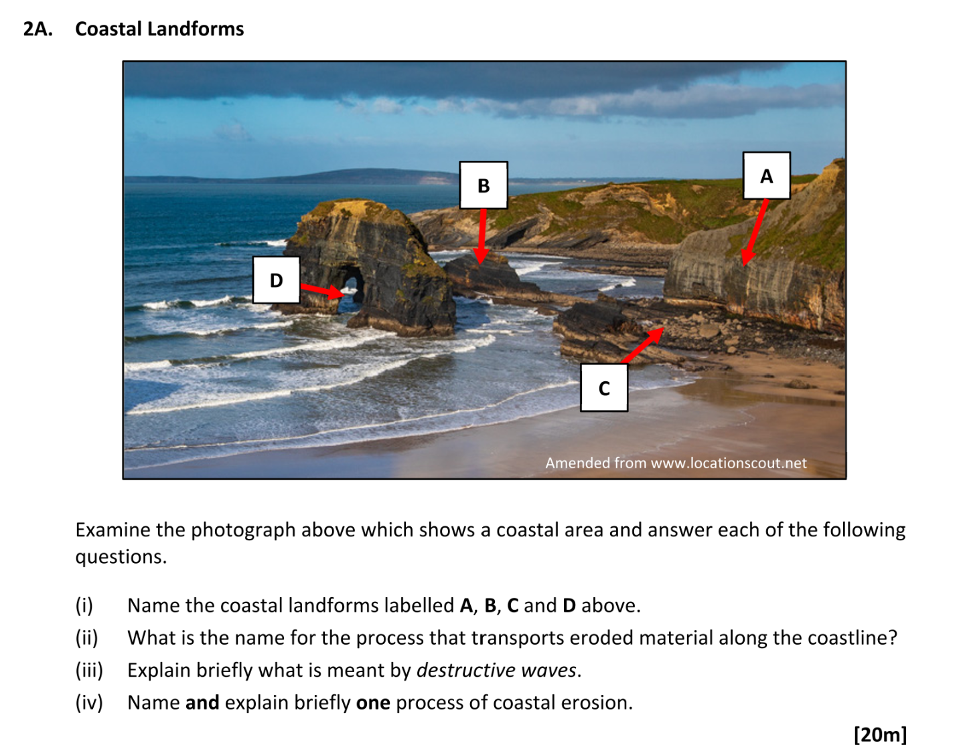
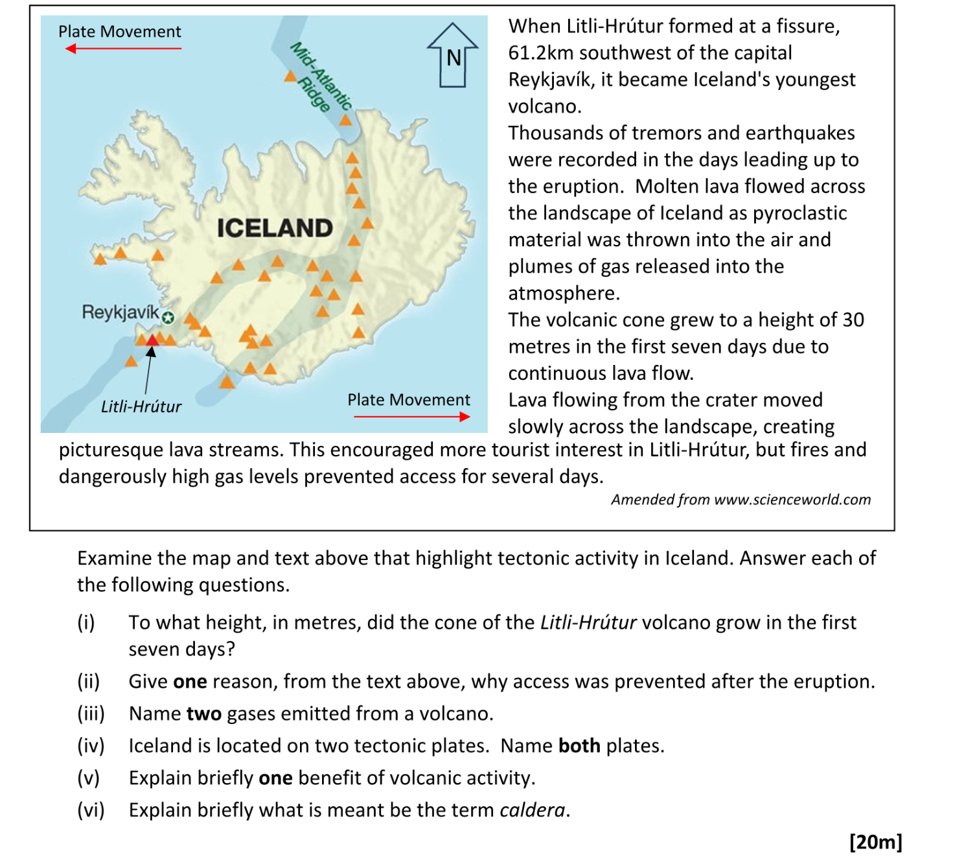
20 Mark question

Slide 17
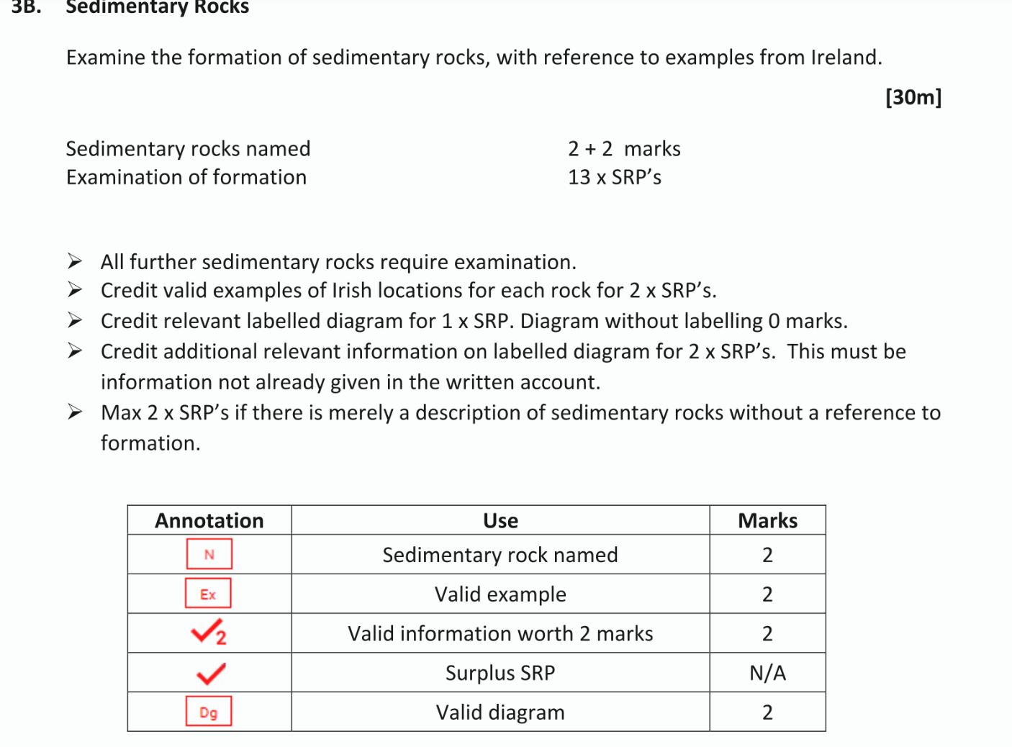
30 Mark question

Slide 18
Project
River investigation
Worth 40% for both levels
Group activity-Individual written booklet
Fieldstudy completed in September-due April of 6th Year.

Slide 19
Cross Curricular
Geography links in with Biology, Maths, Economics and the new subject climate action and sustainable development.

Slide 20
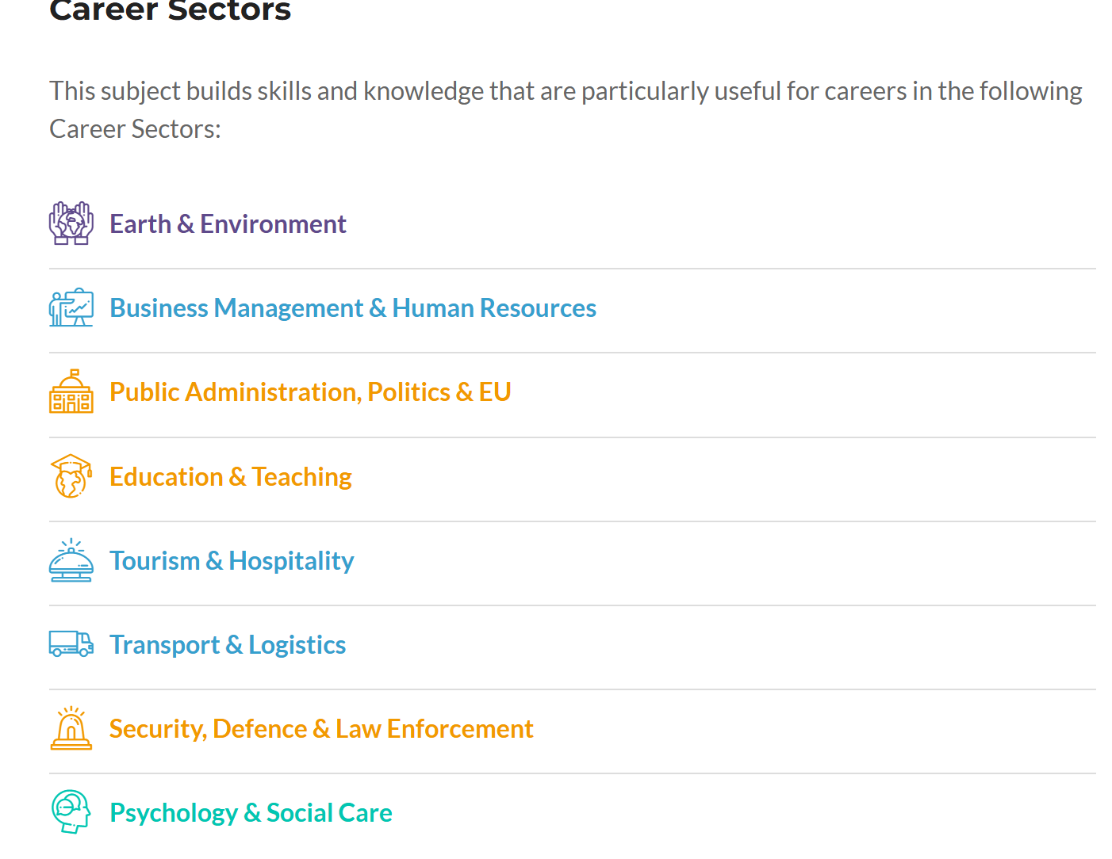

Slide 21
Common Questions
Do you need to have done Junior cycle Geography?
Is there a lot of writing?
How much is the project worth?
What’s the style of learning in the classroom?
Do we get to go on fieldtrips/guest speakers?

