Slide 1
Leaving Certificate Biology

Slide 2
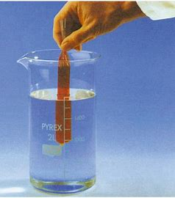
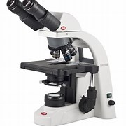
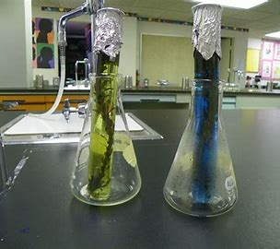
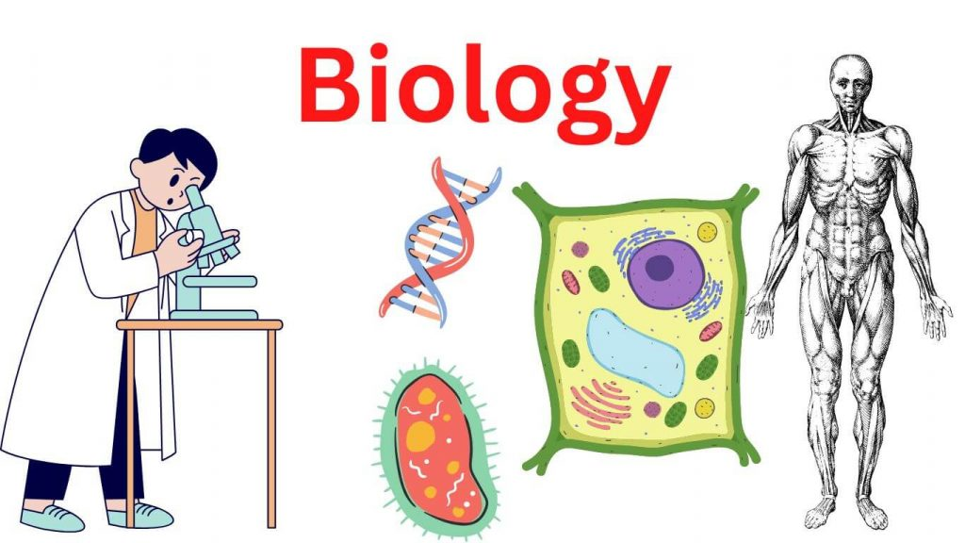
Biology is the study of living things

Slide 3
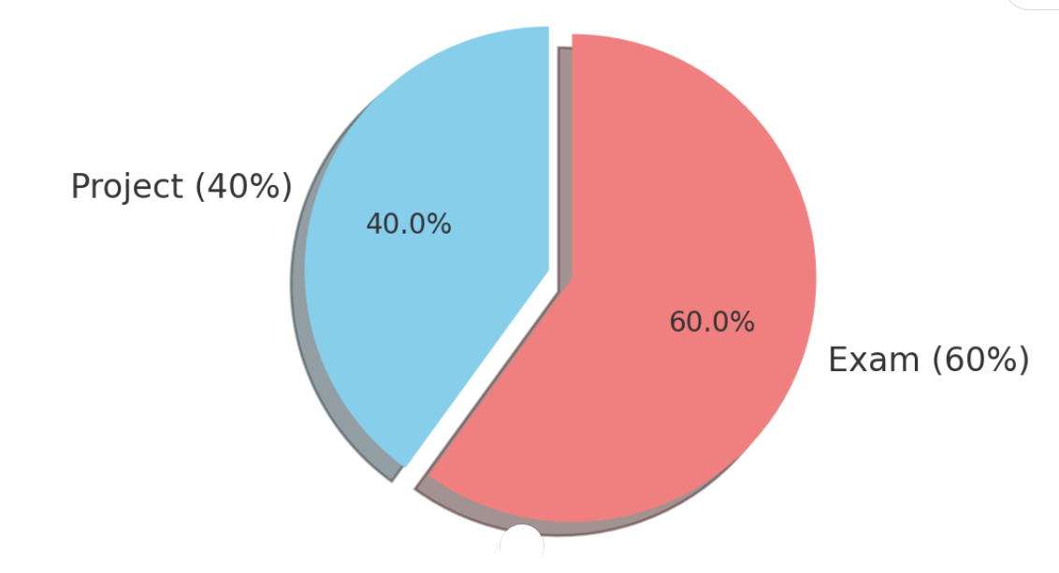
EXAMINATION SPLIT
40% Project. Receive a brief with guidelines and must carry out experiment to satisfy the brief and guidelines.
60% Final Exam. This is a combination of short answer questions, experimental questions and long answered questions.

Slide 4
Biology overview
There are 4 strands in leaving certificate biology. Each strand contains many different chapters.
Unifying strand
Organisation of life
Structures and processes of life
Interactions of life

Slide 5
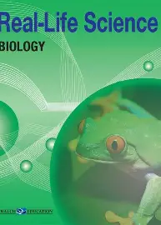
1- Unifying strand:
Scientific knowledge
Investigating in science
Science in society
Biological reasoning.

Slide 6
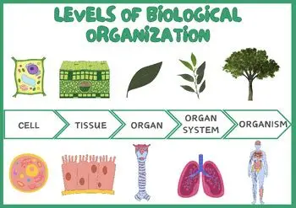
2- Organisation of life
The characteristics of life
Viruses, classifications and the domain of life
The unit of life: The cell
Biomolecules: The chemical of life
Transfer molecules
DNA, RNA & Genetic code
Genetic inheritance
Evolution: The origins of life

Slide 7
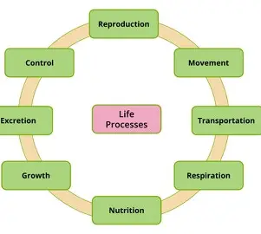
3-Structures and processes of life
Enzymes
Photosynthesis
Respiration
Cell division
DNA, Replication, Proteinsynthesis and mutations
The musculoskeletal system
The nervous system
The endocrine system
Homeostasis
Immunity
Human reproduction
Plant reproduction
Transport across membranes
The urinary system
Digestive system
The breathing system.
The circulatory system and blood
Transport in plants

Slide 8
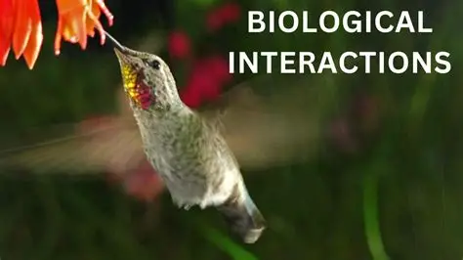
4 –Interactions of life
Ecology, ecosystem and biodiversity
Investigating an ecosystem
Microorganisms
Nutrient cycling
Genetic engineering

Slide 9
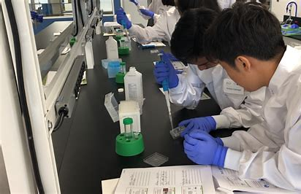
Experiments
Currently there are 22 practical activities that students must carry out.
Experimental questions appear every year in the biology paper.

Slide 10
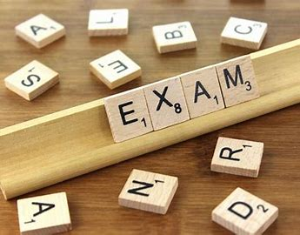
THE EXAM
Duration: 2hr 30 mins
Total marks: 300
Format: Single booklet- write answers in the spaces provided.
Number of Q’s: 7
Marks per Question: 50

Slide 11
Exam structure:
Section A:
Question 1- Everyone must do worth 50 marks.
Integrative question combining diagrams, data analysis and multiple short parts across several topics.
Section B:
Question 2 – 7 – Pick any 5 questions from this section. (5x 50 marks =250 marks).
Structured, context based long questions.

Slide 12
The PROJECT
In term 2 of 5th year students will receive an investigative brief from the SEC.
This allows students to develop their own thinking and ideas on areas they would like to explore in relation to the brief. Students will design an appropriate investigation to explore this particular area.
Students are also required to carry out scientific research and an experiment on an issue within the brief.
Students will receive headings and guidelines (word count) for their experimental write up and will receive guidance from their teacher.
Students will design their own investigation.
In total it should take students 20 hours to complete.

Slide 13
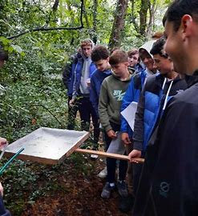
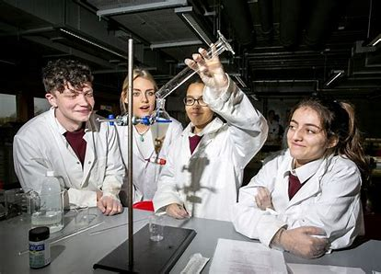
BIOLOGY TRIPS
Students get the opportunity to go on an ecology fieldtrip. This gives students the opportunity to gain a real hands on insight into the world of science outside the classroom by investigating ecosystems and habitats.
In 6th year students go on a day trip to the University of limerick where they will set up and carry out experiments on the syllabus. This provides students the opportunity to revise experiments and also working with others and learning from each other.

Slide 14



FURTHER EDUCATION
Biology is a huge stepping stone for many third level courses. Furthermore it is often a specific requirement for some courses.

