Slide 1
Leaving Certificate History
(TY Subject Choice Presentation)

Slide 2
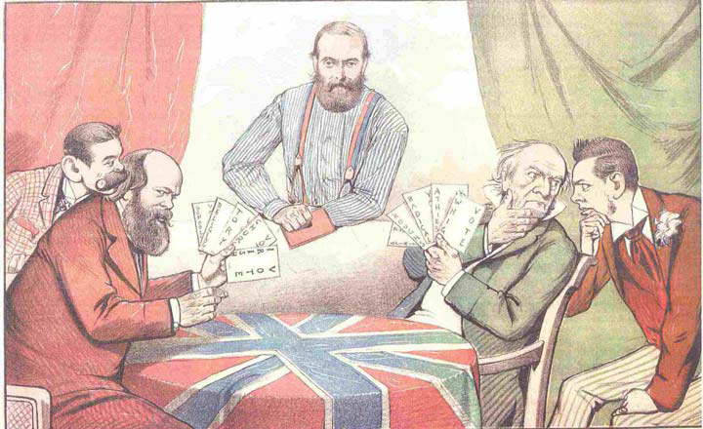
Why Study History???
Your choice of subject for Leaving Certificate may influence your future career or third level options
Why not think about what history can offer?
Weekly Freeman, 1885

Slide 3
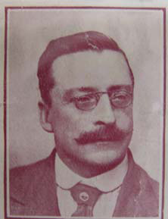

Why Study History???
History is very relevant to modern life.
Many books, films and plays are inspired by historical events.
Many people enjoy history as a hobby, as can be seen in the popularity of history books, films and documentaries.
Arthur Griffith Michael Collins

Slide 4
Why Study History???
History also helps us to understand many of the issues that affect the world today.
By broadening your knowledge of current affairs, you are developing yourself personally and preparing yourself more fully for adult and working life.
History is unique in that it investigates how human life has changed over time.
You will develop your understanding of change through the perspectives of political, social, cultural, economic, religious and scientific history.
You will develop an appreciation of the society in which you live and of other societies, past and present.
You will also develop a greater awareness of your own identity and traditions.

Slide 5
Relevance to Careers
Employers tend to see those with a history education as:
* Independent thinkers
* Open-minded and objective
* Disciplined
* Good communicators
* Able to analyse issues and problems
* Able to put together logical arguments

Slide 6
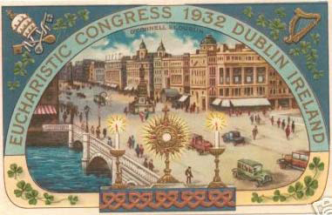
Relevance to Careers
Historians are regarded as having had an education that trains their minds to assemble, organise and present facts and opinions and this is a very useful quality in many walks of life and careers … history is an excellent preparation for very many other jobs.
The Eucharistic Congress 1932

Slide 7
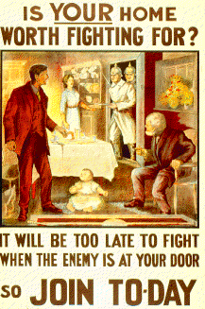
Communication Skills
The study of history is not just about interpreting the past but also presenting your thoughts. History helps you to write in an organised, coherent, logical way, supporting your views with evidence. This will help you in your other subjects, as well as in life and work later.

Slide 8
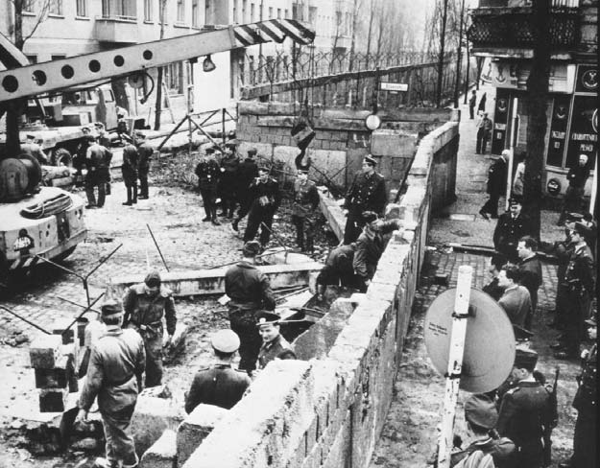
Research Skills
Your study of the past will
introduce you to many
different types of evidence,
such as:
•Maps
•Photographs
•Political cartoons
•Diary entries
•Memoirs
•Photographs
•Official records
                Building the Berlin Wall

Slide 9
Research Skills
By exploring these types of evidence you will enhance your research skills.
You will become skilled at locating historical data from different sources, evaluating it and recording and presenting your findings.
You will also realise the importance of looking at issues from more than one point of view.
You will also develop your ability to think critically, to evaluate the usefulness of sources, to detect bias or propaganda.
These skills are very useful in many careers and in everyday life.

Slide 10
IT Skills
History allows you to access ICT, developing skills that are relevant to life and work today.
The Internet offers a huge range of appropriate historical web sites.
Many other electronic resources also exist for the study of history, such as CD-ROMs, library databases and catalogues.
The use of modern digital media makes studying history very enjoyable and stimulating.

Slide 11
The LC Syllabus
Students will complete 4 of the following modules in the LC programme, 2 from the Irish History section and 2 from the European/Wider World section.
Irish History, 1815-1991
Ireland and the Union, 1815-1870
Movements for political and social reform, 1870-1914
The pursuit of sovereignty and the impact of partition, 1912-1949
The Irish diaspora, 1840-1966
Politics and society in Northern Ireland, 1949-1993
Government, economy and society in the Republic of Ireland, 1949-1989
History of Europe and the wider world, 1815-1992
Nationalism and State formation in Europe, 1815-1871
Nation states and International tensions, 1871-1920
Dictatorship and Democracy, 1920-1945
Division and realignment in Europe, 1945-1992
European retreat from empire and the aftermath, 1945-1990
The United States and the World, 1945-1989

Slide 12
The LC Syllabus
Each year the State Examination Commission makes 1 of the 12 modules compulsory. For candidates sitting the LC in 2016 the compulsory section is No 3. Dictatorship and Democracy 1920-1945. This module will be studied by all candidates that year with a particular focus on 3 case studies.
1) The Moscow Show Trials 1936.
2)The Nuremburg Rallies.
3)The Jarrow March.
These case studies will be studied in detail with particular emphasis on primary sources. During the examination, this module will be answered in the form of documents questions where students will be given documents that relate to 1 of the case studies and will be asked to answer questions based on those documents and their own knowledge of the module.
Students will study all modules from the following 3 perspectives;
1)Politics and Administration
2)Society and economy
3)Culture and religion

Slide 13
Assessment
Terminal Examination = 80% (Honours and Ordinary)
The examination last 2hrs and 50 mins. All four modules are examined and each is worth 20% of the final exam. During this time, students will answer the compulsory documents question mentioned above and will write an essay on the 3 other modules they have completed. (i.e. 3 essays and the documents question, all worth equal marks). For each module studied there will be 4 essay titles given and students will have to choose 1. (i.e 3 essays out of 12).
At Ordinary Level students also answer on the 4 modules. One document question and 3 general questions, 1 on each of the other 3 modules. The general questions provide a document as a stimulus for students and though there is only 1 provided per module, there are choices built into each question so that the student answers 1 set of short answer comprehension questions, 1 paragraph (out of 4) and 1 short essay (out of 4). The short essay is approx. 1 page in length.

Slide 14
The Research Study Report
Research Study Report = 20% (Honours and Ordinary)
Each student will be required to complete an individual study of an event/person of historical significance. This topic is chosen by the student with the support of his teacher and can be taken from any of the 12 modules of the LC syllabus. The RSR involves independent research on the part of the student and the writing up of a report .
The RSR is presubmitted and is worth 20% of the overall marks awarded. (Honours and Ordinary) The RSR provides students with a fantastic opportunity to complete part of the LC History assessment to the highest standard in advance of the exam and thereby give themselves the best chance to reach their full potential.

Slide 15
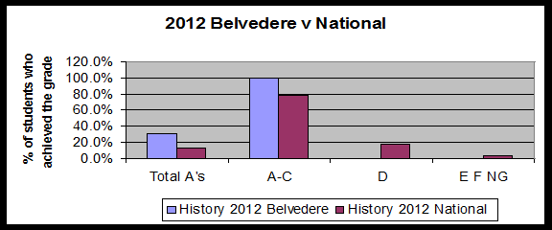
History In Belvedere - 2012

Slide 16
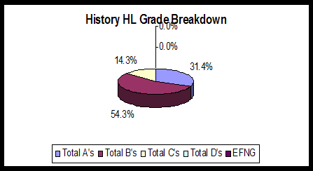
History in Belvedere - 2012

Slide 17
History in Belvedere - 2014
History students in Belvedere have also taken part in one or more of the following Field Trips in the past;
  1) Glasnevin Cemetery
  2) Collins’ Barracks
  3) The Imperial War Museum – London
  4) The National History Museum
  We have also invited guest speakers into classes to discuss their involvement in or perspective on a particular historical event.

Slide 18
Who should choose History?
Students who choose LC History should…
1) …be interested in events and people from the past
2) …be interested in going beyond mere facts and asking the what, why, how and the consequences of historical events.
3) …be capable in English.
4) … be prepared to think independently.
5) …Should NOT base their choice on what they achieved in JC History!

Slide 19
History is who we are and why we are the way we are.
(David McCullough)

