Slide 1

Transition Year at St. Ailbe’s

Slide 2
Admission to the programme
We have currently 83 students enrolled in the TY programme.
Students are invited to attend for a brief interview in April
Students will be given an assigned interview time (usually 10-15 minutes)
Following the interview, the students will be asked to sign a contract, committing to full participation in TY.
The purpose of the interview is also to establish what the students would like to achieve in the course of the year
Prospective students must have a good record of attendance, punctuality, behaviour and a willingness to participate
It would also be an advantage if the student has made a positive contribution to school life in their involvement with extra- curricular activities.

Slide 3
AILBES
In the course of the interview, I outline to students that I use the letters of Ailbe’s to represent some values that I feel are important to TY students
A – Attendance
I – Involvement and Interaction
L - Learn
B – Behaviour
E - Extra-Curricular Activities
S - Self -motivation

Slide 4
TY Subjects
Irish
English
Maths
History
Geography
French, Home Economics and Road Safety (rotation)
Drama
Media Studies
Coding

Slide 5
TY Subjects
World of Science
Computer Applications
E-Portfolio
Construction Studies
Entreprise
PE
Music
Career Guidance
Technology
Media Studies

Slide 6
We build upon our list of activities each year. We also invite students’ input and suggestions too.
Here are some but by no means all of the activities and courses we complete….
September-October
School Musical
Tipperary Tidy Town Talk
Glen Vets TY Academy
Guest Speaker from Cliona’s Foundation
Camino for Cliona’s sign-up
Bank of Ireland Digital Literacy talk and creation of the school bank
Gaisce – The President’s Award

Slide 7
TY Activities
November-December
Work Experience Week 1
TY Comedy Show in Limerick
Performance at the Tipperary Peace Convention Christmas Celebration
The Abbey and St. Anne’s Show
St. Mary’s Community Food Bank fundraising and preparation of hampers
Ice-skating trip to Limerick

Slide 8
Activities continued:
Carol singing
Language students had the opportunity to attend lectures in Mary Immaculate College as part of the Languages Connect programme
LawEd Workshop
Christmas Wreath- making workshop

Slide 9
TY Activities
January-February
Driving lessons
Jiving
Garda College Templemore – TY Programme
RSA Road Safety Matters – preparation of questions for the Theory Test (ongoing Road Safety is a rotation subject)
Work Experience Week 2

Slide 10
TY Activities
March-April
Driving
Barista
Trip to Lake Garda at Easter
Work experience Week 3

Slide 11
TY Activities
May
Ballyhass/ Gaisce Trip
End of year trip to Spike Island
TY Graduation

Slide 12
TY Review
The TY programme is reviewed annually to ensure quality and relevance.
Student feedback is essential in keeping the programme enjoyable, varied and beneficial

Slide 13
Cost
The fee for TY is the same as other academic years, €150.
Although students will not have textbooks in all subjects, this cost covers photocopying, class materials and heavily subsidised activities and workshops
Other costs include activities and optional extras like the school tour at Easter, driving lessons, ice skating trip to Limerick and Ballyhass Outdoor Activity Centre
Some activities incur a fee for day trips. This includes the entrance fee and the bus.
A number of workshops are free and other trips are subsidised

Slide 14
The Benefits of TY
By the end of Transition Year, students should:
Demonstrate increased confidence and maturity
Show improved communication and teamwork skills
Have greater awareness of career pathways
Be better prepared for Senior Cycle study
Students who engage in the programme will benefit most
Opportunities are offered to all students, but it is up to the student themselves to participate

Slide 15
I have included a number of photos of some of the activities that we have done so far this year.
We are very proud of their achievements and level of commitment and we are just half way through the year
We still have lots more to pack in
Thank you for your time and I wish you every success in your future studies here at St. Ailbe’s
If you have any further questions, please do not hesitate to contact me clong@tipperaryetb.ie

Slide 16
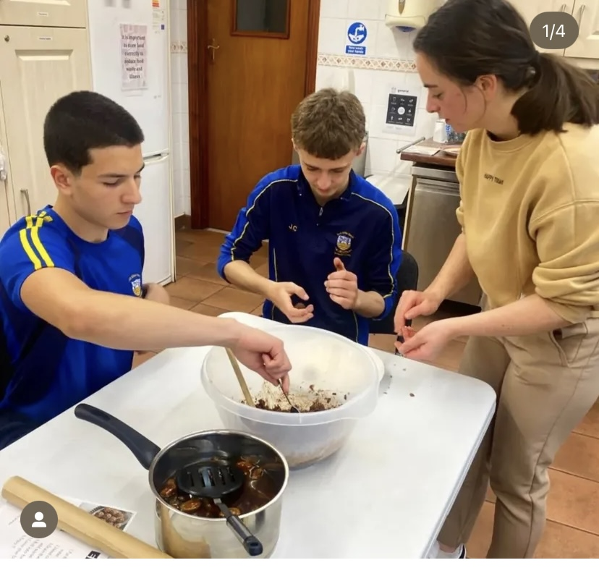
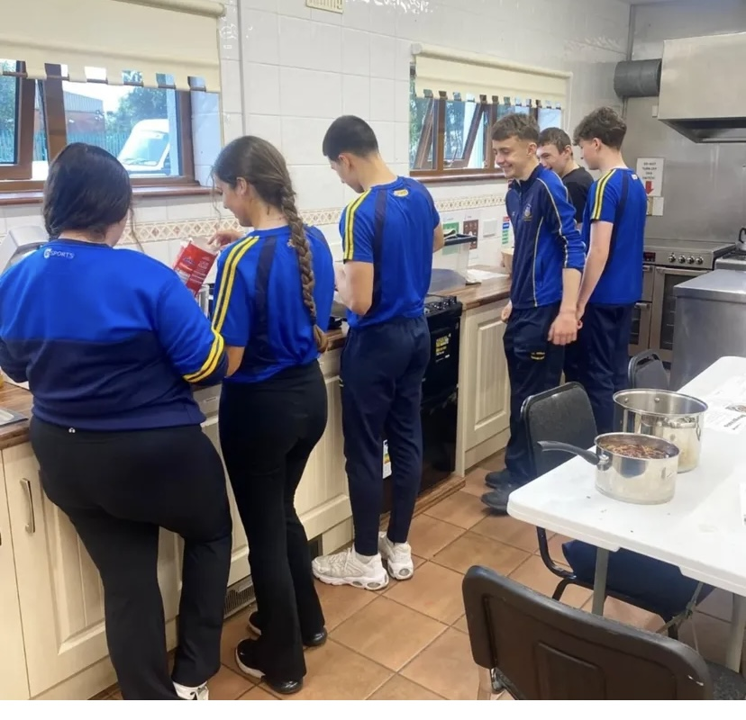
Cooking In Knockanrawley

Slide 17
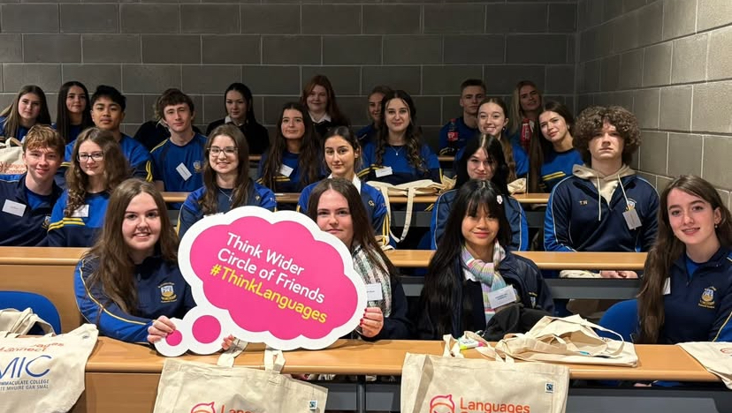
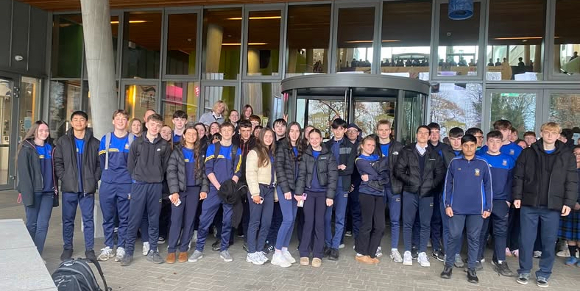
Think Languages in MIC

Slide 18
TY Comedy in The Lime Tree

Slide 19
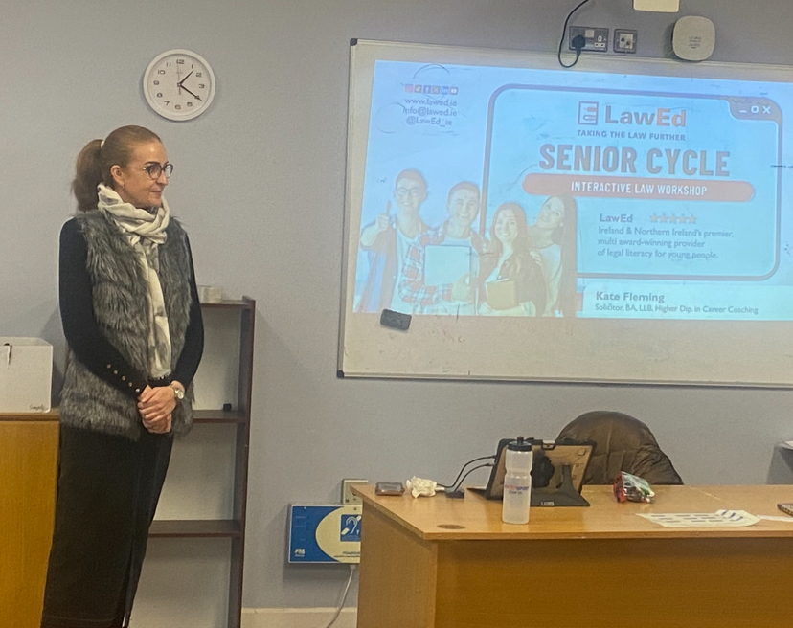
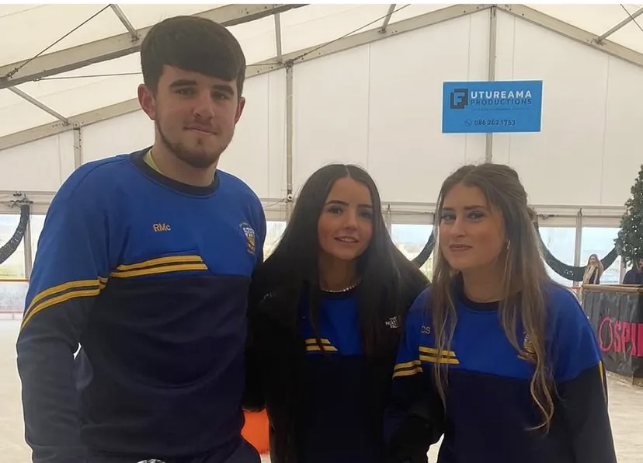

Slide 20
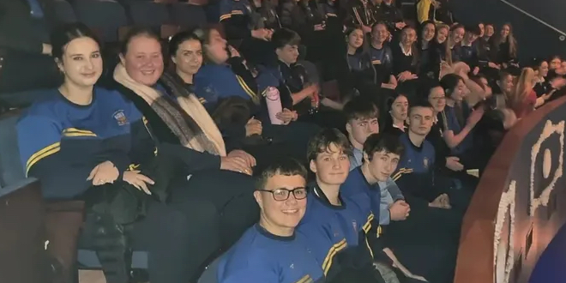
The Abbey and St. Anne’s Show

Slide 21
LawEd Workshop

Slide 22
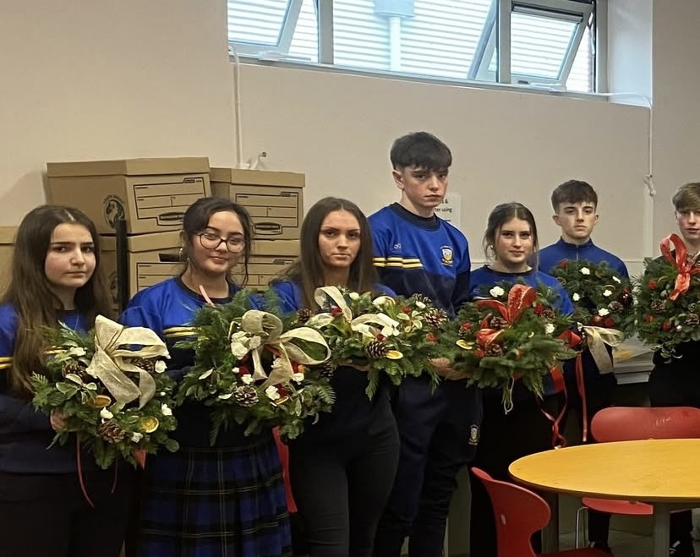
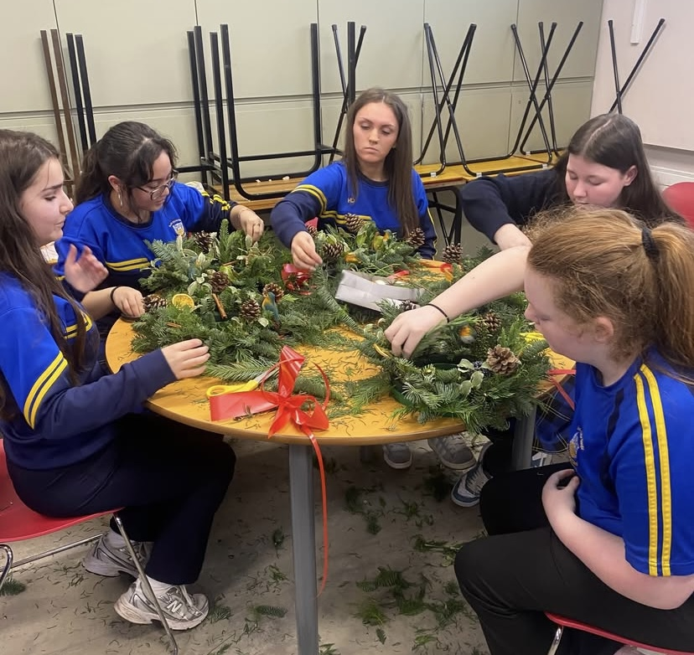
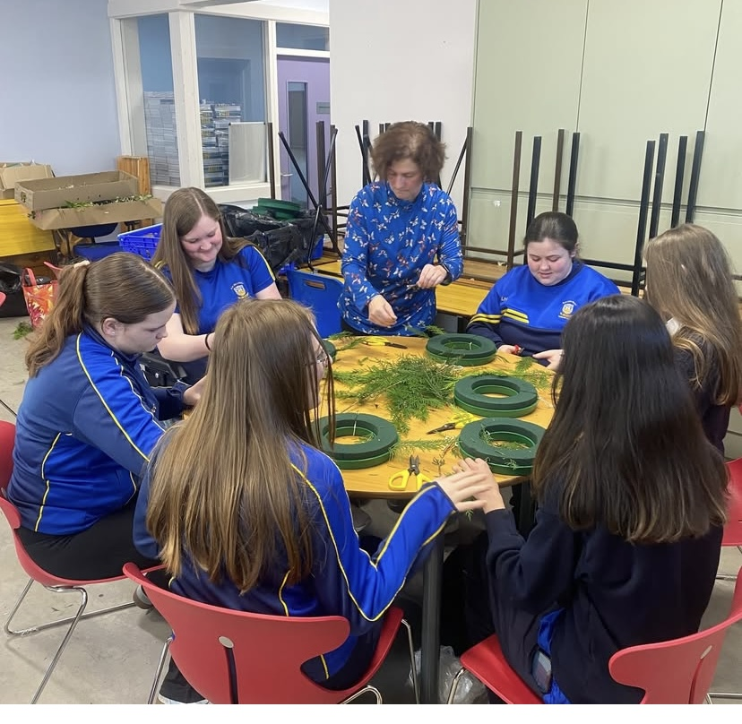
Christmas Wreath-Making Workshop

Slide 23
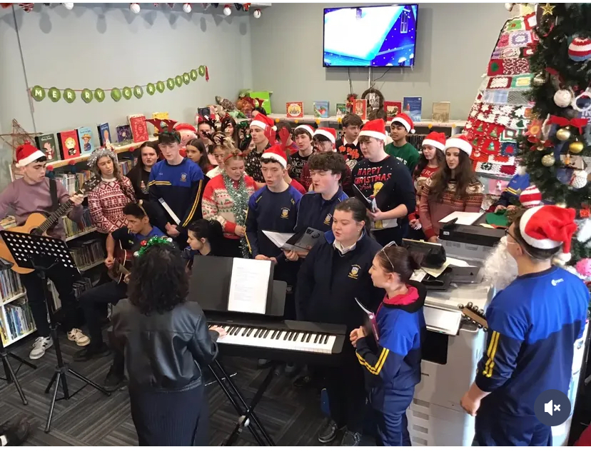
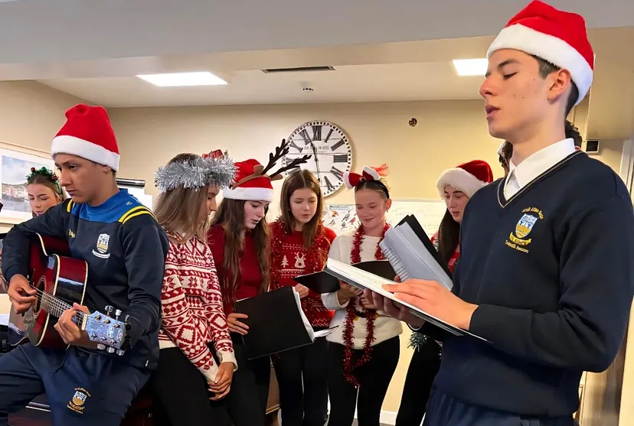
Carol Singing

Slide 24
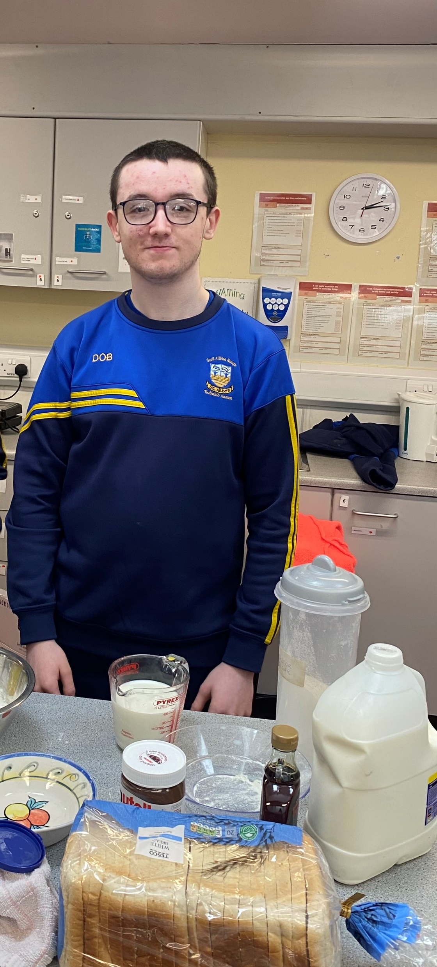
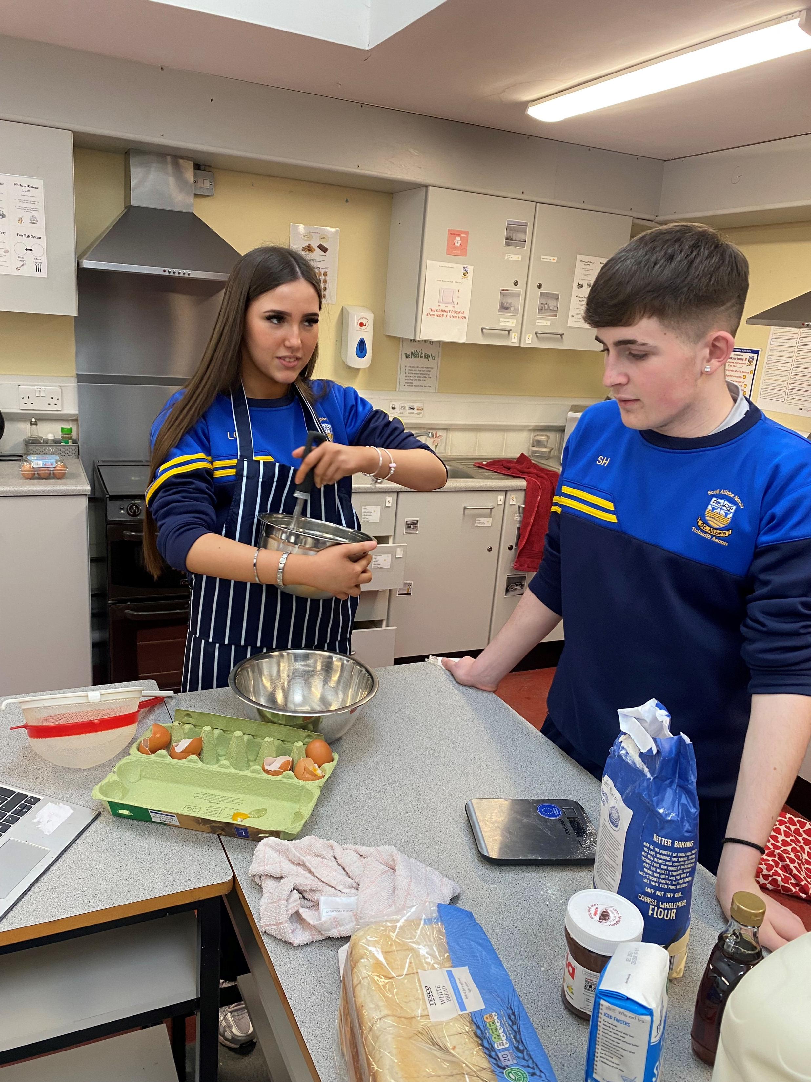
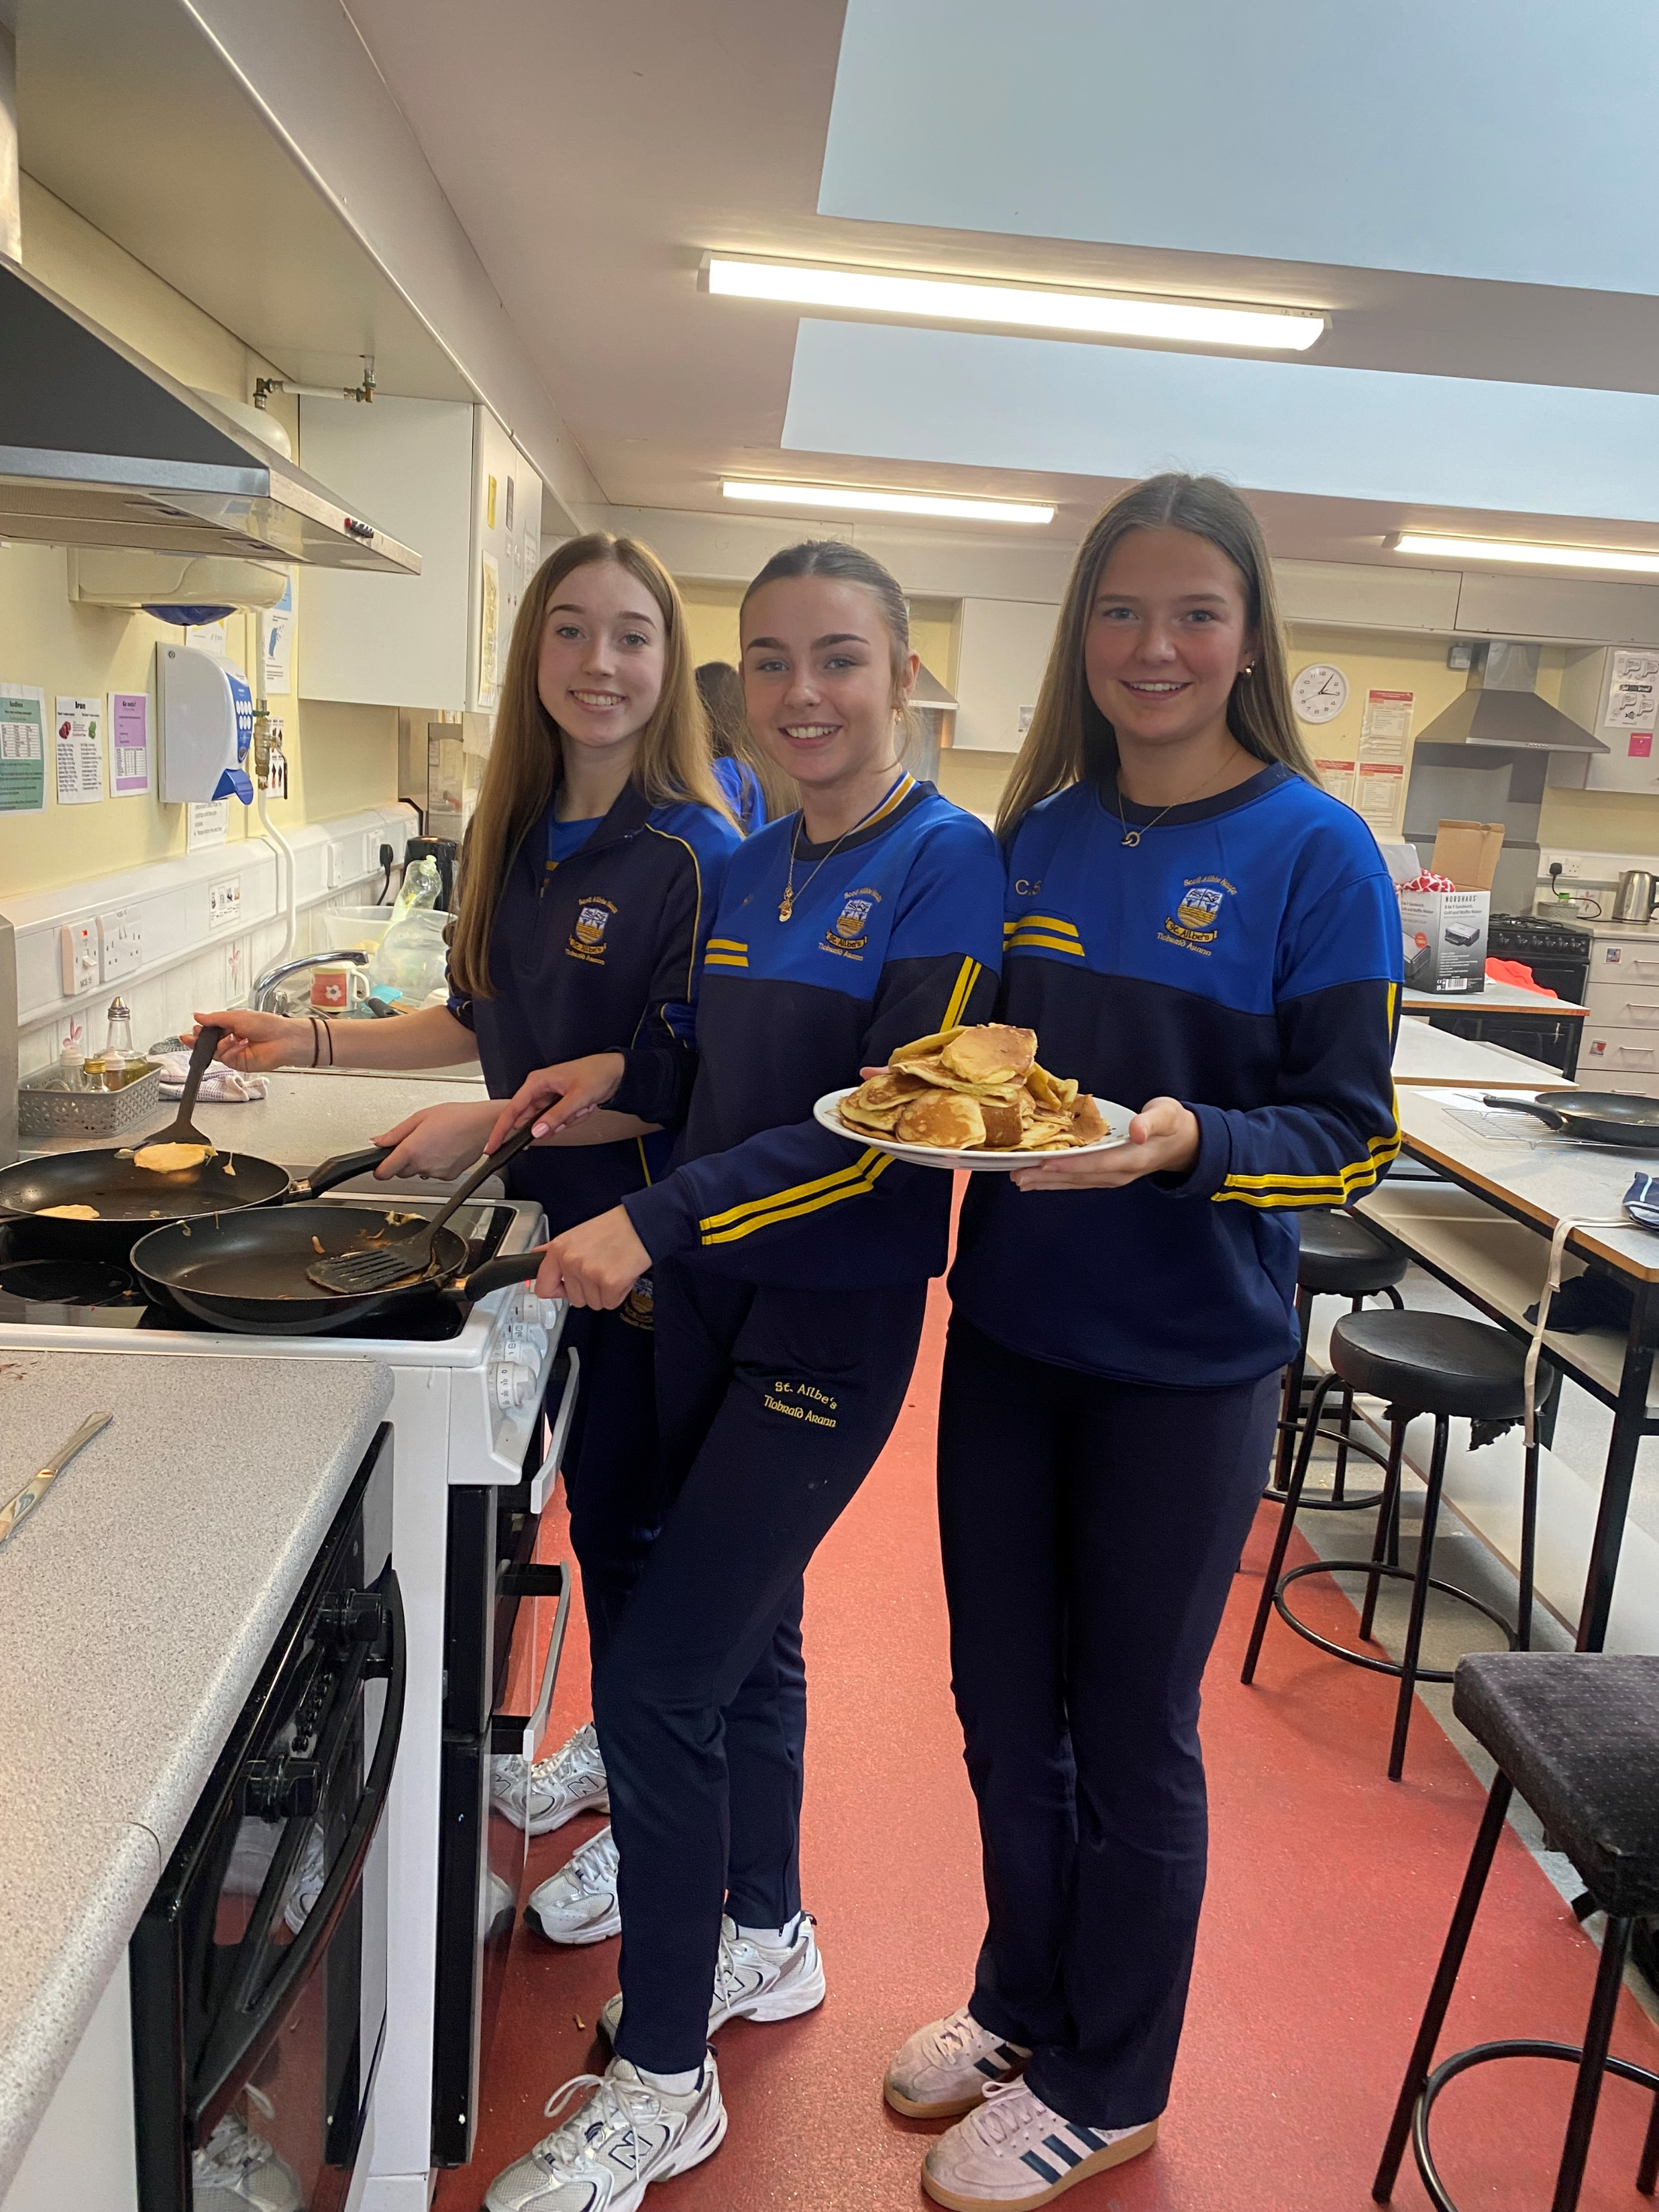
TY Brunch – Pancakes, Waffles and French Toast

Slide 25
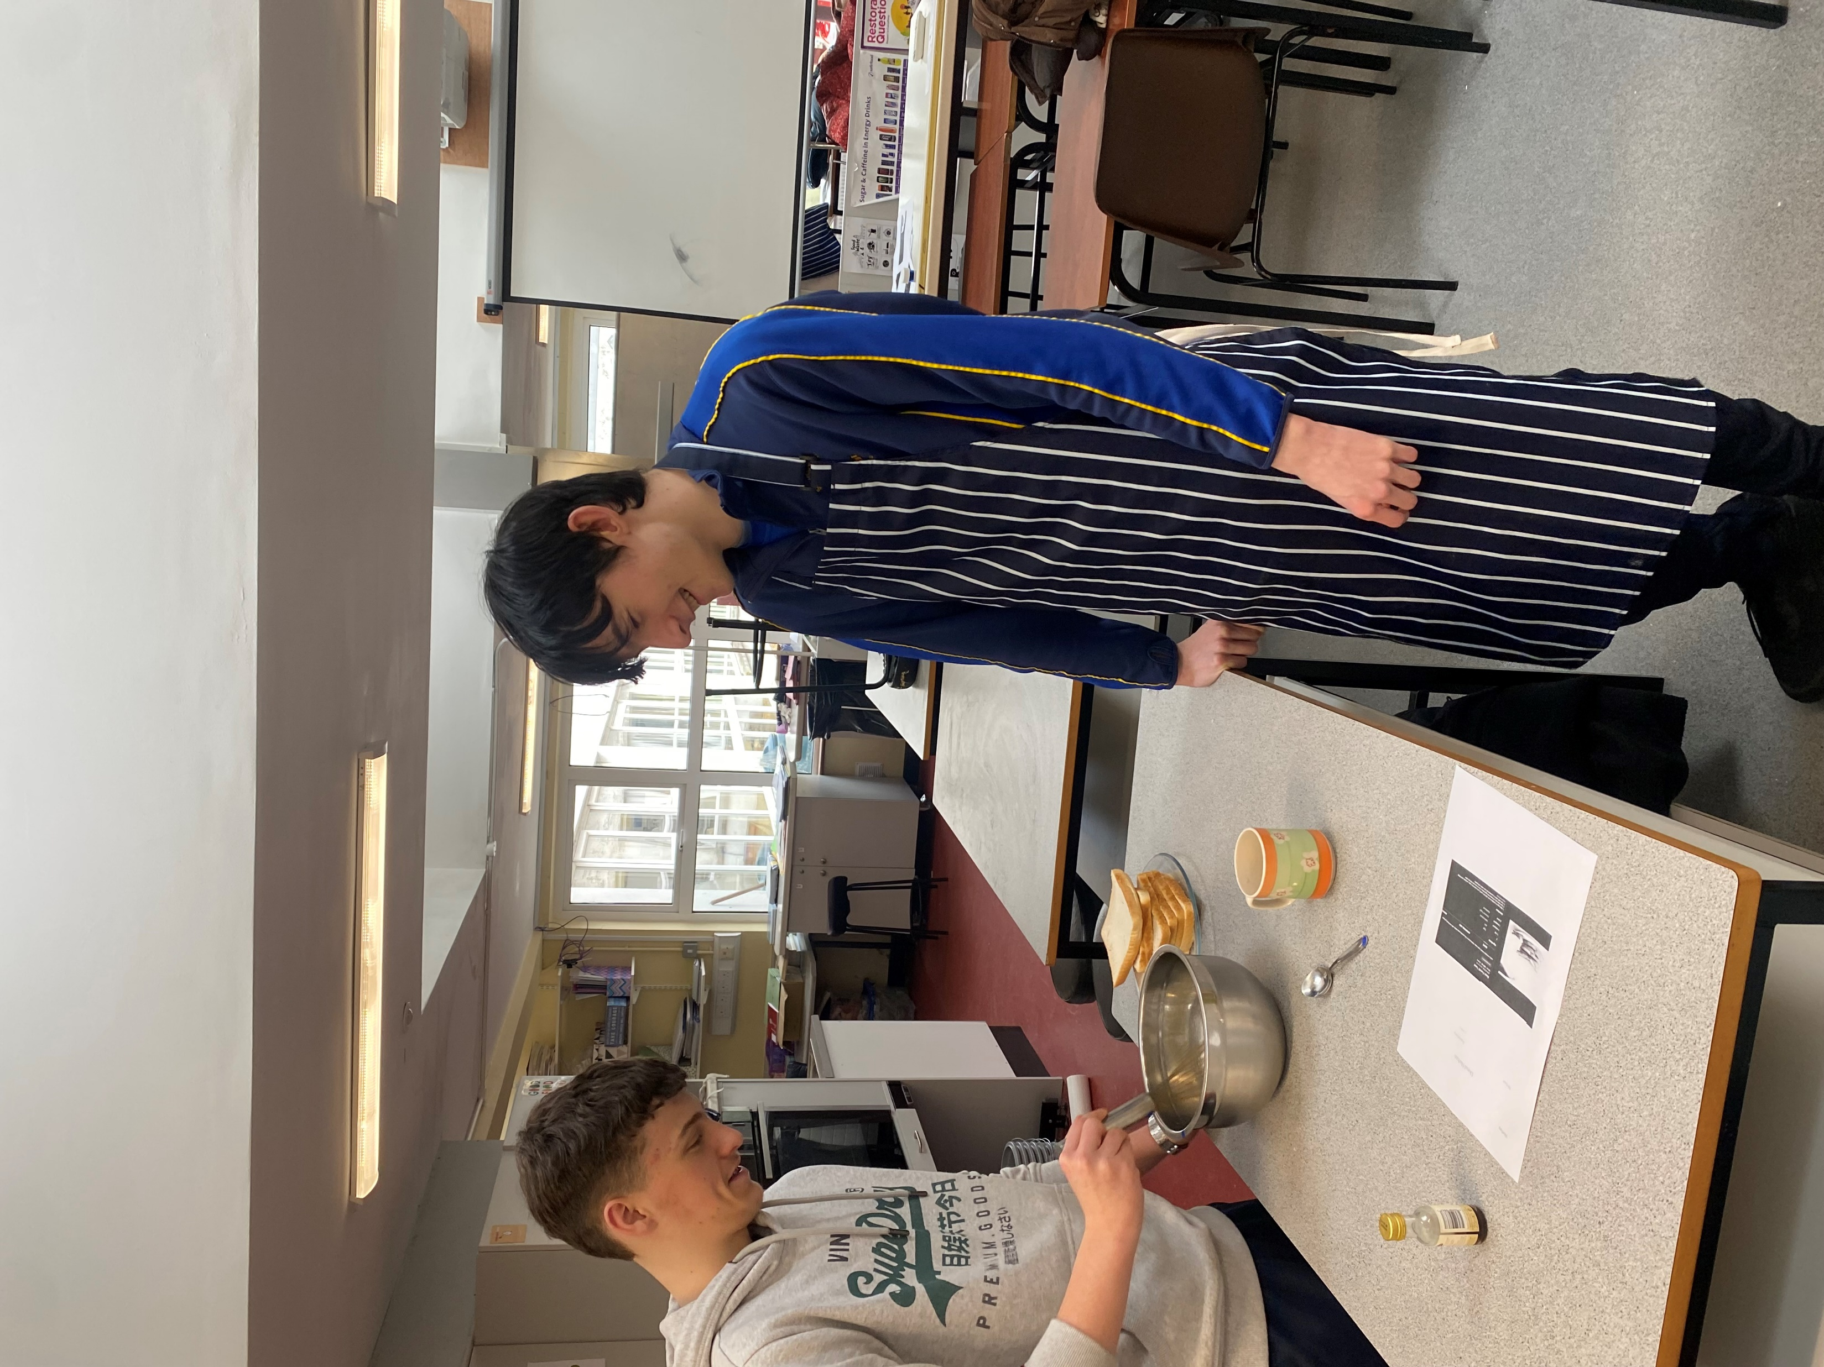
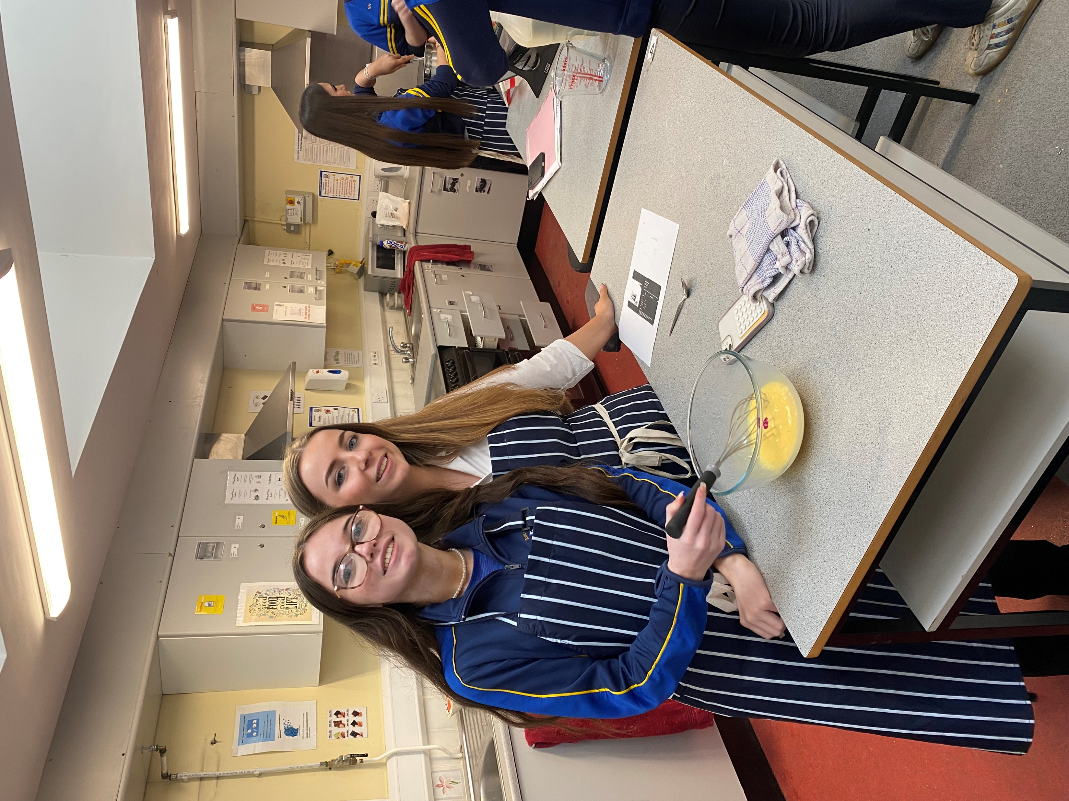
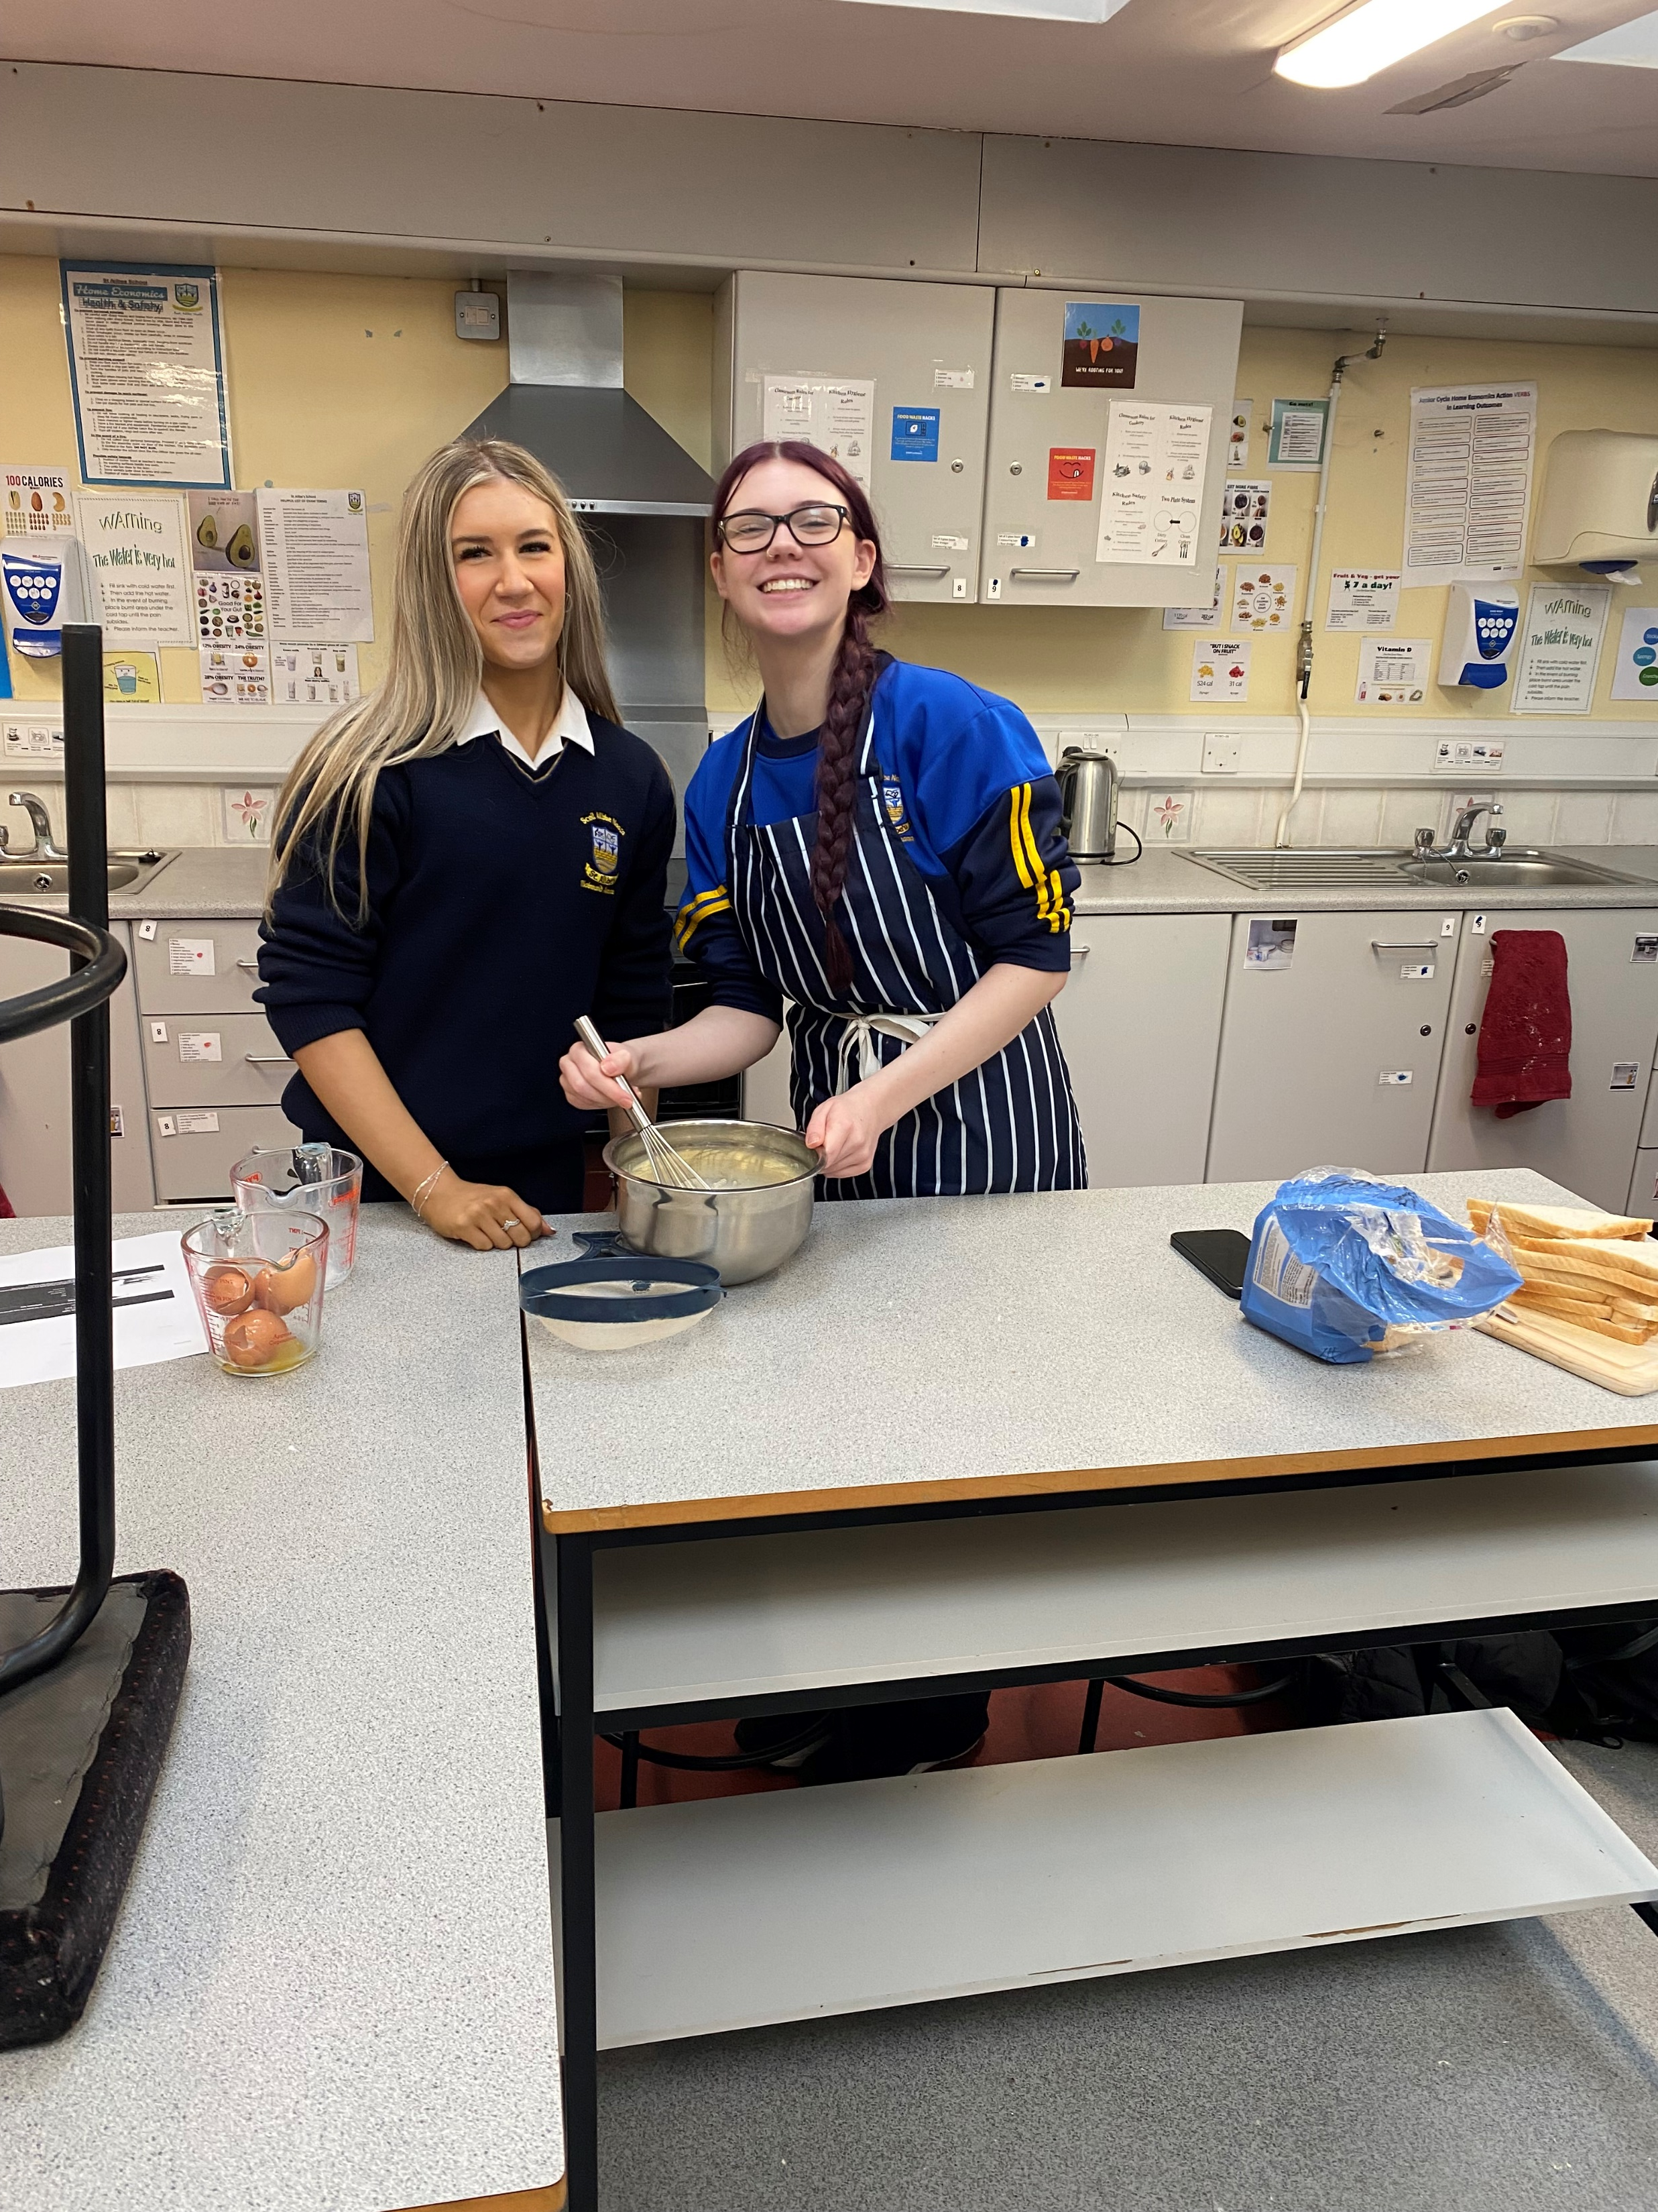
TY Brunch

Slide 26
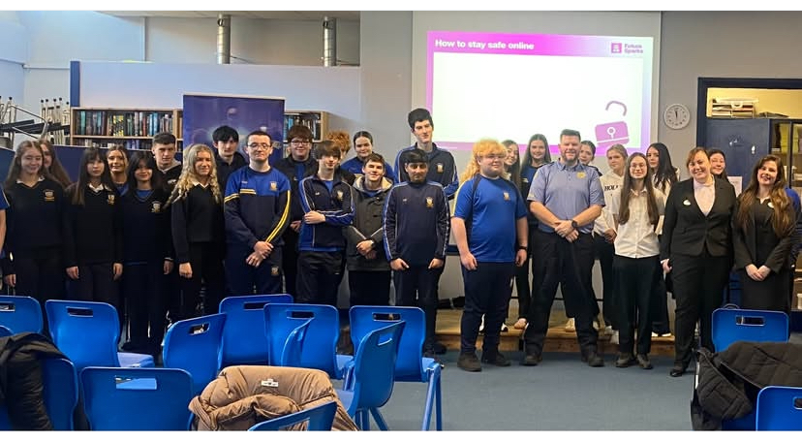
AIB and Garda Talk- Future Sparks

Slide 27
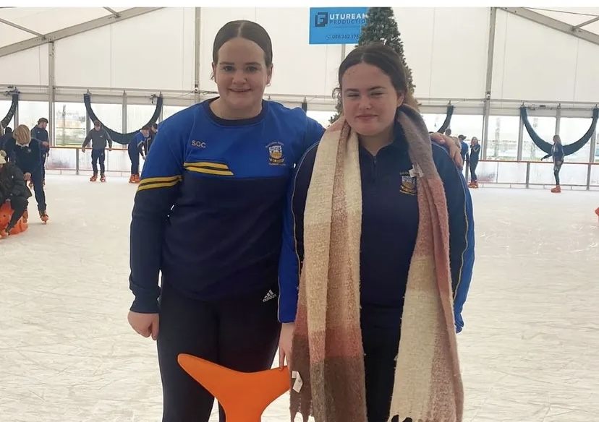
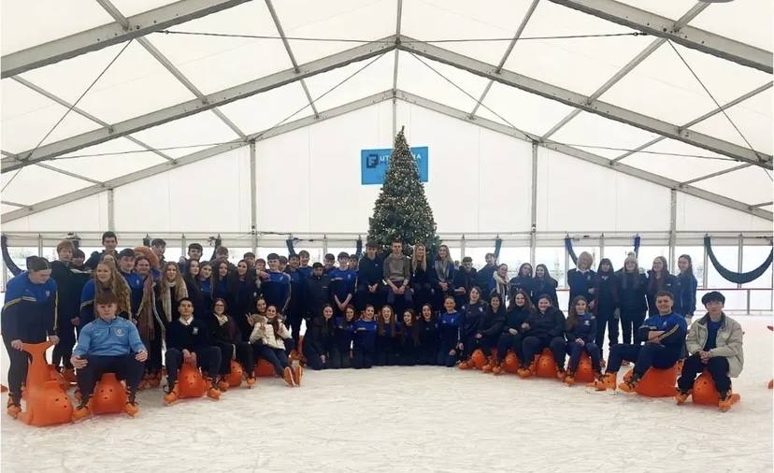
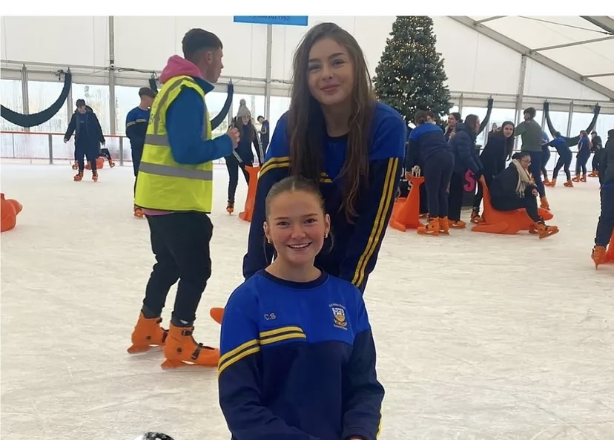
Ice-Skating and Shopping Trip in Limerick

