Slide 1
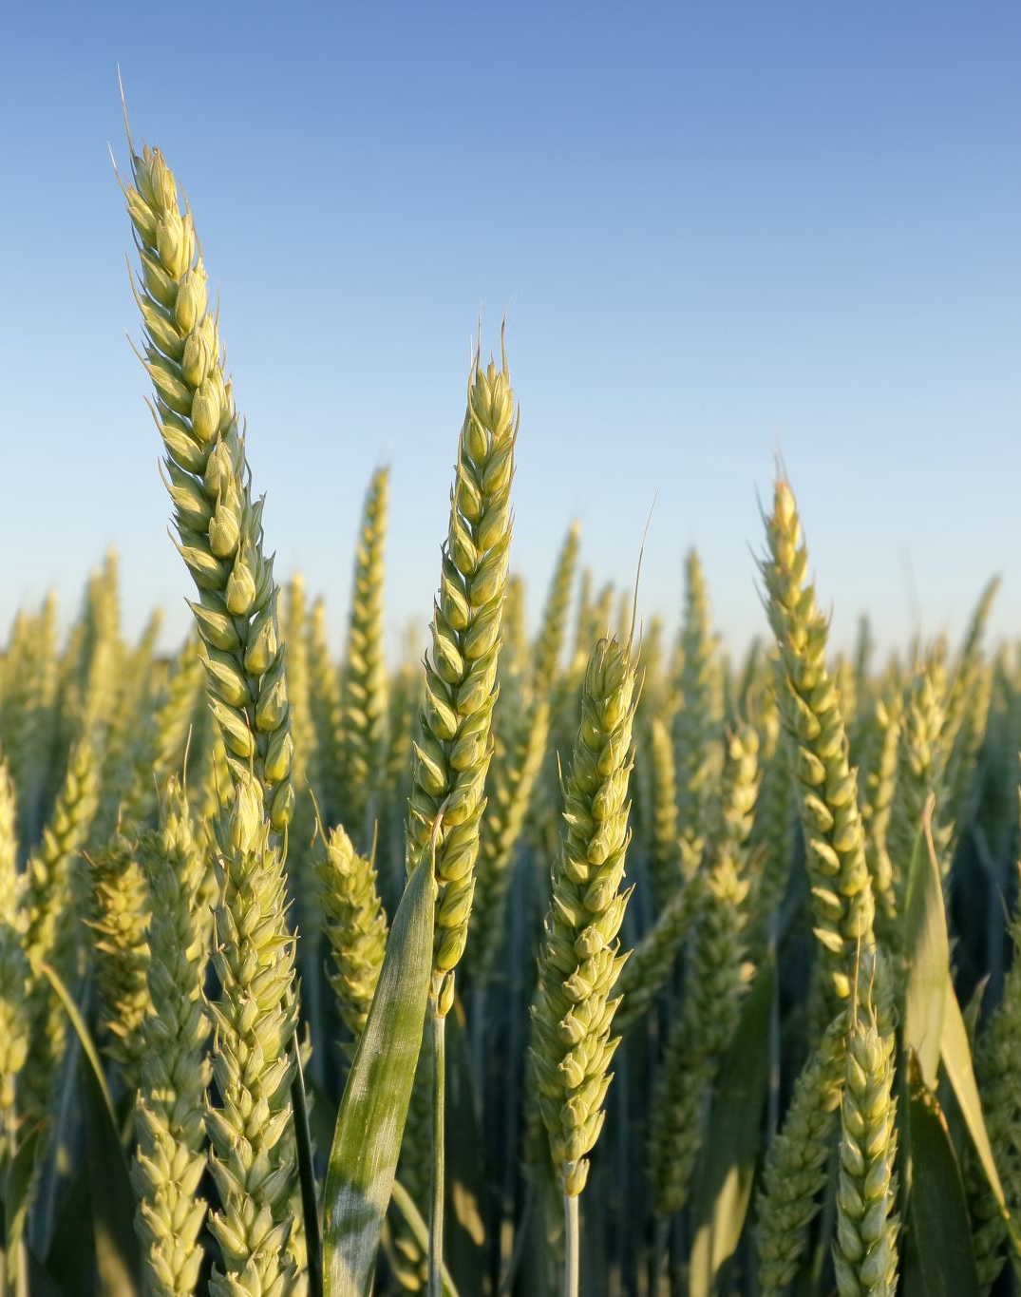
Why Choose Agricultural Science For Your Leaving Certificate?

Slide 2
Exploring Agricultural Science – More Than Just Farming
Why Agricultural Science is an excellent subject choice for your Leaving Certificate — whether you’re from a farming background or not.
It’s a subject that combines science, environment, food production, animals, business, and sustainability — all topics that matter now more than ever

Slide 3
A Practical Science for Real Life
Agricultural Science is the study of the science and technology behind food production and the environment.
You’ll explore topics like:
Animal and crop production
Soil science and plant growth
Climate and sustainability
Food and nutrition
Genetics and biodiversity
It’s a hands-on subject that connects what you learn in biology, geography, technology and engineering with real-world applications.

Slide 4
Fascinating Areas You’ll Explore
Here are some topics students always find interesting:
How genetics and breeding improve animal performance
How to protect the environment while producing food
The role of technology in agriculture (automatic drafting systems and robotic milking machines)
How climate change impacts what we grow and eat.
Agricultural Science helps you understand how science supports everyday life — from the food on your plate to the air we breathe.

Slide 5
Learning Beyond the Classroom
One thing that makes Agricultural Science stand out is how interactive and practical it is. You don’t just read about agriculture — you visit farms, carry out experiments, and learn through investigation.
You’ll complete a practical project worth 25% of your final mark, which includes fieldwork, lab research, and data collection.
It’s ideal for students who enjoy learning by doing, not just studying from books.

Slide 6
Practical Skills for Any Career
Studying Agricultural Science helps you build skills that are useful in any field:
Problem-solving and analysis
Research and data interpretation
Report writing and project management
Independent learning
It also helps you develop environmental awareness and scientific thinking — skills that employers really value.

Slide 7
How You’re Assessed
The LC course is split into two main parts:
Written exam = 75%
Individual Investigate Study (IIS) = 25%
22 experiments (20 OL 22 HL)
Specific Practical Activities.

Slide 8
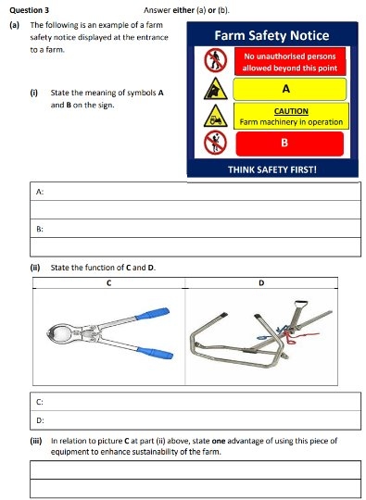
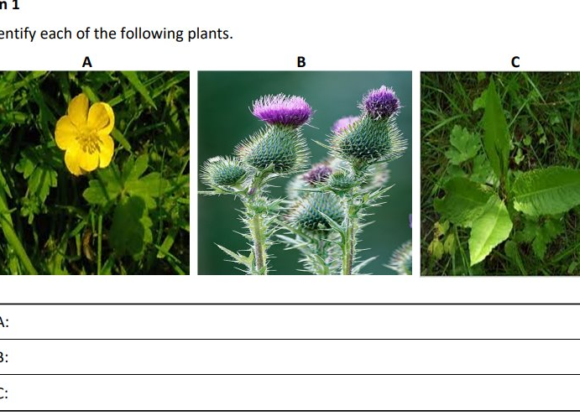
Written exam

Slide 9
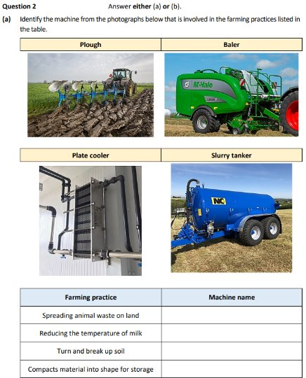
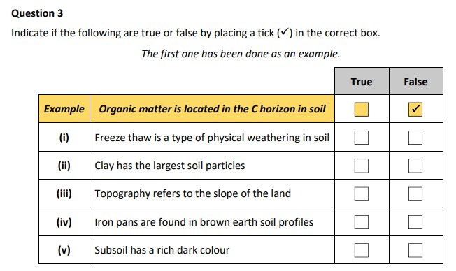

Slide 10
Individual Investigative Study
Project covers farm visits, lab experiments, and reports
Theme changes each year –​
2023: Exploring nutrition and nutrients - the importance to Irish Agriculture of their effective use and management​
2024: The role of food production in maintaining natural resources in Irish Agriculture​
2025: investigate how change(s) in agricultural practice and/or advances in technology can contribute to a positive future for Irish agriculture ​
The project gives you a great chance to secure marks before the final
exam and rewards consistent effort rather than rote memory.
You can earn a quarter of your marks before the exam — a great safety net

Slide 11
Career Pathway- Where Agricultural Science can take you.
People often think Agricultural Science only leads to farming — but that’s not true at all! Here are some career areas this subject can open up:
Food Science & Nutrition (working with quality, innovation, and sustainability)
Environmental Science & Ecology (conserving biodiversity, tackling climate change)
Animal Health & Veterinary (study animal welfare, research, or veterinary medicine)
Agribusiness & Marketing (management, sales, or entrepreneurship in the food sector)
Research, Teaching & Government Services (policy, education, or advisory roles)
Agriculture is Ireland’s largest indigenous industry — meaning there are tons of opportunities at home and abroad.

Slide 12
Agriculture Is the Future
Did you know Ireland exports enough food to feed over 40 million people?
The agri-food sector supports around 165,000 jobs across farms, processing, and distribution.
It contributes roughly €14 billion to Ireland’s exports every year.
One in eight jobs in rural Ireland is connected to the agri-food industry.
The agricultural sector is embracing high-tech innovations — drones, AI, sensors, and genetics — meaning Agricultural Science connects directly to science, technology, engineering, and sustainability.
It’s a subject that truly prepares you for the future.

Slide 13
A Subject With Real World Impact
Agricultural Science is perfect if you enjoy science, nature, or hands-on learning. It offers great career options, builds real-life skills, and helps you understand one of the most important industries in the world — food and sustainability.

Slide 14
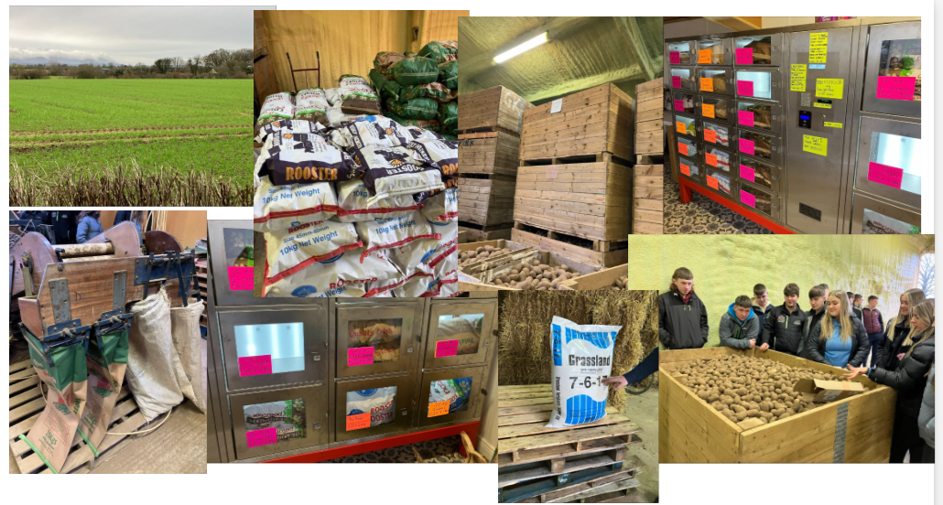
Larry O’Dwyer Tillage Farmer Dundrum

Slide 15

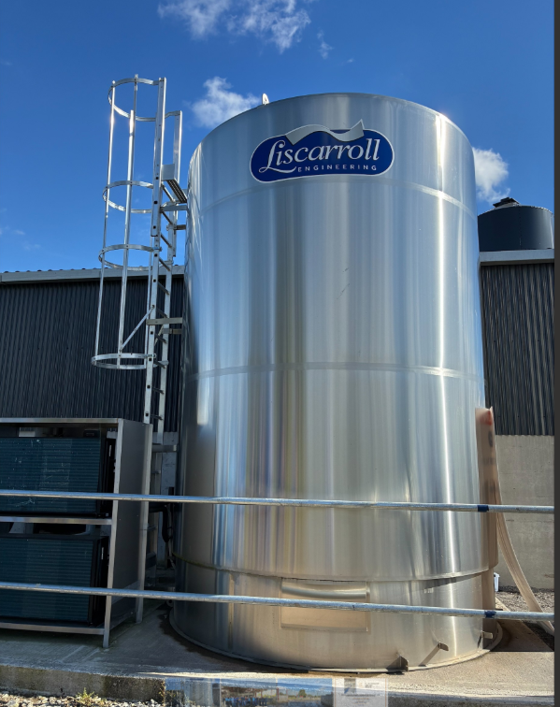
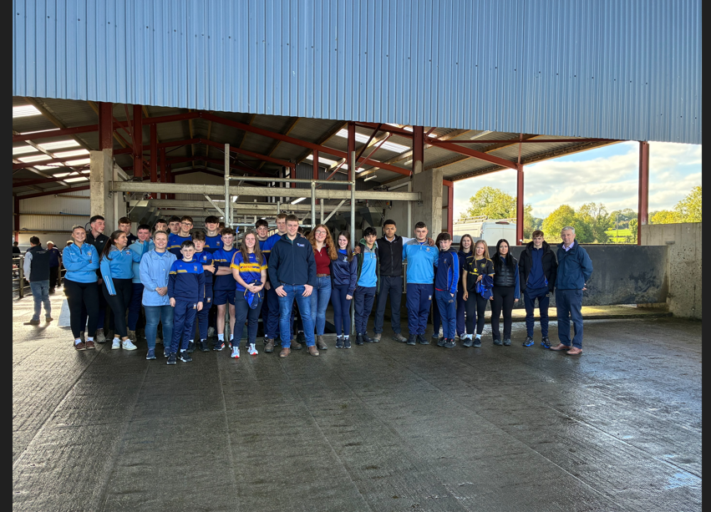
John, Carmel, TJ & Rebecca Moloneys Farm Shronell

Slide 16

Dairy Women Ireland Event

Slide 17
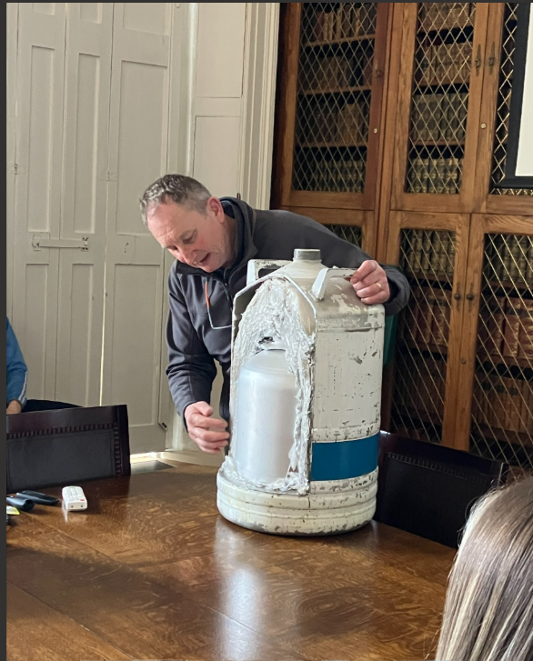
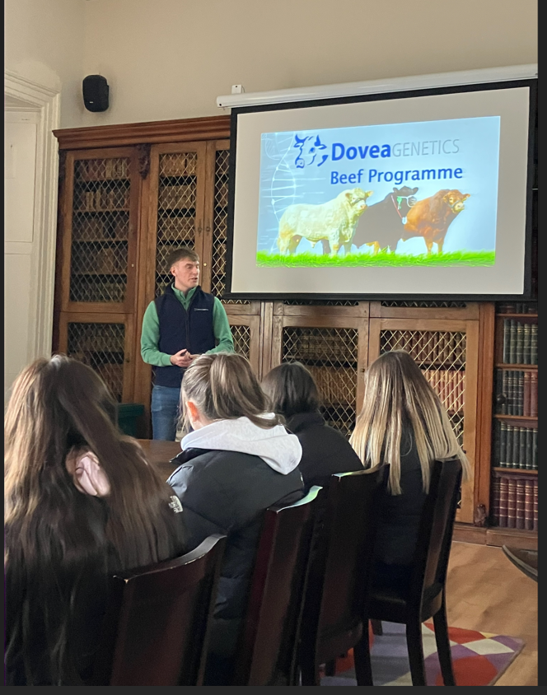
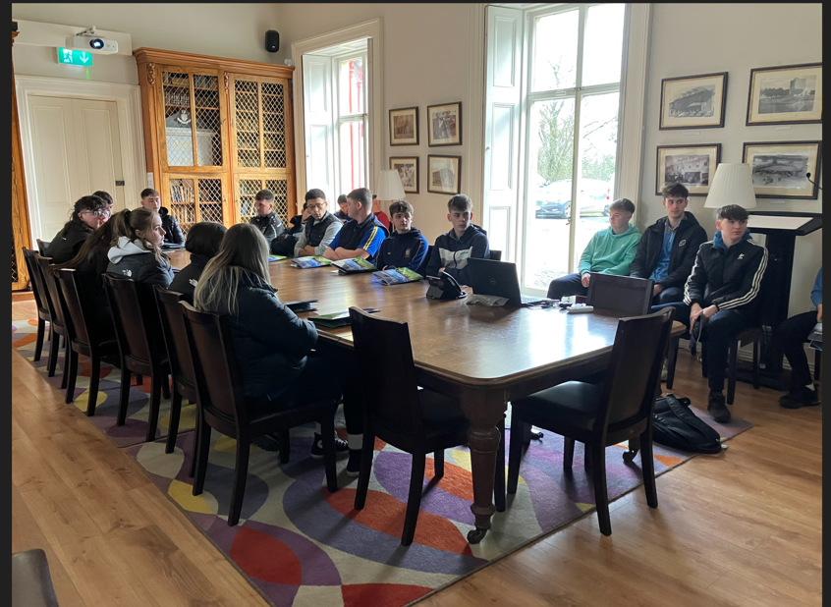
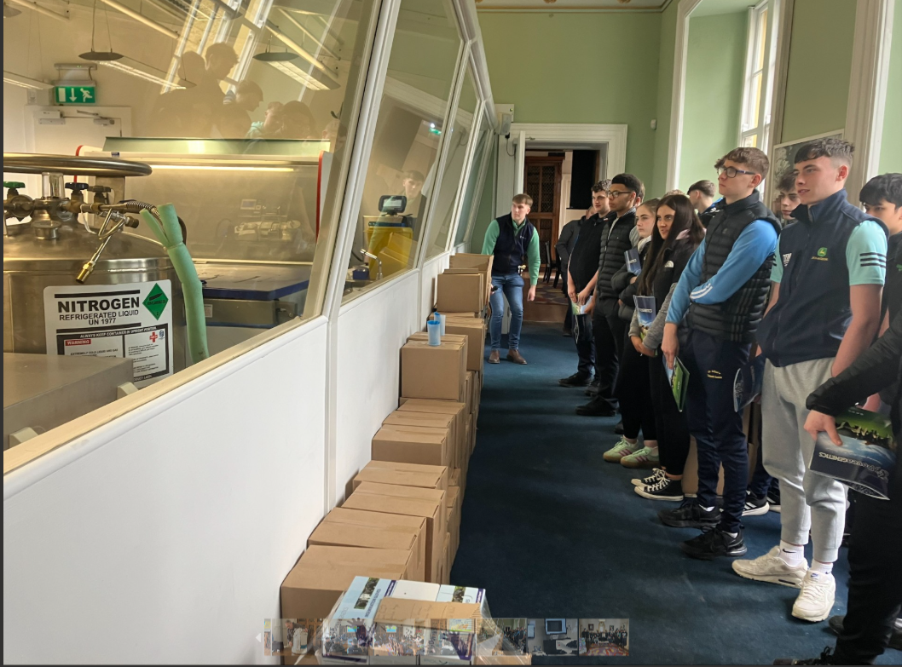
Dovea Genetics Thurles

